Slide 1
Hardening Enterprise Apache Installations
Sander Temme sander@temme.net

Slide 2
Disclaimer
The information discussed in this presentation is provided "as is" without warranties of any kind, either express or implied, including accuracy, fitness for a particular purpose, reliability, or availability.
It is your webserver, and you alone are responsible for its secure and reliable operation. If you are uncertain about your approach to hardening and protection, consult a security professional.

Slide 3
Enterprise?
You own the box(es)
You own the app(s)
You maintain the software
You monitor the network
It’s vital to your business
Notes:
Now, what do I mean by “Enterprise Installation”?

Slide 4
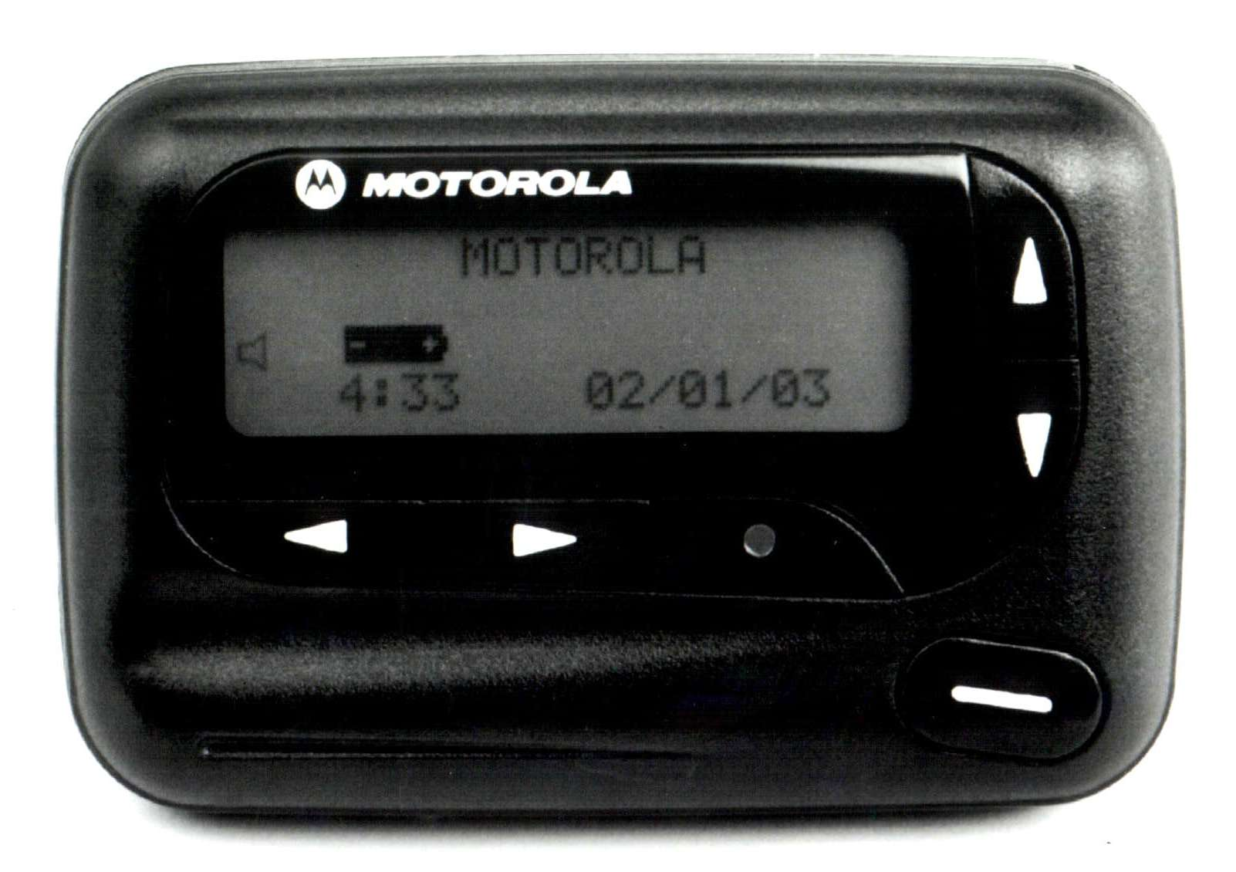

Slide 5
Agenda
The Threat Model
Apache HTTP Server Security
Deploying Apache
Application Security
Case Studies

Slide 6
The Threat Model

Slide 7
Who Gets Attacked?
Everyone!
Just because you’re small…

Slide 8
Threat Matrix
 | Vandalism | €€ | Resources | Theft
Criminals |  | [DD] |  | [P]
(ex) Employees
Competitors | [Df] |  | [I]
Political adversaries | [Df]
Script Kiddies | [Df] [DD]
[P]: Privilege Escalation
[I]: Code Injection
[DD]: (Distributed) Denial of Service
[Df]: Defacement
…

Slide 9
Who Attacks You?
Criminals
Disgruntled Employees
Ex Employees
Competitors
Script Kiddies

Slide 10
Why Do They Attack?
Vandalism
Resource (ab)use
Financial Gain

Slide 11
Types of Attacks
Denial of Service (DOS)
Theft of Service
Theft of Assets
Notes:
DOS: making your server unavailable, crashing, saturating network; but also vandalism, defacement.
Theft of service: someone uses your box as a warez server or worm host
Theft of assets: like customer credit card numbers

Slide 12
Attack Vectors
Execute malicious code
(Over)write config data
Upload content
Bypass access control

Slide 13
OWASP Top Ten
A1 – Cross Site Scripting (XSS)
A2 – Injection Flaws
A3 – Malicious File Execution
A4 – Insecure Direct Object Reference
A5 – Cross Site Request Forgery
A6 – Information Leakage and Improper Error Handling
A7 – Broken Authentication and Session Management
A8 – Insecure Cryptographic Storage
A9 – Insecure Communications
A10 – Failure to Restrict URL Access
http://www.owasp.org/
Notes:
OWASP is the Open Web Application Security Project, a worldwide free and open community focused on improving the security of application software. They publish a Top Ten most critical web application security flaws. This is the 2007 update, based on CVE data and their own assessment. You can learn more at www.owasp.org.
This kind of stuff really deserves a session of its own, or perhaps even an entire conference. I won’t dwell upon it here, but note that none of these flaws have direct bearing on Apache itself: these are all flaws in application code.

Slide 14
Apache Security

Slide 15
Apache is Secure
Very few vulnerabilities reported
No critical vulnerabilities in 2.2.x
Upgrade to any new release
announce@httpd.apache.org
Default installation locked down
But it doesn’t do a whole lot
http://httpd.apache.org/security/vulnerabilities-oval.xml

Slide 16
Apache Security Process
Report security problems to security@apache.org
Real vulnerabilities are assigned CVE number
Vulnerabilities are classified, fixed
New httpd version released
http://httpd.apache.org/security_report.html http://cve.mitre.org/ http://httpd.apache.org/security/impact_levels.html announce@apache.org

Slide 17
Deploying Apache

Slide 18
Points of Attention
Apache installation
Operating System
Network Environment

Slide 19
Apache Installation
Two ways to install Apache
Compile from source
Install vendor-supplied package

Slide 20
Install From Source
Download Apache Source
http://httpd.apache.org/download.cgi
Verify signature on tarball
./configure …; make; su make install
./configure --help
Create apache user and group

Slide 21
Install a Package
Most vendors offer packages
Red Hat: httpd RPM
Debian/Ubuntu: apache2
FreeBSD: /usr/ports/www/apache22
…
Patched for OS/Distro
Digitally signed
Customized config

Slide 22
Package Considerations
Different approaches
Packages, dependencies
Directory structure variations
Learn them
Different versioning
Custom configurations
Automated updates
Play well with other packages

Slide 23
Apache Configuration Tips
Write your own
Disable unused modules
Understand AAA directives
And how they nest

Slide 24
Server: the Controversy
Yes:
We’d like to fly our colors
“They” will try anyway
No:
Slapper tested Server: header
Don’t give “Them” anything
Manipulate with ServerTokens, mod_headers
Totally change with ModSecurity

Slide 25
OS Configuration
Look for world-writable directories
/tmp, /usr/tmp, /var/tmp, …
Put on partition mounted -o noexec^{(*)}
Consider chroot, jail, zones^{(*)}
Turn off unnecessary services^{(*)}
Especially network listeners
Don’t install -devel packages, compiler^{(*)}
Consider diskless netboot for web heads^{(*)}
Most of filesystem read-only
Easy to recover from incidents
(*) Not designed as a security feature

Slide 26
Windows
Use what you know!!!
Pull Server Root out of install dir
httpd -n Apache2.2 -d c:\mysite -k reconfig
Create apache user
Services run as SYSTEM user
Can write to many directories
Write access only to c:\mysite\logs subdirectory
Let Apache2.2 Service log on as apache

Slide 27
Infrastructure
Block outgoing connections
Web Server only serves incoming connections
Minimize incoming connections
Port 80, port 443
ssh, sftp, etc. through bastion
Use firewall

Slide 28
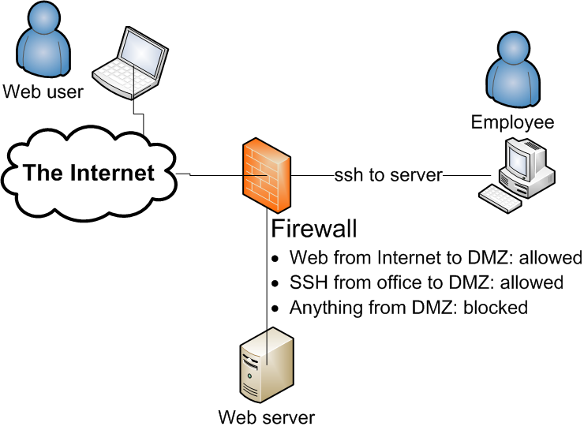
Suggested DMZ Configuration
Notes:
Introduce DMZ = De-Militarized Zone (and point to it)

Slide 29
Do I Need an Appliance?
Firewall, Application Firewall, IPS/IDS, …
Useful but beware of limitations
Build or buy?
They cost $$, €€, ££
Your time is also valuable
Policy vs. Preference

Slide 30
ModSecurity
Web Application Firewall
Runs Right Inside Apache
Can see SSL session content
Rule-based request filtering
…
# Accept only digits in content length
#
SecRule REQUEST_HEADERS:Content-Length "!^\d+$” \ "deny,log,auditlog,status:400, \ msg:'Content-Length HTTP header is not numeric', \ severity:'2',id:'960016',tag:'PROTOCOL_VIOLATION/INVALID_HREQ'"

Slide 31
Application Security

Slide 32
Considerations
Safest: Disconnected, turned off, buried…
Next best: flat files
Dynamic content: danger
How to mitigate danger?

Slide 33
Common Sense
Restrict what can run
Restrict what it can do
Reach out to network?
Write to the filesystem?
Write to a database?
Load scripts or modules?

Slide 34
An Important Question
WHY?

Slide 35
Why…
Does your server have to “see” the net?
Can users upload stuff that gets executed?
Would httpd have to write to the filesystem?
Would you expose anything but 80 and 443?
Would you serve that URL?
Would your OS execute untrusted code or scripts?
Would your users be able to log in and edit through the front door?
Does your site have to be served by a scripting engine?
…

Slide 36
Database Privileges
Bugzilla: GRANT SELECT, INSERT, UPDATE, DELETE, INDEX, ALTER, CREATE, LOCK TABLES, CREATE TEMPORARY TABLES, DROP, REFERENCES ON bugs.* TO bugs@localhost IDENTIFIED BY '$db_pass';
Wordpress: GRANT ALL PRIVILEGES ON databasename.* TO "wordpressusername"@"hostname” IDENTIFIED BY "password";
Joomla 1.5: GRANT ALL PRIVILEGES ON Joomla.* TO nobody@localhost IDENTIFIED BY 'password';
Drupal: SELECT, INSERT, UPDATE, DELETE, CREATE, DROP, INDEX, ALTER, CREATE TEMPORARY TABLES, LOCK TABLES
Gallery 2: mysql gallery2 -uroot -e"GRANT ALL ON gallery2.* TO username@localhost IDENTIFIED BY 'password'”;

Slide 37
Database Privileges (2)
Line of defense!
Apps written by coders
Not DBAs
GRANT ALL PRIVILEGES
Really?
Separate schema definition from app code

Slide 38
PHP Configuration
PHPIniDir directive specifies location of php.ini file
Disable dangerous features:
register_globals = Off
allow_url_fopen = Off
display_errors = Off (production)
enable_dl = Off

Slide 39
Software and Libraries
Be on Announcements lists
Update as needed
Consider packages

Slide 40
Case Studies

Slide 41
Further Reading
Ryan C. Barnett, Preventing Web Attacks With Apache, 0-321-32128-6
Ivan Ristic, Apache Security, 978-0596007249
Tony Mobily, Hardening Apache, 978-1590593783
http://httpd.apache.org/security_report.html
http://www.cisecurity.org/
Mike Andrews and James A. Whittaker, How to Break Web Software, 0-321-36944-0
http://www.owasp.org/

Slide 42
Conference Road Map
Christian Wenz – Web Application Security Bootcamp (training)
Ivan Ristic – Web Intrusion Detection with ModSecurity
Christian Wenz – Web Application Security With/Despite Web 2.0
Joe Orton – Kerberos and Single Sign-on with HTTP
Alex Karasulu – Apache TripleSec: Strong (2-factor) Mobile Identity Management

Slide 43
Thank You
http://people.apache.org/~sctemme/ApconEU2008/Hardening%20Enterprise%20Apache.pptx

