Slide 1

Wengines, Workflows, and 2 years of advanced data processing in Apache OODT
Chris A. Mattmann
Senior Computer Scientist, NASA JPL
Adjunct Assistant Professor, USC
Member, Apache Software Foundation

Slide 2
Agenda
Apache OODT
Workflow Support (Workflow1)
Wengine features (NPP others)
History and Status
Where we’re at

Slide 3
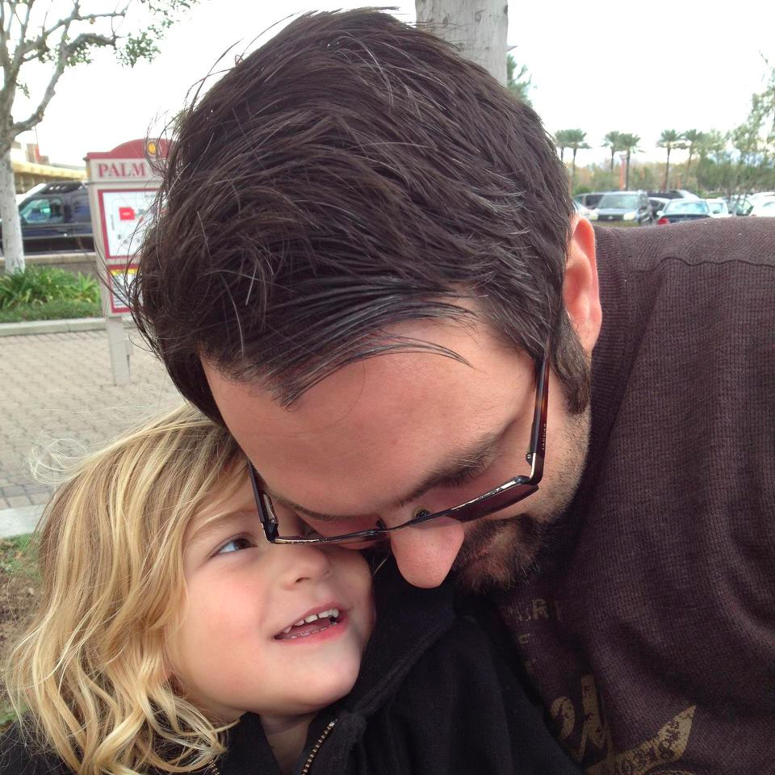
And you are?
Apache Executive Officer and Member involved in
  OODT (PMC), Tika (PMC), Nutch (PMC), Incubator (PMC), SIS (PMC), Gora (PMC), Airavata (PMC), cTAKES (Mentor), lots of other projects
Senior Computer Scientist at NASA JPL in Pasadena, CA USA
Software Architecture/Engineering Prof at Univ. of Southern California

Slide 4
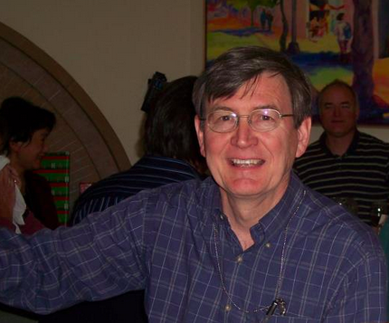




History of Apache OODT
“Oldies but goodies”
information integration
1st generation CAS
1999-2003
“Hard man”
2nd generation “better CAS”
2003-2005
“Matt man and Crew”
Next generation CAS and open source@TheASF
2005-present

Slide 5
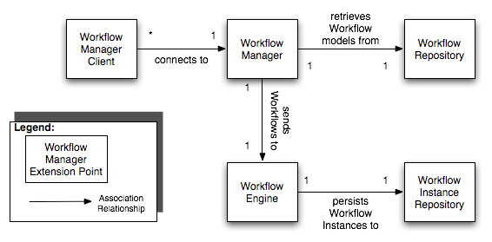
Context
http://oodt.apache.org/components/maven/workflow/development/developer.html

Slide 6
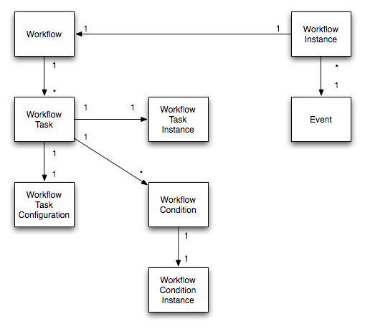
Workflow Manager: some terminology

Slide 7
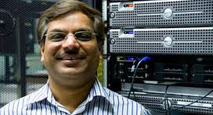
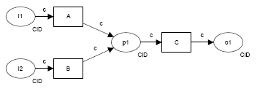
“The Beginning of Workflow”
Chris and Paul learn about workflows - 2004
Raj Buyya A Taxonomy of
Workflow Management
Systems for Grid Computing
Workflow Patterns
http://workflowpatterns.com

Slide 8

“The Beginning: More”
Paul is initially more interested in workflows than Chris
Chris becomes interested in workflows b/c of this mission - http://oco.jpl.nasa.gov/

Slide 9
2005 – Oh No, a “mission!”
Was forced signed up to be the “Lead Process Control System (PCS) developer” for OCO
Was worried b/c existing CAS couldn’t support OCO
Schemed brainstormed with Paul about what to do

Slide 10
What is Workflow Management?
Modeling, executing and monitoring groups of one or more Workflow Tasks
Tasks could be
  A script file
  A java process
  An external command
  A call to a web service
  Many more…

Slide 11
Workflow
Workflow has many definitions
  It’s typically represented as a graph
  In traditional science data pipeline systems, this graph is constrained to be a sequential set of process nodes

Slide 12
The State of Things
The existing CAS was able to handle sequential science data pipelines very well
  It handles them as a set of individual tasks that are mapped to a product type
  Tasks are kicked off on ingestion of a product
    Or by other tasks
However, the approach and process to executing pipelines and tasks was ad-hoc
  Task can kick off another task, but by communicating directly with the database to insert its “id” in the “next task” table
  Tasks are only grouped by product type, so you need to have a product type to have a group of associated tasks
Additionally, the approach didn’t allow for parallel execution of tasks
  Tasks were put into a global queue
Also tasks from different “workflows” can compete against one another because the queue is global
Also control patterns are ad-hoc, does not support standard control flow

Slide 13
New Requirements and Drivers
Workflow should be represented as a graph. This will allow for true parallelism.
Workflow Management should support identified workflow patterns especially control-flow.
  The current level of support for control-flow has to a large extent been relegated to tasks. A collection of tasks is associated with a product ingestion and there is only a priority to sort out the order of execution.
Data-flow should be captured.
The workflow should be able to minimally hook together input and output streams between tasks.
Workflow need not have any interaction with a database
  What if I want to persist a workflow in XML?
  Or as a flat file, or some other lightweight format

Slide 14
Architectural Implications
Workflow Repositories
  Places to go and fetch and “abstract” workflow description from
Workflow Execution Engines
  Give it an abstract workflow, and let it rip
    Turns an abstract workflow into a “Workflow Instance”
  Should allow monitoring of the workflow instance
System interface
  Associate abstract workflows with “events”
  This way, workflows can be tied to things other than just product ingestion

Slide 15
How is this different from the existing CAS?
The Workflow Repository need not be a relational Database
  It could be a flat file
  A (set of) XML file(s)
  An object database
  Factories create Workflow Repositories, which create Workflows
Tasks are associated with “Workflows”, not “Product Types”
  This decouples workflow from the File Management aspects of the CAS
Conditions can be pre, or post
  As opposed to the existing CAS where “Rules” are effectively pre-conditions on a task, and there is no concept of a post condition

Slide 16
How is this different from the existing CAS?
Workflows are interfaces
  They could be backed by a (directed graph), or by an iterator (i.e., a sequential pipeline) or by a HashMap
Workflow Tasks have clearly separated out dynamic and static metadata, and they can share metadata
  Dynamic metadata is passed via the Workflow Engine between all the tasks in a workflow
    They can all read/write to it
  Static metadata is associated with each workflow task
Workflow Events are captured and delivered via Workflow Listeners, which are interfaces
  Many different backend implementations of Workflow Listeners

Slide 17
Workflow Execution
Once you’ve got a Workflow, how do you execute it and turn it into a Workflow Instance?
You hand it off to a Workflow Engine

Slide 18
What does the Workflow Engine do?
Workflow Engine manages:
  A configurable, extensible thread pool
    “Worker Threads” are used to process the Workflow Instance they are each handed
  A queue of worker threads if they aren’t any available workers in the thread pool to process a Workflow
  Monitoring which Workers are handling which Workflow Instances, and the state and status of each Workflow Instance
Workflow Engines execute instances of Workflows

Slide 19
What’s the external interface to the system?
Event-based
  Event names come into the Workflow Manager
  The Workflow Manager looks up any Workflows associated with the event name
  The Workflow Manager then calls the Workflow Repository to obtain representations of the Workflow
  The Workflow Manager then hands off Workflow representations to the Workflow Engine for execution
Current implementation uses XML-RPC, but it’s an interface, so it could use REST/HTTP/SOAP/etc.

Slide 20
The Workflow Manager
So, how do we put all of these things together?
Well, something like:
  A Workflow Manager has
    One or more Workflow Repositories to obtain abstract Workflow descriptions from
    One or more Workflow Engines to execute Workflows on
    One or more external interfaces

Slide 21
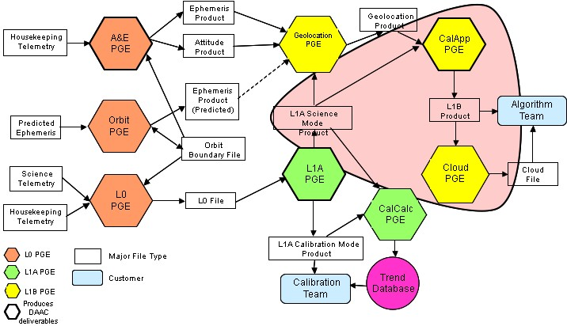
We called this “Workflow1”
Worked great for OCO

Slide 22
Properties of Workflow1
ThreadPool Workflow Engine
1 Thread per entire workflow instance
Worked very well for routine production pipeline processing – we know that we will run A <= X <=B jobs per day where
A is a good minimal bound on the max threads per JVM – totally OS dependent (256 is a large number)
B is the maximal number of threads that doesn’t bound the JVM

Slide 23
ThreadPool was
http://svn.apache.org/repos/asf/oodt/trunk/workflow/src/main/resources/workflow.properties
Based on java.util.concurrent
ThreadPoolExecutor
Easily configurable
If you ran out of threads, scale horizontally and add more JVMs

Slide 24
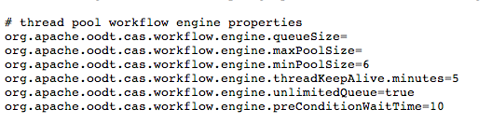
Portion of workflow config for ThreadPool Executor

Slide 25
Other Workflow1 Stuff
Branch and bounds was supported implicitly
You want branch and bounds?
1. Define N>1 Workflow that is mapped to an event name
1a. Define N+1 workflow to be “reducer”
2. It will be executed in parallel, hence the branch
3. the Bounds is handled by a pre-condition on N+1 task

Slide 26
Metadata context keys

Slide 27
Problems with keys
Key naming collision
Tasks needed to handle this explicitly in “production rules”
No grouping of keys
Grouping was achieved using “_” key naming scheme
PCS_InputFiles
PCS_CrawlForDirs

Slide 28
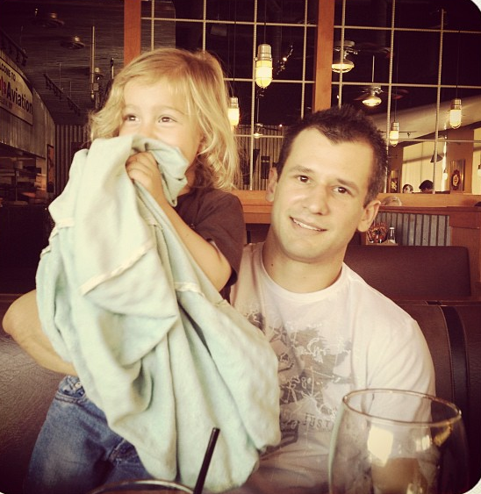
Enter this guy
Not the one on the left, that’s my son
B Brian Foster
- now at Google, curses!

Slide 29
And this mission
http://npp.gsfc.nasa.gov
NPOESS Preparatory Project (NPP) now called Suomi NPP
Sounder PEATE Testbed Element

Slide 30
They told Brian this
A little different than the OCO use case
So,.., the next THREE years worth of jobs, we’d like to submit today…
and then have your “workflow manager” manage the jobs for the next 3 years
This effectively blew up our thread pool workflow engine

Slide 31
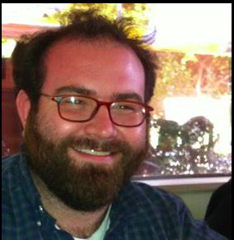
Random David Woollard sighting
David Woollard and Brian Foster had to figure out how to solve the NPP problem
Decided we need a new workflow manager
…branch/fork/sigh

Slide 32
Not their fault
Paul R. and I and others didn’t have time to fully watch this, and other OODT PMC members weren’t really vested in those particular components
Brian was learning and doing great and we decided in the end that going off into a branch and not destroying Workflow1 users in the trunk was better than having to integrate everything…so we punted

Slide 33
NPP Pipeline – more SCF than ops system

Slide 34
Enter “Workflow2” or “Wengine”
What sucks about Workflow1?
Can’t explicitly model branch and bounds
Fixed through “sequential” and “parallel” processors – Paul R.’s idea OODT-70
No global level workflow conditions
Added them OODT-205
Really only pre conditions in Workflow1
Add post conditions OODT-502

Slide 35
More improvements
Condition timeouts
OK it’s timed out waiting for a file, run anyways OODT-207
Optional or required
Allowing boolean OR based conditionals (test this and report its success, but don’t block) – OODT-208
Better failure state reporting and checkpointing
OODT-206

Slide 36
Yes more improvements
Workflow Metadata keys https://oodt.jpl.nasa.gov/jira/browse/OODT-303 (internal JPL JIRA -- was already fixed in ASF JIRA in 0.1-incubating)
By Group, e.g.,
PCS/InputFilesGroup/InputFiles
PCS/Output/MetFileWriter
PCS/FileManagerUrl
Task1/SomeKey1
Collect all keys for a group
wmet.search(“PCS”) -> all keys, can interrogate for values

Slide 37
And more…
Workflow Lifecycle Management
State-driven execution – inversion of control
What this literally means – in PCS stat and in PCS OPSUI you see more states

Slide 38
Runner Framework
Workflow1 had facilities to submit jobs to Resource Manager or to run them on its own locally
Was a hack inside of IterativeWorkflowProcessorThread
Brian F. turned this into an explicit interface
Could hook Workflow directly to e.g., Hadoop
I’m not convinced this was the right way to do this, but I applaud the clean up of my code

Slide 39
Sub Workflows
Workflows whose sub-tasks can be other workflows (OODT-211)
Yes, this is recursive, and mind blowing

Slide 40
“Dynamic Workflows”
This is one of my favorites OODT-209
% ./wmgr-client --url http://localhost:9001 --operation --dynWorkflow --taskIds id1,id2,id3

Slide 41
Enough, how can I use all this stuff?
Brian’s code existed as forked and un-supported (by community) in NPP repo at JPL
Brian, by his own awesomeness, realizes before he leaves me for Google in 2011 that we need to push it to Apache
http://svn.apache.org/repos/asf/oodt/branches/wengine-branch - last working PEATE version

Slide 42
Chris spends 2 years figuring out what Brian did
OODT-215
My initial “god” issue to solve everything in JIRA, tried to break the problem down into manageable steps
Still took me 2 years – help from Paul R. and from Brian (even though he left for Google he still works on Apache OODT muwahahah)
OODT-491
“Finish line tasks for Wengine”

Slide 43
Wengine support in trunk first appears
In Apache OODT 0.4
But was largely a work in progress, and well…didn’t fully work
Apache OODT 0.5 happens
back compat restored for “Workflow1” style engines
Chris and Brian clean up a ton of the branch stuff, and finish most of OODT-491
Apache OODT 0.6 we finish for real real real

Slide 44
Who will use Wengine?
PEATE uses it today
Their job processing requirements as an SCF are quite large
U.S. National Climate Assessment (NCA) project, “Snow Hydrology for the Western US and Alaska”
will tell you about this on the next slides

Slide 45
Talk Part #2
Doing stuff with Wengine and why you should care

Slide 46
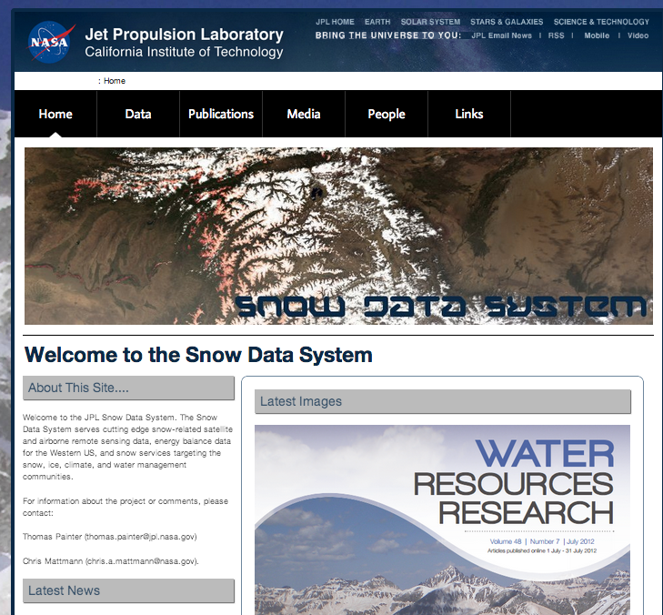
JPL Snow Server
http://snow.jpl.nasa.gov
Full bore processing and delivery system
  Near real time and historical processing
  Dust forcing and snow covered area products
  Tower data
  GIS interfaces
  CSV, JSON, GeoTIFF
  data format download

Slide 47
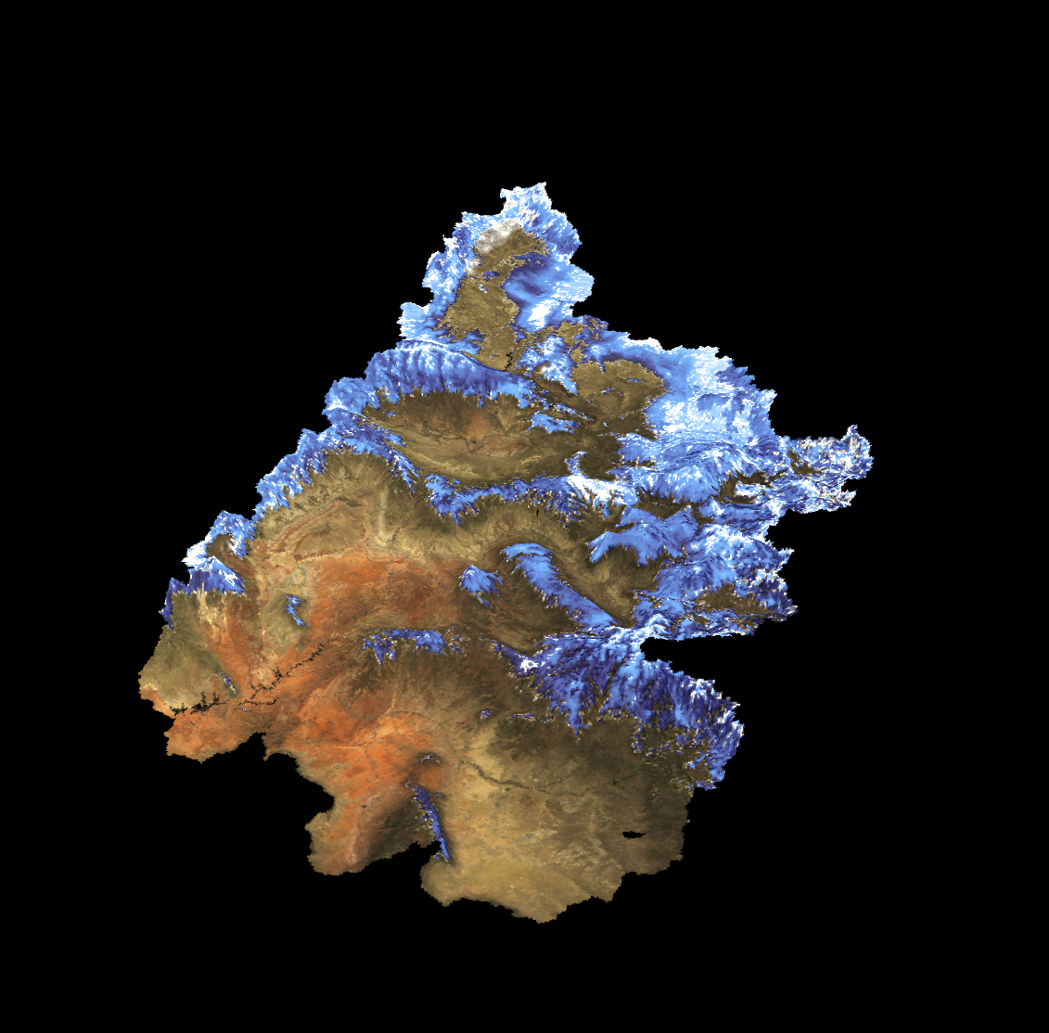
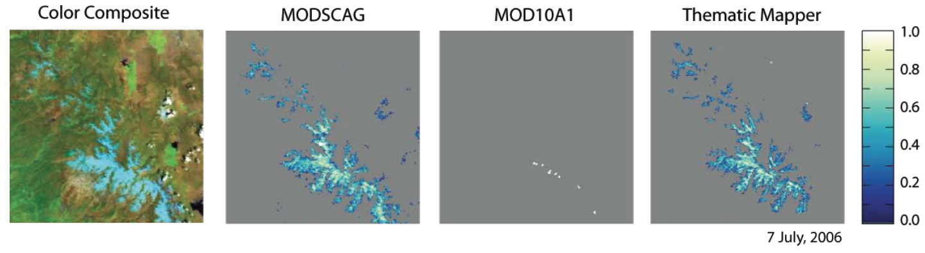
MODIS Snow Covered Area and Grain Size (MODSCAG)
JPL MODSCAG algorithm
(Painter et al 2009)
Spectral mixture analysis of MODIS Surface Reflectance products
Daily 500 m coverage in late morning and early afternoon from NASA satellites Terra and Aqua
Credit: Tom Painter
Upper Colorado River Basin
March 9, 2009

Slide 48
MODSCAG Processing: Two Products/ Two Inputs
MODIS tiles are defined by their horizontal and vertical tile IDs (the 2 characters after the h and the v respectively)
Historical Tiles over the Western United States (LPDAAC)
  Time Range: 2000 - Present
  h08v04, h08v05, h09v05, h09v04, h10v04
  LPDAAC is NASA Land Processes data center located at the USGS Earth Resources Observation and Science (EROS) Center in Sioux Falls, South Dako
MODIS Near Real-Time Products (LANCE MODIS NRT)
  Time Range: Dec 2011 - Present
  Western United States
  High Asia

Slide 49
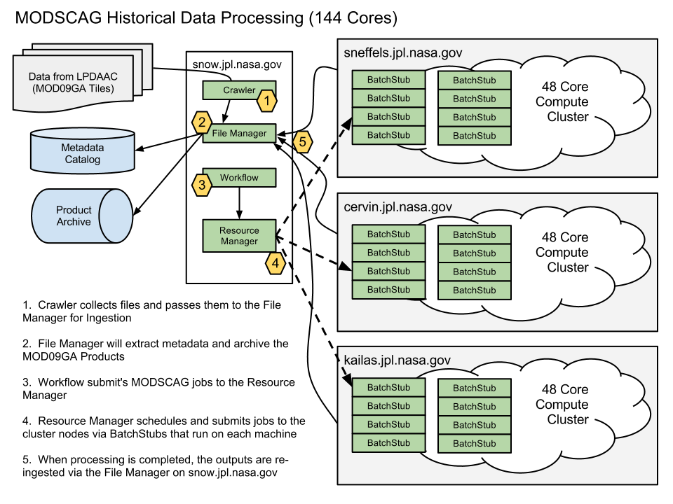
Credit: Cameron Goodale

Slide 50
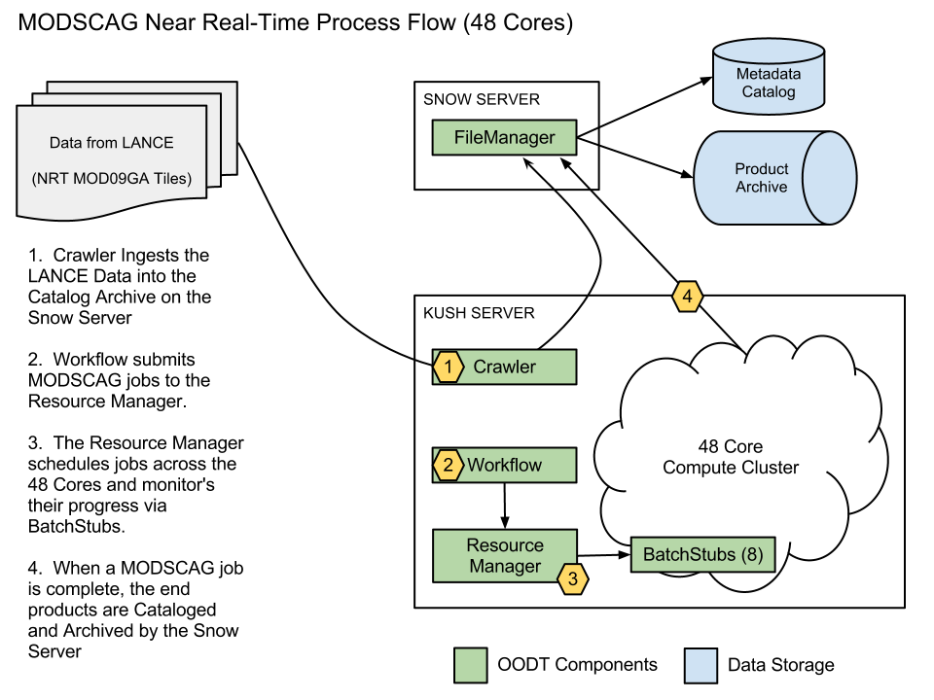
Credit: Cameron Goodale

Slide 51
Dust Radiative Forcing
300
200
100
0
Dust Radiative Forcing (W/m²)
MODDRFS
Dust Radiative Forcing in Snow from MODIS
Painter and Bryant, 2012
17 May 2009

Slide 52
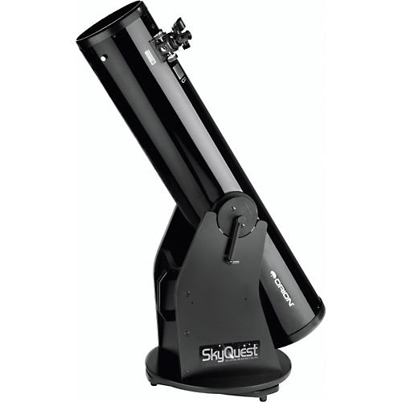

Now, what have I cooked up for today?
I have an Orion SkyQuest XT8 Classic Dobsonian Telescope
I also have an iPhone 5

Slide 53
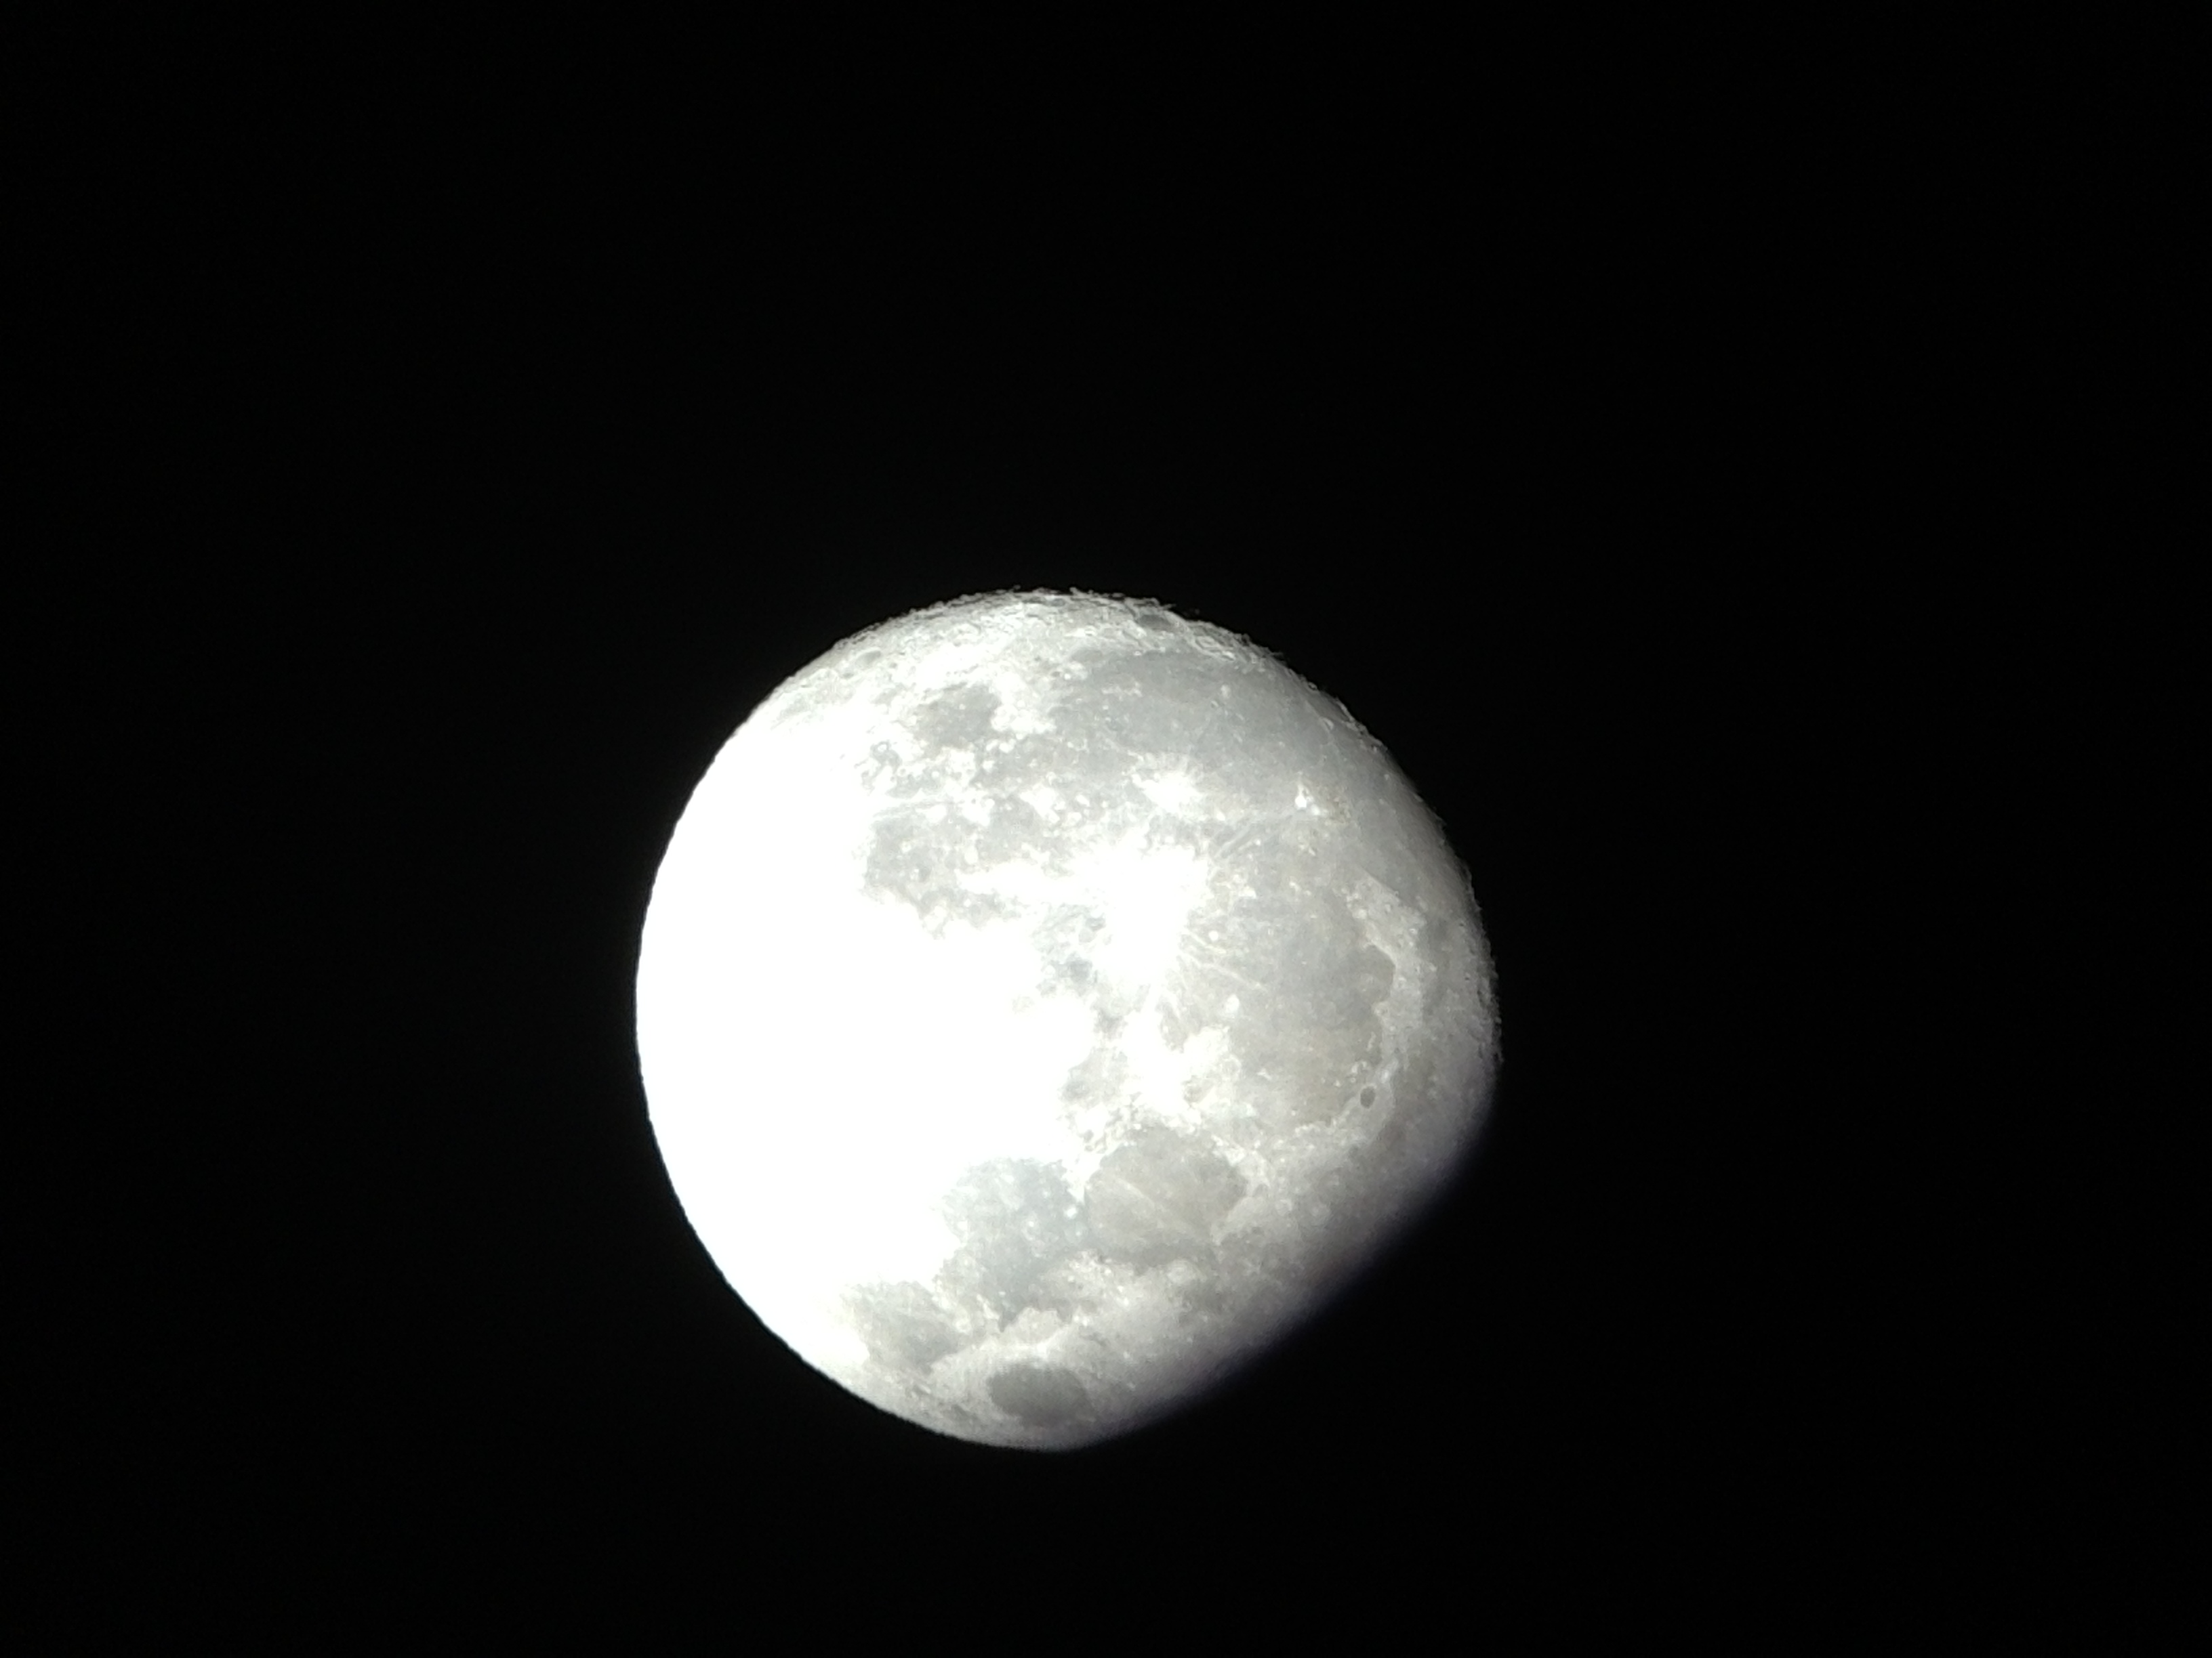
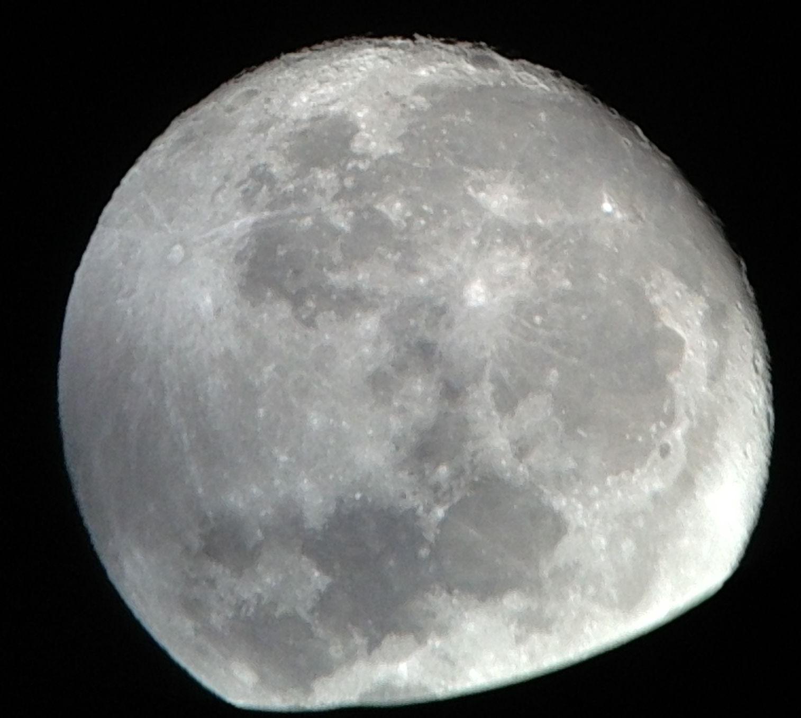
I had a few days of time for some great lunar science

Slide 54
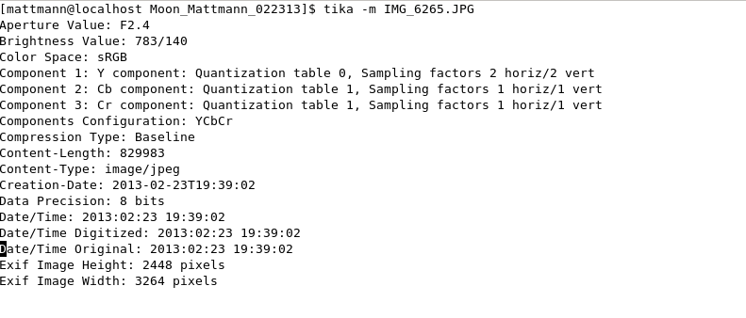
As it turns out those images have metadata

Slide 55
Add metadata
Geocoding, WGS84 lat, lng
Planetary met, TARGET=MOON, etc.

Slide 56
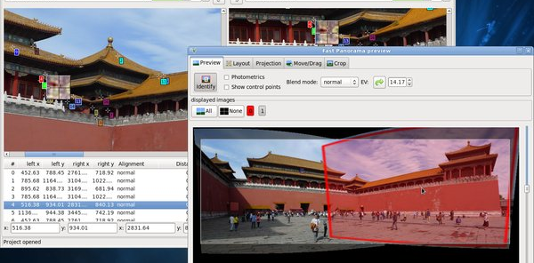
Found Hugin

Slide 57
Wanted to do something cool with it
Discovered enshape
Figured out how to make it combine images

Slide 58
Getting started
Workflow2 Quick Start on OODT Wiki
https://cwiki.apache.org/OODT/workflow2-quick-start-guide.html
OODT documentation sucks! Check the wiki it’s better there

Slide 59
Will now show you some workflow stuff
Dreams of moon images, died
Will illustrate dynWorkflows

Slide 60
What’s left?
Supporting looking up workflows by category (needed to say “give me all workflows that aren’t ‘done’) OODT-517
Fix the resource manager runner OODT-518
Fix all the wall clock and per task timing OODT-519

Slide 61
Want to help?
dev@oodt.apache.org
OODT-215 and OODT-491 homework
Get a beer with me or Brian
I bribe you?

Slide 62
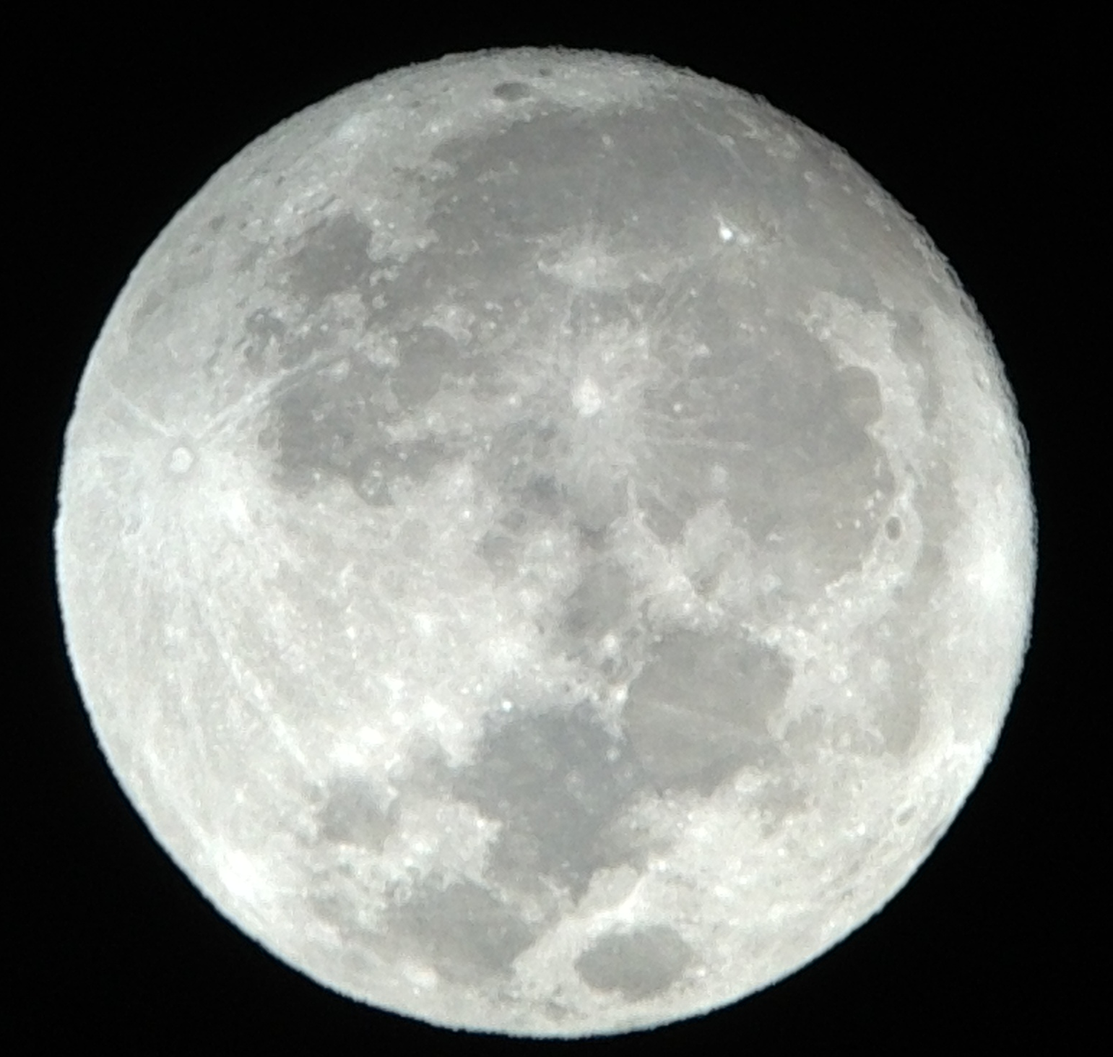
Questions
Thanks!
Chris Mattmann
@chrismattmann
mattmann@apache.org

