Slide 1
CMIS: One ECM API to Rule Them All

Slide 2
What is CMIS?
Vendor independent API for working with content repositories
Specification managed by OASIS
Web Services Binding
ATOM Pub Binding
Browser Binding (new in 1.1)
CMIS Query Language

Slide 3
The Beauty of
Presentation Tier
REST
SOAP
Content Services Tier
?
Enterprise Apps Tier
?

Slide 4
Meet CMIS
Client
consumer
read
write
Services
Domain Model
Content
Management
Interoperability
Services
provider
Vendor Mapping
Content Repository
CMIS lets you read, search, write, update, delete, version, control, … content and metadata!

Slide 5
Use Cases
Client
Content Repository
Client
Content Repository
Content Repository
Content Repository
Content Repository
Content Repository
Collaborative Content Creation
Portals
Client Application Integration
Mashup
Workflow & BPM
Archival
Virtual Documents
DAM / WCM

Slide 6
Types
Document
Content
Renditions
Version History
Folder
Container
Hierarchy
Filing
Described by
Type Definitions
Relationship
Source Object
Target Object
Policy
Target Object

Slide 7
Type Definitions
Object
Type Id
Parent
Display Name
Queryable
Controllable
Property
Property Id
Display Name
Type
Required
Default Value
…
*
Document
Versionable
Allow Content
Folder
Relationship
Source Types
Target Types
Policy
Custom Type

Slide 8
Developed by 30+ ECM Vendors
Implementations Already Available…
Providers
Consumers

Slide 9
Open Source implementation of CMIS
Apache Chemistry is the umbrella project for all CMIS related projects within the ASF
OpenCMIS (Java, client and server)
cmislib (Python, client)
phpclient (PHP, client)
DotCMIS (.NET, client)
ObjectiveCMIS
Android OpenCMIS

Slide 10
New stuff coming in CMIS 1.1
Browser Binding
Support for Secondary Types (aka “Aspects”)
Type Mutability
cmis:item

Slide 11
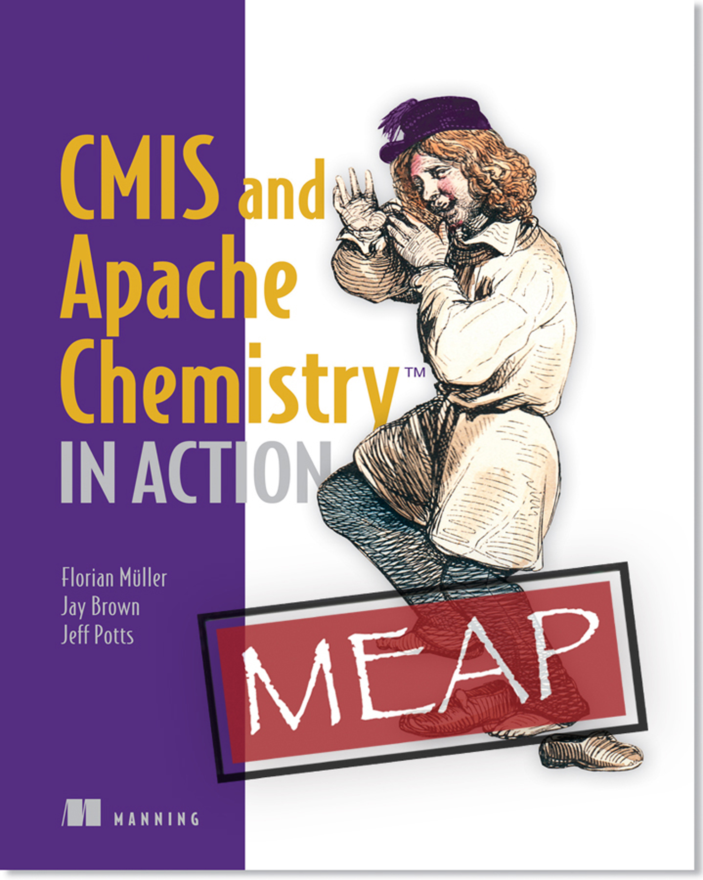
CMIS & Apache Chemistry in Action
Everything you need to know about CMIS 1.0 & 1.1
Lots of Groovy and Java examples
Also covers Python, Android, & iOS
Now on MEAP!
37%-off: 12cmisal

Slide 13
CMIS Code Examples

Slide 14
Example: Getting a Session
// set up session parameters
Map<String, String> parameter = new HashMap<String, String>();
parameter.put(SessionParameter.BINDING_TYPE, BindingType.ATOMPUB.value());
parameter.put(SessionParameter.ATOMPUB_URL, "http://cmis.alfresco.com/service/cmis");
parameter.put(SessionParameter.USER, "admin");
parameter.put(SessionParameter.PASSWORD, "admin");
// get a list of repositories and choose the first one
SessionFactory factory = SessionFactoryImpl.newInstance();
List<Repository> repositories = factory.getRepositories(parameter);
Session session = repositories.get(0).createSession();

Slide 15
Example: Using the Session
Information about the repository:
RepositoryInfo ri = session.getRepositoryInfo();
String id = ri.getId();
String name = ri.getName();
Access objects by id or path:
CmisObject object1 = session.getObject("1234567890");
CmisObject object2 = session.getObjectByPath("/my/path/doc");
Iterate through a folder:
Folder rootFolder = session.getRootFolder();
String rootFolderId = rootFolder.getId();
for(CmisObject object: rootFolder.getChildren()) {
String name = object.getName();
if(object instanceof Document) {
Document doc = (Document) object;
long size = doc.getContentStreamLength();
}
}

Slide 16
Navigation
// get root folder
Folder root = session.getRootFolder();
String rootFolderName = root.getName();
println "Root folder: ${rootFolderName}\n"
// print root folder children
for(CmisObject object: root.getChildren()) {
String name = object.getName();
String typeId = object.getType().getId();
String path = object.getPaths().get(0);
println "${name} \t${typeId} \t(${path})"
// get parents
/*
for(CmisObject parent: object.getParents()) {
String parentName = parent.getName();
println " Parent: ${parentName}"
}
*/
}

Slide 17
Paging
Folder root = session.getRootFolder();
printList( root.getChildren() )
//printList( root.getChildren().getPage(3) )
//printList( root.getChildren().skipTo(2) )
//printList( root.getChildren().skipTo(2).getPage(3) )
void printList(ItemIterable<CmisObject> list) {
list.each { println "${it.name} \t${it.type.id}" }
long numItems = list.getTotalNumItems();
boolean hasMore = list.getHasMoreItems();
println "--------------------------------------"
println "Total number: ${numItems}"
println "Has more: ${hasMore}"
println "--------------------------------------"
}

Slide 18
Properties
CmisObject object = session.getObjectByPath("/User Homes/florian/Test Folder/MyText");
for(Property<?> property: object.getProperties()) {
String propId = property.getId();
String displayName = property.getDefinition().getDisplayName();
String queryName = property.getDefinition().getQueryName();
PropertyType datatype = property.getType();
Object value = property.getFirstValue();
println "${displayName}: ${value}"
println " Data type: ${datatype}"
println " Id: ${propId}"
println " Query name: ${queryName}"
println ""
}

Slide 19
Content
CmisObject object = session.getObjectByPath("/User Homes/florian/Test Folder/MyText");
if(!(object instanceof Document)) {
throw new Exception("Not a document!");
}
Document doc = (Document) object;
ContentStream content = doc.getContentStream();
if(content == null) {
throw new Exception("Document has no content!");
}
String filename = content.getFileName();
String mimeType = content.getMimeType();
long length = content.getLength();
InputStream stream = content.getStream();
println "File: ${filename}"
println "MIME Type: ${mimeType}"
println "Size: ${length} bytes"
println "Has stream: " + (stream != null)

Slide 20
Query
String cql = "SELECT cmis:objectId, cmis:name, cmis:contentStreamLength FROM cmis:document";
ItemIterable<QueryResult> results = session.query(cql, false);
//ItemIterable<QueryResult> results = session.query(cql, false).getPage(10);
//ItemIterable<QueryResult> results = session.query(cql, false).skipTo(10).getPage(10);
for(QueryResult hit: results) {
for(PropertyData<?> property: hit.getProperties()) {
String queryName = property.getQueryName();
Object value = property.getFirstValue();
println "${queryName}: ${value}"
}
println "--------------------------------------"
}

Slide 21
Folders
Folder root = session.getRootFolder();
// create a new folder
Map<String, Object> properties = new HashMap<String, Object>();
properties.put("cmis:objectTypeId", "cmis:folder");
properties.put("cmis:name", "a new folder");
Folder newFolder = root.createFolder(properties);
printProperties(newFolder);
// update properties
Map<String, Object> updateproperties = new HashMap<String, Object>();
updateproperties.put("cmis:name", "renamed folder");
newFolder.updateProperties(updateproperties);
newFolder.refresh();
printProperties(newFolder);
// delete folder
newFolder.deleteTree(true, UnfileObject.DELETE, true);

Slide 22
Documents
Folder root = session.getRootFolder();
// create a new document
String name = "myNewDocument.txt";
Map<String, Object> properties = new HashMap<String, Object>();
properties.put("cmis:objectTypeId", "cmis:document");
properties.put("cmis:name", name);
byte[] content = "Hello World!".getBytes();
InputStream stream = new ByteArrayInputStream(content);
ContentStream contentStream = new ContentStreamImpl(name, content.length, "text/plain", stream);
Document newDoc = root.createDocument(properties, contentStream, VersioningState.MAJOR);
printProperties(newDoc);
// delete document
newDoc.delete(true);

