Slide 1
Apache OODT: From the Beginning to Big Data Management
Dan Crichton
NASA Jet Propulsion Laboratory

Slide 2
Agenda
Introduction of Space Data Challenges
Movement Towards Big Data
History of OODT
Application of OODT
Beyond Science

Slide 3
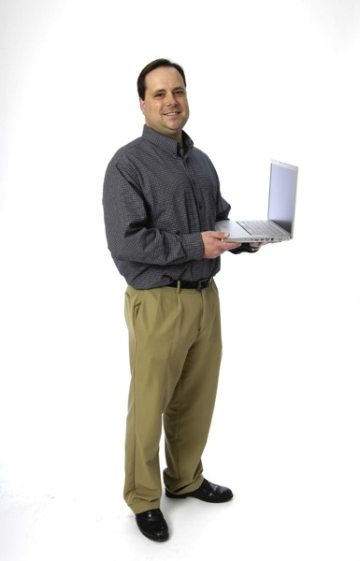
About Me…
As a Principal Computer Scientist, joined NASA Jet Propulsion Laboratory in 1995
  ~25 years developing software with different hats
Program Manager, Planetary Data System Engineering
  NASA’s official archive for all solar system science data
  Chair, International Planetary Data Alliance (2011-2013)
Program Manager, Data Systems in Earth Science and Technology
PI, Early Detection Research Network Informatics Center, National Cancer Institute
Current member of the National Research Council Committee on Tools for the Analysis of Massive Data
Original PI of OODT

Slide 4
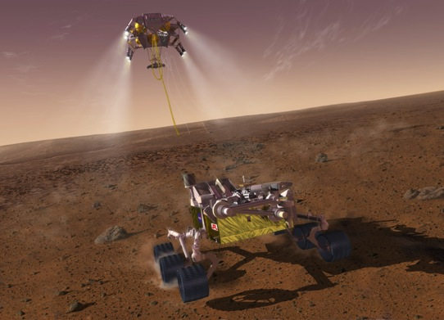
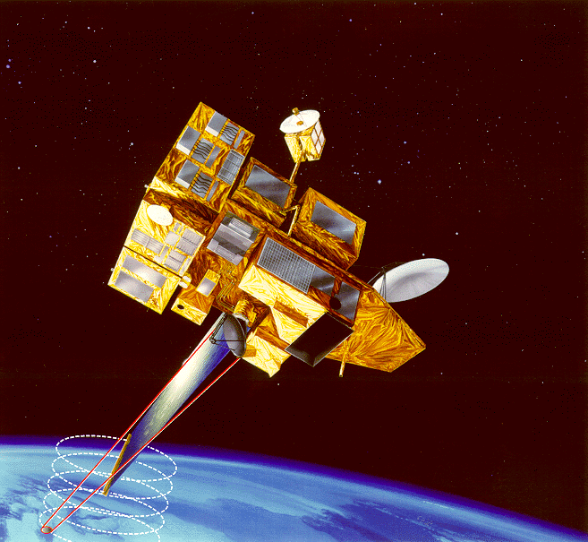
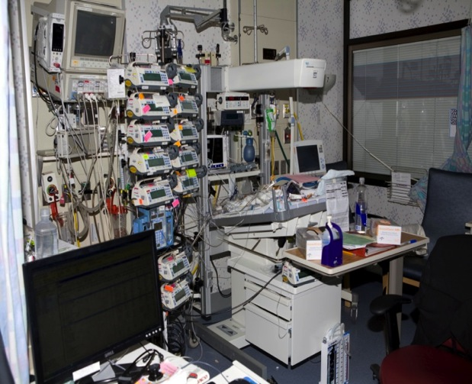
Observational Science Platforms
?
What do these have
In common?
What’s being
observed

Slide 5
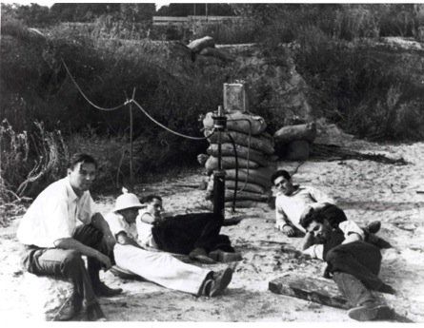
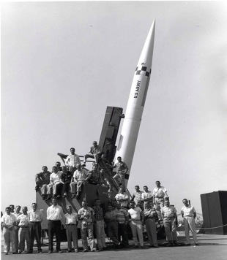
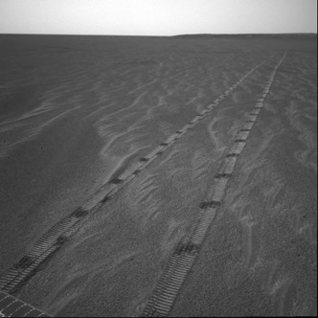
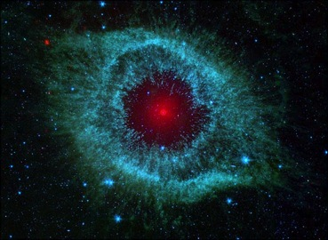
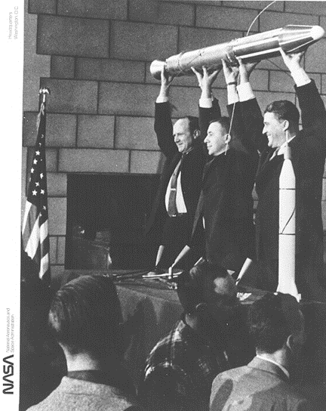
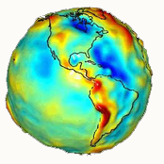
History of JPL
Caltech students (1936)
Missiles (1940s)
Explorer 1 (1958)
Spitzer Space Telescope (2004 – present)
Earth Science (1978 – now)
Mars Exploration Rovers (2004 – present)
JPL is a NASA FFRDC and a Division of Caltech

Slide 6
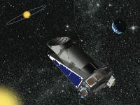
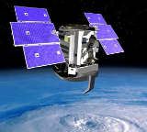
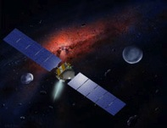
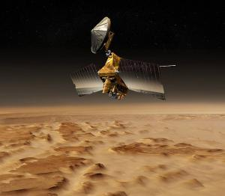
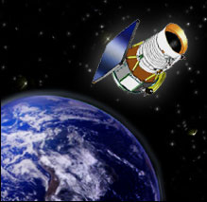
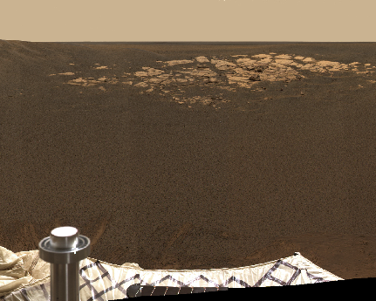
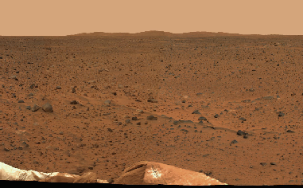
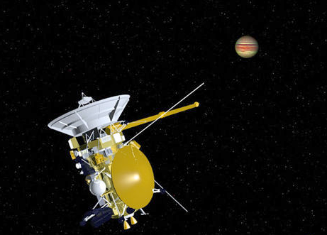


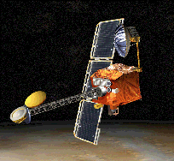
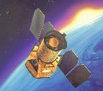

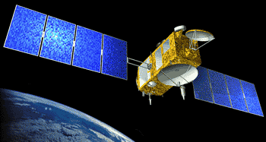
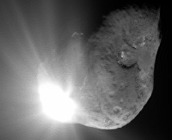
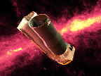
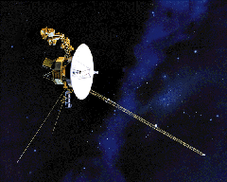
Sample JPL Missions
Mars Odyssey
Kepler
Cassini
CloudSat
Spitzer
Spirit
Stardust-NExT
ACRIMSAT
Opportunity
GRACE
GALEX
Dawn
Mars Reconnaissance Orbiter
Deep Impact-Epoxi
(Plus ASTER, MISR, TES, MLS, AIRS, M³, MIRO, Herschel, Planck, and LRO Diviner instruments)
Jason 1 and Jason 2
Two Voyagers
Wide-field Infrared Survey Explorer (WISE)

Slide 7
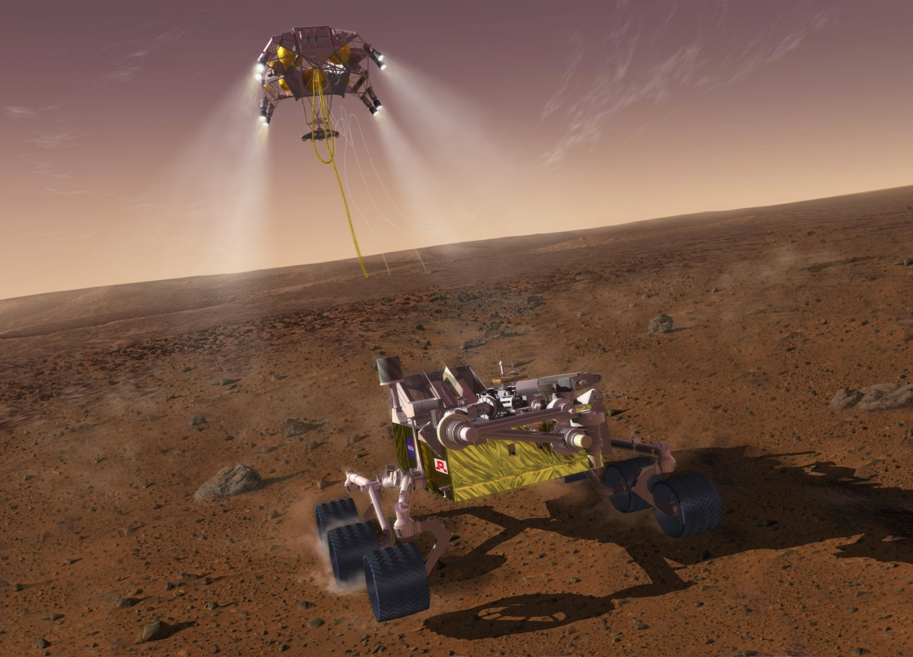
Landed @ Gale Crater on Mars, August 6, 2012

Slide 8
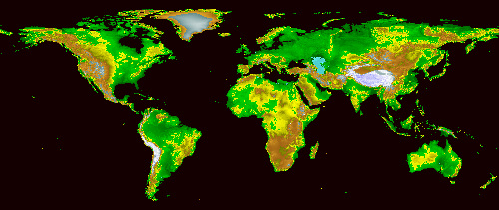
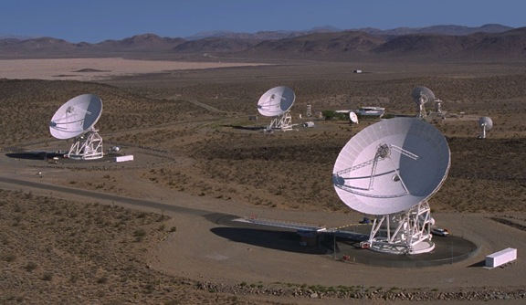
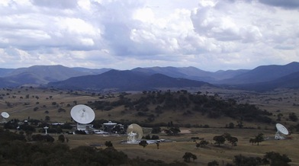
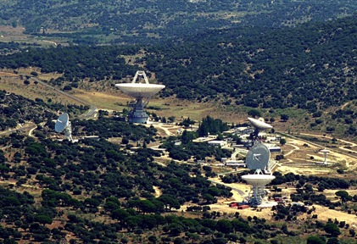
Deep space exploration enabled by
NASA’s Deep Space Network (DSN)
Goldstone
Canberra
Madrid

Slide 9
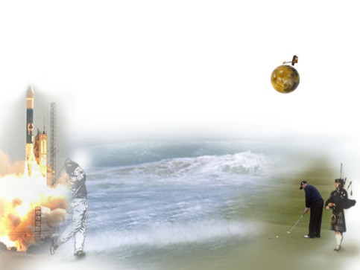
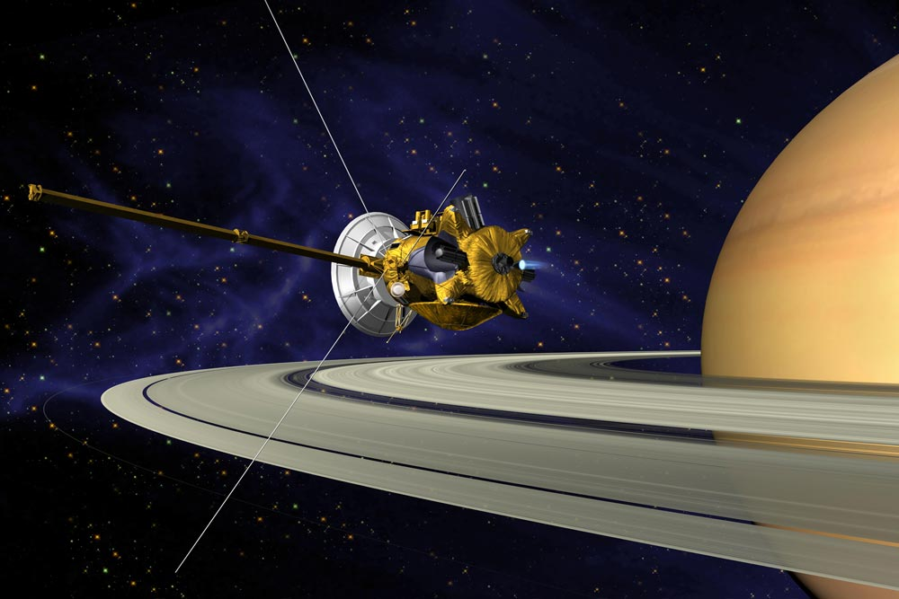
Example Challenges
After traveling 450 million km, the Spirit rover arrived at Mars within 80m of its target—a tap-in for a birdie (And the hole on Mars was moving at 60,000 mph)!
We receive a 10⁻¹⁸ W signal from Saturn (@ 1 Billion miles)
  It takes 2 * 10²¹ to power a refrigerator light

Slide 10
Software Plays a Critical Role in the Mission Pipeline
Flight Software
Ground Data Systems
Science Production/Processing
Science Analysis
Credit: Consultative Committee on Space Data Systems
Our focus is how the science production and science analysis benefits from the open source paradigm for observational systems

Slide 11









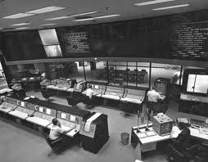

Challenges Challenges in Working with Scientific Data
Scientific collaboration is world-wide; public access to data is a requirement
  Data is managed in highly distributed environments
  Little data sharing occurring between organizations
Systems are very heterogeneous
  Data systems are often developed around science and instrument teams
  Access to data has traditionally been difficult
  Data is represented in different formats and structures
Massive data sets are being generated challenging traditional analysis approaches

Slide 12
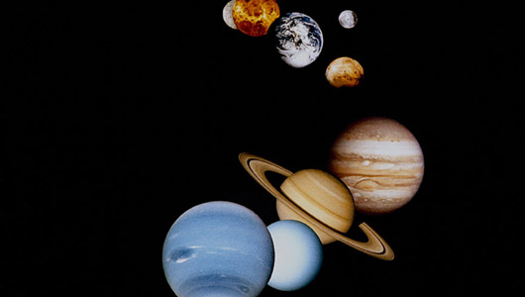
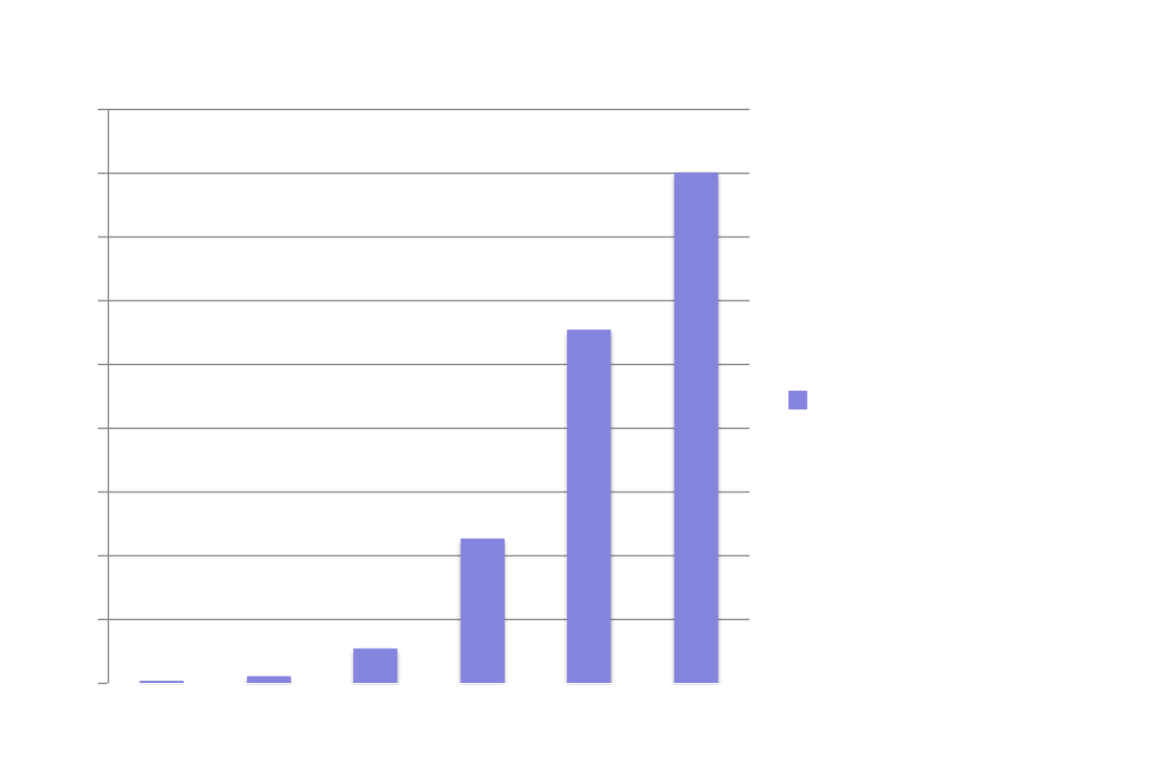
Growth of Distributed Planetary Data
Archived from U.S. Solar System Research
Yes, size matters, but so does complexity…

Slide 13
Growth of NASA Earth Science
Data Holdings
Notes:
Since the launch of first Terra in 1999, Aqua in 2002, and finally Aqua in 2004 have accelerated the growth in the Level 2 data collections. NASA’s decadal survey recommendations are, if anything, more data intensive than their predecessors in the EOS era.

Slide 14
Moving Towards a New Paradigm
Highly distributed, multi-organizational systems
  Systems are moving towards loosely coupled systems or federations in order to solve science problems which span center and institutional environments
Sharing of data and services which allow for the discovery, access, and transformation of data
  Systems are moving towards publishing of services and data in order to address data and computationally-intensive problems
  Infrastructures which are being built to handle future demand
  Use of commodity services to address elasticity
Addressing complex modeling, inter-disciplinary science and decision support needs
  Need a dynamic environment where data and services can be used quickly as the building blocks for constructing predictive models and answering critical science questions
  Need to ensure information architectures support the varying science needs
Changing the way in which data analysis is performed
  Moving towards analysis of distributed data to increase the study power
  Enabling greater collaboration across centers
Systemizing data analysis is the the future for massive data sets

Slide 15
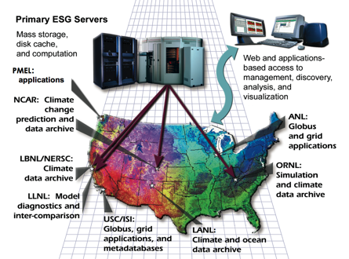
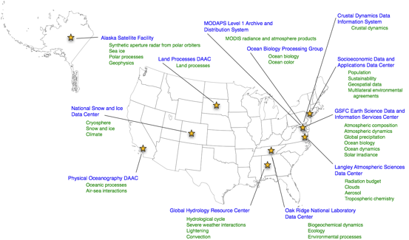
Data System Scientific Research Networks: Access to Models and Observations
Highly distributed/federated
Collaborative
Information-centric
Discipline-specific
Growing/evolving
Heterogeneous (Implementations)
Integrated with Upstream SDS
Solar System Exploration
Climate Research
Earth Observation
Cancer Research
15

Slide 16
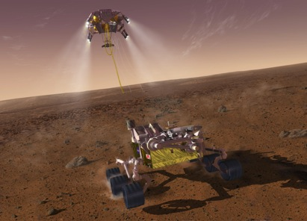
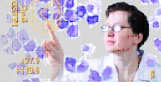
Common Architectural Patterns…
Across scientific domains, we have discovered common themes for observational systems
Each has its own communities, standards and systems
But, there is an underlying reference architecture that be leveraged
A key need is building federations of data archives that allow us to learn from the data

Slide 17
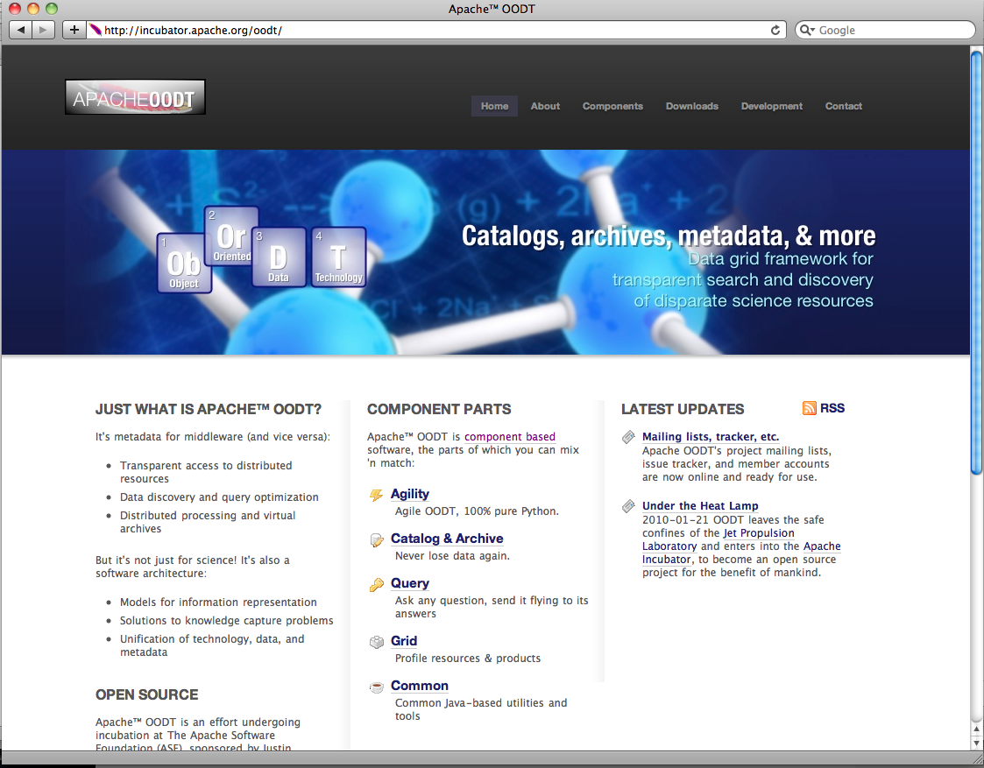






OODT: An Open Source Framework for Building Distributed Science Data Mgmt Environments
Funded by NASA in 1998
  Application to Planetary Science (1999)
  Application to Interferometry (1999)
  Application to Cancer Research (2001)
  Application to Earth Science (2002)
  Application to Medicine (2003)
  Application to Climate Research (2008)
  Application to Radio Astronomy (2010)
  Science data generation
  data capture, end-to-end
  Distributed access to science data repositories by the community
Runner-up NASA Software of the Year, 2003
Entered the Apache incubator program in January 2010; Top Level Project in 2011.
  First NASA Apache Project
http://oodt.apache.org
17

Slide 18


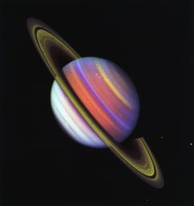
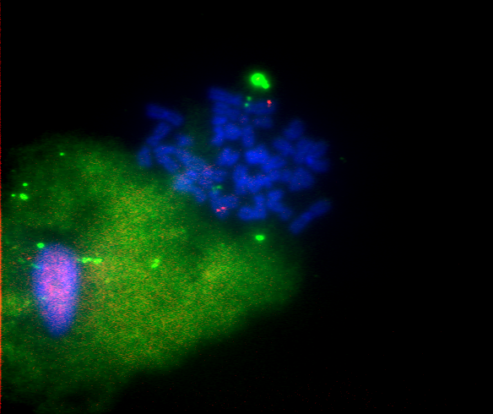
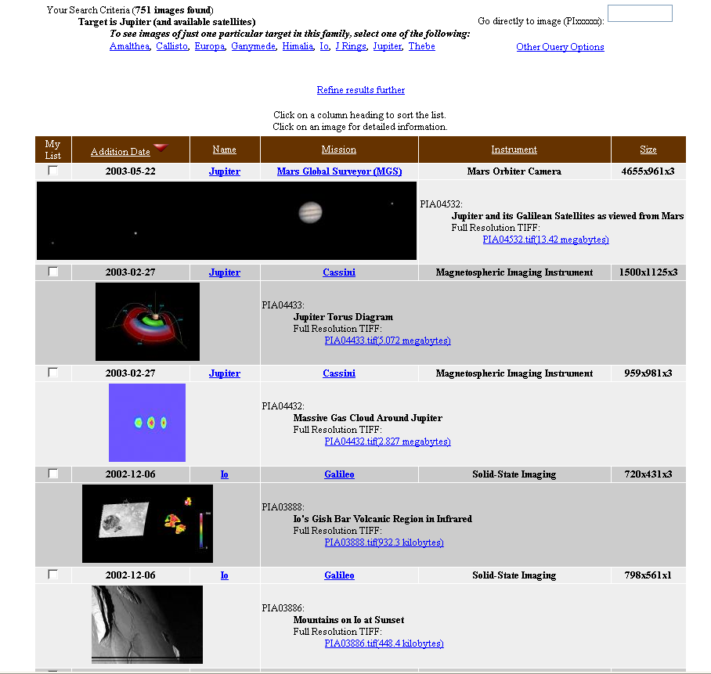
OODT (Object Oriented Data Technology) Vision
A scalable computing framework for constructing large-scale, distributed, data systems for scientific generation, management and analysis following a set of architectural patterns
Data and Computers interconnected to form a virtual data repository
Integrated Data Resources
Biomedicine
Planetary
Earth Science
Engineering
Space Physics
Notes:
The OODT vision was to support NASA’s long term needs of enabling the engineering and science of our missions to be managed as virtually distributed environment whereby data assets appeared centralized to scientists and engineers, but are physically distributed. This meant that design for our missions can occur across several NASA centers and partners, it meant that science processing could occur at a NASA center or a PI’s university, and it meant that users would be able to get to the data without understanding where it is physically housed. The key goal was creating seamless access and sharing of the data.
Bob Hanish at Hubble Space Telescope

Slide 19
OODT Architectural Principles*
Separate the technology and the information architecture
Encapsulate the messaging layer to support different messaging implementations
Encapsulate individual data systems to hide uniqueness
Provide data system location independence
Require that communication between distributed systems use metadata
Define a model for describing systems and their resources
Provide scalability in linking both number of nodes and size of data sets
Allow systems using different data dictionaries and metadata implementations to be integrated
Leverage existing software, where possible (e.g., open source, etc)
* Crichton, D, Hughes, J. S, Hyon, J, Kelly, S. “Science Search and Retrieval using XML”,
Proceedings of the 2nd National Conference on Scientific and Technical Data, National Academy of Science, Washington DC, 2000.

Slide 20
OODT Implementation
Implemented as Java-based software server components
Provided messaging as a “plug-in” component that can be replaced independent of the other core components. Messaging components include:
  CORBA, Java RMI, REST, etc
Provided client APIs in Java, C++, HTTP, Python, IDL
Installation on a variety of platforms (Windows, Unix, Mac OS X, etc)
Used several international data architecture standards

Slide 21
Supporting the Science Data Lifecycle
Ingestion of data: Steps for transformation and validation
Cataloging of Structured and Unstructured Data: Separation of the description (catalog) of data from the physical data storage
Data Processing: Workflows for executing scalable jobs
Data Management: Construction and management of metadata catalogs and data (often distributed)
Data Discovery: Discovery of data for scientific research
Data Access: Access to the scientific data
Data Distribution, Computation and Transformation: Support for analysis and services (e.g., subsetting) on the data

Slide 22


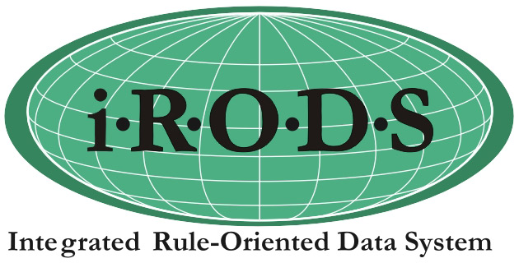

OODT Science/Mission/Project Specialization
Unique
Rqmts.
Science/Mission/Project-Specific
OODT Extension
Discipline Models
Mission-Specific Services
Specific
OODT Core Framework
Core Components/Models
Process Control Framework
New capabilities/
improvements
Common
Common Components
ASF, Others
More Capabilities

Slide 23




Common Apache Technologies in Use to Enable Science Data
Apache Tomcat
  Core
  App
  Server
  for many of our Data Web Services and Web Apps
Apache HTTPD
  Powers front-facing portals, redirects to app servers (like Tomcat), vhosting, as well as fronting for Plone
Apache Tika
  Metadata
  extraction, content identification
Apache Hadoop
  Cloud Storage
Also using Apache OODT to link all of these specific technologies together!

Slide 24
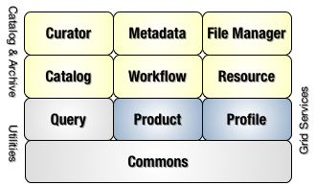
OODT Components
Software Components
  Catalog/Archive Services
    Data/file mgmt/workflow mgmt
    Curation and metadata management
    Distributed, scalable
  Grid Services
    Profile Services – discovery of resources/data
    Product Services – access/transformation of data
    Query Services – query federation
    Web Grid – web-based messaging to connect services
Core Data Models for managing catalogs and resources
Domain Models for capturing specific data and metadata objects

Slide 25
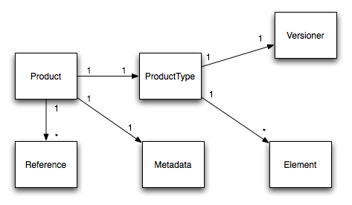
OODT Data Models (CAS File Management)
http://oodt.apache.org/components/maven/filemgr/development/developer.html

Slide 26
Catalog/Archive Services

Slide 27
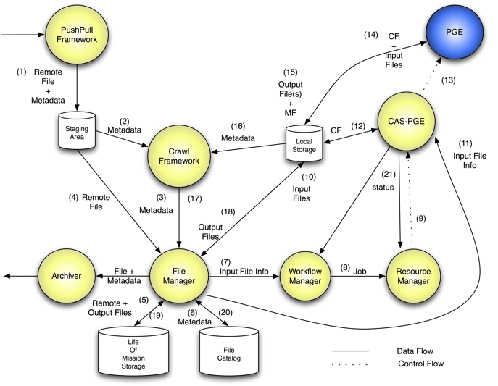
OODT CAS Components & Functions
Automatic File Ingestion
Product Delivery
Information Management & Process Control

Slide 28






OODT Data Models (Resources, Queries)
nasa.pds.xmlquery
XMLQuery
XMLQuery
-
1
fromSet
-
resultModeId: String
resultModeId: String
-
-
propogationType: String
propogationType: String
QueryElement
-
1
selectSet
QueryElement
-
propogationLevels: String
propogationLevels: String
-
-
role: String
-
role: String
-
maxResults: int
maxResults: int
1
whereSet
-
-
value: String
-
value: String
-
kwqString: String
kwqString: String
-
-
numResults: int
numResults: int
-
-
mimeAccept: List
mimeAccept: List
1
1
queryHeader
result
1
QueryHeader
QueryHeader
-
-
id: String
id: String
QueryResult
-
1
QueryResult
-
title: String
title: String
-
-
list: List
-
list: List
-
description: String
description: String
-
-
type: String
type: String
-
-
statusID: String
statusID: String
-
-
securityType: String
securityType: String
-
-
revisionNote: String
revisionNote: String
-
-
dataDictID: String
dataDictID: String
Based on Dublin Core
Request/Response Model
Resource Metadata Model
Based on ISO/IEC 11179

Slide 29
Conceptual Search/Retrieval Pattern
Name Server
Name Server
Name Server
Node 1
Profile Server
Web I/F
Node 1
Profile Server
Node 1
Profile Server
Query Server
XMLQuery
Node 1
Profile Server
Web server
Plugins
Web Server
XMLQuery
Resource
Catalogs
QueryClient
XMLQuery
Repository Node
Product Server
Desktop I/F
XMLQuery
XMLQuery
Node 1 Products
XMLQuery
Repository Node
Product Server
XMLQuery
Node 2 Products
XMLQuery
…
Repository Node
Product Server
Node N
Products

Slide 30
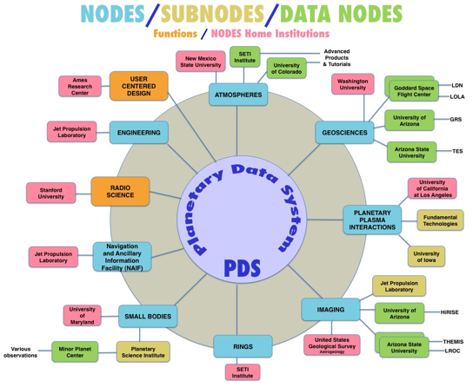
NASA Planetary Data System
Purpose: to collect, archive and make accessible digital data and documentation produced from NASA’s exploration of the solar system
Infrastructure: a highly distributed infrastructure with planetary science data repositories implemented at major government labs and academic institutions
  All data is captured based on a common set of standards
  Approximately 500 TBs of data
  Movement towards international interoperability
  Implemented Apache OODT in 2002 to share data
Credit: S. Hughes, D. Crichton,
S. Kelly, S. Hardman, P. Ramirez

Slide 31
Application as a Science Data System for Earth Satellite Missions
Leveraged Apache OODT for constructing ground data systems for earth science missions
  Used OODT Catalog and Archive Service software
  Focus is on File & Workflow Management
  First application in 2002 to SeaWinds & QuikSCAT
Constructed “workflows”
  Execution of “processors” based on a set of rules
  Explicit separation of workflow management from management of computational resources
Provided “lights out” operations
Multiple Missions
  SeaWinds
  QuikSCAT
  Orbiting Carbon Observatory (OCO), OCO-2…
  NP Sounder PEATE
  SMAP
SeaWinds on ADEOS II (Launched
Dec 2002)
Credit: S. Hardman, D. Freeborn, C. Mattmann,
D. Crichton

Slide 32

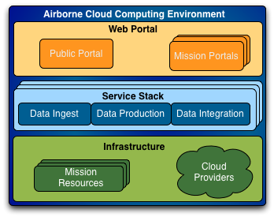

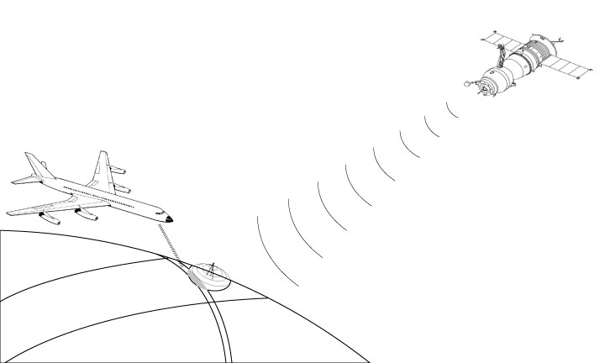
Application to Airborne Science Missions
Users & Science
Community
Modeling &
Visualization
Spacecraft
& Other Data Sources
Airborne
Data
Ground
Sensors
A data management infrastructure based on Apache OODT (2011)
Credit: D. Freeborn, D. Woollard, E. Law, D. Crichton, L. Kay-Im,
32

Slide 33


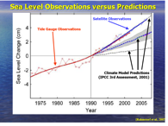





Application to Climate Research
Support for Model Evaluation
How to bring as much observational scrutiny as possible to the IPCC process?
How to best utilize the wealth of NASA Earth observations for the IPCC process?
Next Target : IPCC AR5
Model Output Available for Analysis Spring 2011
Papers Due ~ Late 2011/Early 2012
Report Completion 2013

Slide 34

Earth System Grid Federation

Slide 35

Application to Climate Research
(…Climate Data Exchange)
Specific Tools
(H2O, CO2, …)
Credit: A. Braverman, C. Mattmann, D. Crichton,
L. Cinquini, M. Cayanan

Slide 36


Lunar Mapping & Modeling Project (LMMP)
Purpose: Access to lunar data (e.g., images) and models for mission planning purposes
Infrastructure: LMMP has developed a geospatial infrastructure that manages lunar data products and a portal for data access & analysis (distributed, cloud-based infrastructure built on Apache OODT in 2011)
Capability: It supports generation and access to a diverse collection of FGDC model based lunar data products resulted from historical and recent lunar missions (models, imageries, maps)
PDS & other Data Systems
Science Community,
Data Analysis & Modeling,
General Public
Moon
Lunar
Spacecraft
/ Lander
Standard I/F Protocol
Standard Data Model
Data Management & Access
Data Storage, Data Processing
Data Generation
Workflow, Web Portal
Knowledge Base
Tools / Services
Visualization
Distribution/Movement
Ground Communication / Data System
DS Tools
DS Tools
DS Tools
Mission Operations/
Planning
Instrument /Sensor
Operations
Program
Planning
Credit: E. Law, S. Mohaltra, B. Bui, P. Ramirez

Slide 37



Radio Astronomy and Big Data
Leverage Apache OODT infrastructure to prototype JPL’s ability to construct SKA and radio science relevant software services
  Science-user focused processing
  Build SKA data archive prototype
Radio Astronomy Challenges
Square Kilometer Array will return exabyte scale data results
OODT being used as a platform for exploring approaches to build the archives
Other NSF efforts underway to explore OODT and Big Data in Astronomy
Credit: C. Mattmann, A. Hart, L. Cinquini

Slide 38


Application to Biomedical Research
“To thrive, the field that links biologists and their data urgently needs structure, recognition and support. The exponential growth in the amount of biological data means that revolutionary measures are needed for data management, analysis and accessibility. Online databases have become important avenues for publishing biological data.” – Nature Magazine, September 2008
EDRN is a network of over 40 principal investigators in the U.S. that enables sharing and analysis of cancer biomarker data.
Leverage Apache OODT in 2001 to capture, manage, share, and analyze data for the EDRN enterprise.
38
DJC-38
38
38

Slide 39

Application to Cancer Research: Early Detection Research Network
Purpose: Construction of a knowledge environment to advance early detection of cancer biomarker research
Infrastructure: EDRN has developed a comprehensive infrastructure to support biomarker data management across EDRN’s distributed cancer centers based on Apache OODT
  Collaborative, Distributed
  Informatics elements span multiple organizations
  Model for biomarker discovery and validation
Capability: It supports capture and access to a diverse collection of distributed sets of information and results based on a core ontology for biomarker research
  Biomarkers
  Biospecimens
  Scientific Data Sets
  Protocols
From: distributed research databases
Credit: D. Crichton, C. Mattmann, S. Kelly
A. Hart, H. Kincaid, R. Verma

Slide 40




Medicine: The
Patient is the Data…
This is where evidence and information start

Slide 41




NASA/JPL and CHLA Collaboration
Funded in 2009 by US National Library of Medicine to explore a decision support infrastructure for linking data within and across PICUs
  Based on early work from Wetzel/Crichton in 2003
NASA Jet Propulsion Laboratory
  Developed several national data management infrastructures for sciences including efforts in both space science and biology
  Leverage Apache OODT to bring data together
  Leverage JPL approaches for data analysis
Childrens Hospital Los Angeles
  Experts in critical care medicine
  Project management for the VPICU
  Diverse sets of disparate patient-centric data
  Director of the Virtual Pediatric Intensive Care Unit
D. Crichton
R. Wetzel

Slide 42



Towards these Goals:
The VPICU Information Grid
Data extraction from multiple disparate data sources, preferably automated;
A rationalized, secure data architecture built on Apache OODT
Robust analytical computational tools applicable to large sets of clinical data to develop digital representations of groups of patients with known outcomes; and similar derived analytical computational tools applicable to individuals, who have an unknown and potentially alterable outcome.
Ultimately, learning from the data…
Credit: D. Crichton, R. Wetzel,
C. Mattmann, A. Hart, D. Kale,
P. Vee

Slide 43
Conclusion: Apache OODT and Big Data Management Beyond Science
While OODT is addressing big data management challenges for science, many of OODT’s architectural patterns are not unique!
Common challenges OODT is helping to address:
  How to you capture massive data repositories for analysis?
  How do you develop methods for processing data?
  How do you analyze data from highly distributed data repositories?
  How do you tie together distributed resources from data to computation to drive integrated data analysis?

Slide 44
Get Involved!
Learn more and track our progress at:
  http://oodt.apache.org
Join the mailing list:
  oodt-dev@oodt.apache.org
Chat on IRC:
  #oodt on irc.freenode.net
Acknowledgements
  Key Members of the OODT teams@JPL: Chris Mattmann, Steve Hughes, Andrew Hart, Sean Kelly, Sean Hardman, Paul Ramirez, David Woollard, Brian Foster, Dana Freeborn, Emily Law, Mike Cayanan, Luca Cinquini, Heather Kincaid, Rishi Verma, Cameron Goodale, Mike Joyce
  Projects, Sponsors, Collaborators: Planetary Data System, Early Detection Research Network, Climate Data Exchange, Virtual Pediatric Intensive Care Unit, NASA SMAP Mission, NASA OCO-2 Mission, NASA NPP Sounder Peate, NASA ACOS Mission, Earth System Grid Federation

Slide 45
THANK YOU
Contact
Dan Crichton
NASA JPL
Dan.Crichton@jpl.nasa.gov
What’s being
observed

