Slide 1
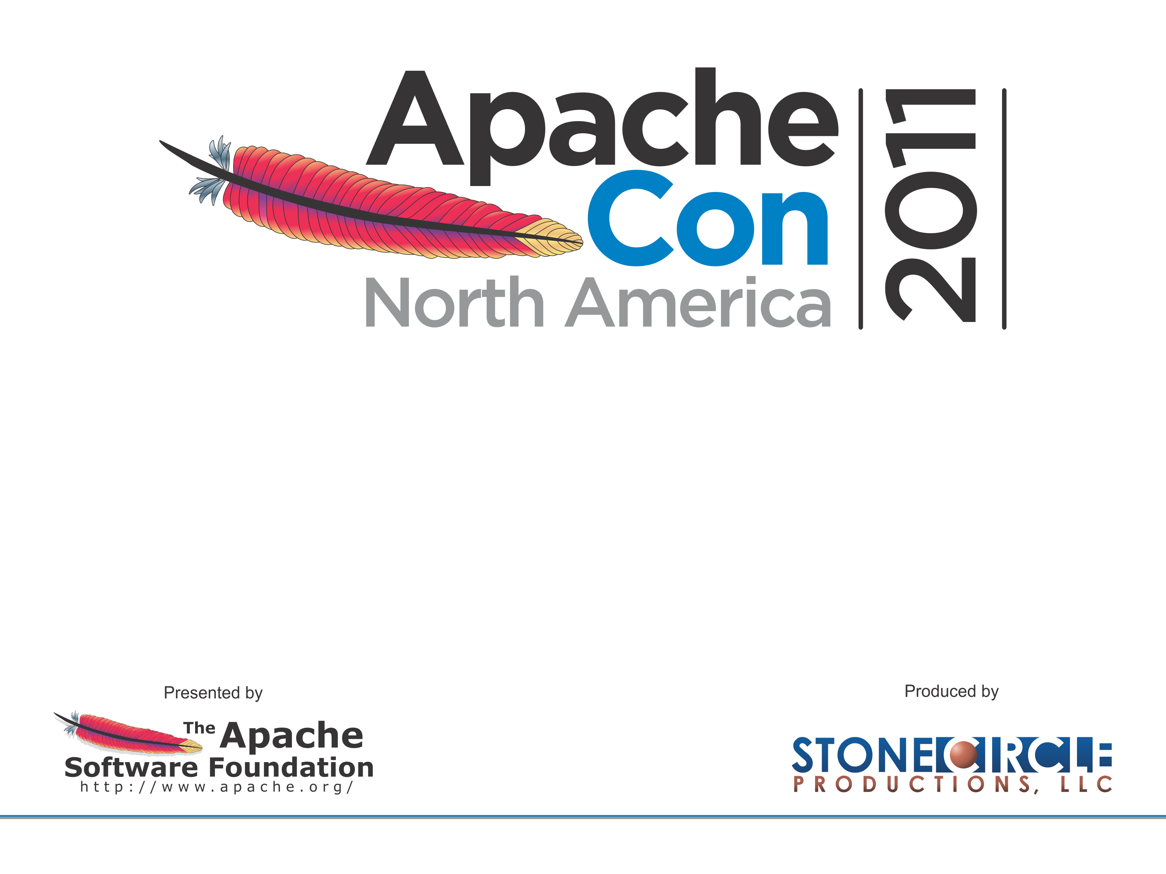
Content Repositories with
CMIS and Apache Chemistry
Stephan Klevenz, SAP AG
stephan.klevenz@sap.com, November 2011

Slide 2
CMIS & Apache Chemistry
State of the Art Content Repositories with CMIS & Apache Chemistry
Unstructured Content – everywhere
Context
  CMIS – an OASIS Standard
  Apache Chemistry – an Open Source Implementation of CMIS
  Just Commodity? Or is there a challenge?
Discussion and Q&A

Slide 3
That’s me
Stephan Klevenz
Committer of Apache Chemistry
Member of OASIS CMIS Technical Committee
Software Architect at SAP AG
Expertise in
  Building Business Applications (ERP) in relation to Enterprise Content Management
  Long Distance and Open Water Swimming

Slide 4
Standardization History
Operating System Level
  SMB aka CIFS, Microsoft, IBM, 1983
  NFS, Sun, 1984
  Samba, Sun, Microsoft, 1992
Web Protocol
  WebDAV, IETF, 1996
  CMIS, OASIS, 2008
APIs
  JCR – Java JSR170, JSR283, 2002

Slide 5
Conten Management Interoperability Services
Founding CMIS
  Initiators – IBM, Microsoft and EMC
  Supporters – OpenText, Alfresco, Oracle, SAP and others in 2008
Technical Committee at OASIS
  TC founded in November 2008
  Since then in working mode
Current State
  CMIS 1.0 – released since 05/2010
  Many DMS vendors support CMIS already in their current products

Slide 6





















50+ CMIS implementations
Providers
Consumers

Slide 7
CMIS – Big Picture

Slide 8
CMIS - Capabilities
Domain Model
  Document – Content Stream, Renditions
  Folder – Hierarchy, Paths, File-able Objects
  Relation – Relationship Object-Type Definition
  Policy – Policy Object-Type Definition
Capabilities
  Repository Services – Repository Info, Types
  Navigation Services – Children, Tree, Descendants
  Object Services – CRUD, Properties, Content Stream, Renditions, Versioning
  Multi-Filing Services – add Object to Folder
  Discovery Services – Query, Content Changes
  ACL – getAcl, applyAcl
Supported Bindings in Version 1.0
  Atom Pub – REST Protocol Binding
  Web Services – SOAP Protocol Binding

Slide 9

CMIS - Outlook
The CMIS 1.1 specification is on the way.
Accepted new features:
Browser Binding (JSON)
Type Mutability
Under consideration:
Retention & Hold Management
Secondary Types

Slide 10
Recap CMIS
Standards
Founding CMIS
Big Picture
Capabilities
Outlook Version 1.1

Slide 11

Apache Chemistry OpenCMIS is a de-facto reference for CMIS and is also used by the CMIS TC to test new CMIS 1.1 features.
Apache Chemistry started as an incubator project in May 2009 and graduated to a top level project in February 2011.
Apache Chemistry is backed by Adobe, Alfresco, Metaversant, Nuxeo, OpenText, and SAP.

Slide 12
Apache Chemistry - Overview
Open Source implementations of CMIS.
Apache Chemistry is the project to build a CMIS OSS
community within the ASF.
OpenCMIS (Java, client and server)
cmislib (Phyton, client)
phpclient (PHP, client)
DotCMIS (.NET, client)

Slide 13
Apache Chemistry - OpenCMIS

Slide 14
Implement a Server
Define a web application project
  Maven
  Use InMemory Server POM as template
Define and implement Service Factory
  Property File as Web Resource
  class=org.foo.MyServiceFactoryImpl
Implement AbstractCmisService

Slide 15
AbstractCmisService
public class MyServiceImpl extends AbstractCmisService {
@Override
public List<RepositoryInfo> getRepositoryInfos(ExtensionsData arg0) {
RepositoryInfoImpl repoInfo = new RepositoryInfoImpl();
String rootFolderId = „1000“;
repoInfo = new RepositoryInfoImpl();
// set capabilities
RepositoryCapabilitiesImpl caps
= new RepositoryCapabilitiesImpl();
caps.setAllVersionsSearchable(false);
caps.setCapabilityAcl(CapabilityAcl.NONE);
caps.setCapabilityChanges(CapabilityChanges.NONE);
caps.setCapabilityContentStreamUpdates(
CapabilityContentStreamUpdates.NONE);
caps.setCapabilityJoin(CapabilityJoin.NONE);
caps.setCapabilityQuery(CapabilityQuery.NONE);
caps.setCapabilityRendition(CapabilityRenditions.NONE);
caps.setIsPwcSearchable(false);
caps.setIsPwcUpdatable(false);
caps.setSupportsGetDescendants(true);
caps.setSupportsGetFolderTree(true);
caps.setSupportsMultifiling(false);
caps.setSupportsUnfiling(false);
caps.setSupportsVersionSpecificFiling(false);
repoInfo.setId(”apache");
repoInfo.setName(”Apache-Repository");
repoInfo.setDescription(”Apache CMIS Demo");
repoInfo.setCmisVersionSupported("1.0");
repoInfo.setCapabilities(caps);
repoInfo.setRootFolder(rootFolderId);
repoInfo.setPrincipalAnonymous("anonymous");
repoInfo.setPrincipalAnyone("anyone");
repoInfo.setThinClientUri(null);
repoInfo.setChangesIncomplete(Boolean.TRUE);
repoInfo.setChangesOnType(null);
repoInfo.setLatestChangeLogToken(null);
repoInfo.setVendorName(”ApacheDemo");
repoInfo.setProductName(”Apacher Demo-Server");
repoInfo.setProductVersion("1.0");
repoInfo.setAclCapabilities(null);
List<RepositoryInfo> repoInfoList = new
ArrayList<RepositoryInfo>();
repoInfoList.add(repoInfo);
return repoInfoList;
}
...
}

Slide 16
Apache Chemistry - Challenge
CMIS and Chemistry as the SQL and ODBC for Content Repositories

Slide 17
Apache Chemistry - Opportunity
There is no SQL and no ODBC for NoSQL Databases today!

Slide 18
Example: ECM in the Cloud

Slide 19
Demo

Slide 20
Recap Apache Chemistry
Overview about Apache Chemistry
OpenCMIS
Building a Content Repository Server
ODBC/JDBS, NoSQL, Cloud
Demo

Slide 21
Q & A

Slide 22
Sources
Links
  Coverpages: http://xml.coverpages.org/cmis.html
  OASIS CMIS: http://www.oasis-open.org/committees/tc_home.php?wg_abbrev=cmis
  Apache Chemistry: http://chemistry.apache.org

Slide 23
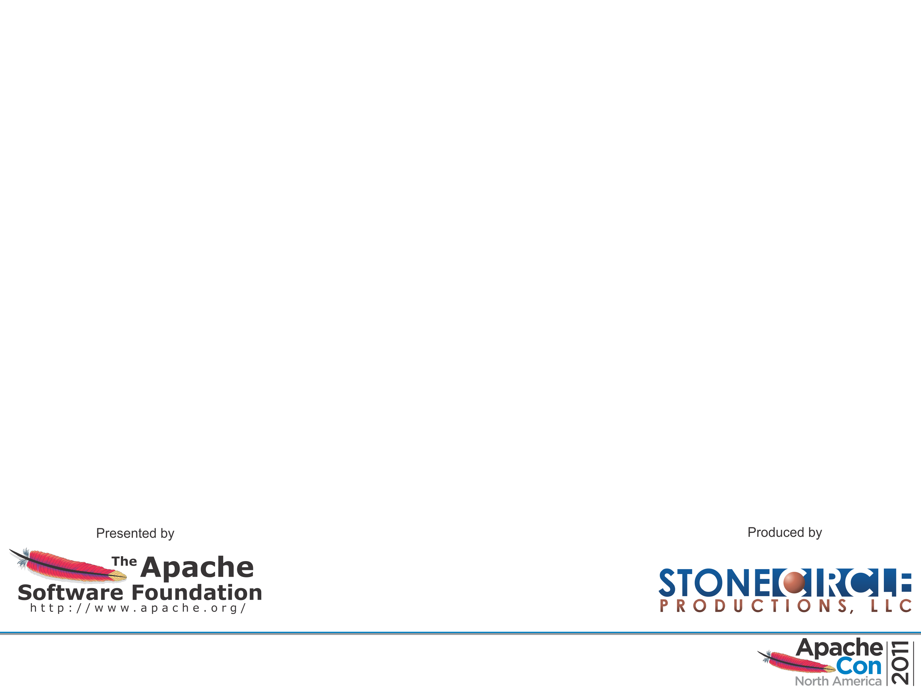
Contact
Stephan Klevenz
  stephan.klevenz@sap.com
  Twitter: @sklevenz

