Slide 1

Using OODT to Support Data-driven Clinical Decision Support
Andrew Hart
Jet Propulsion Laboratory, California Institute of Technology
ahart@apache.org, 2011.11.09

Slide 2
What I Will Cover…
What is the VPICU?
VPICU Research Data Challenges
Data System Architectural Principles & Approach
Overview of the Data System Architecture
OODT Components in VPICU
Next Steps
An earlier version of this talk was given at the 2010 O’Reilly Open Source Convention, in Portland, OR.
http://www.youtube.com/watch?v=KZd6YJtCWfQ

Slide 3
My Background
Andrew Hart
NASA Jet Propulsion Laboratory
  Software Engineer
  Data Management Systems and Technologies Group
Expertise / Interests:
  Committer/PMC member Apache OODT
  Interested in Web User Interfaces, User Experience, Data Management

Slide 4
OODT Background
“A data grid software infrastructure for constructing large-scale, distributed data-intensive systems”
Reference Architecture
Software Product Line
Reusable Components
Common Patterns

Slide 5
What’s a VPICU?

Slide 6
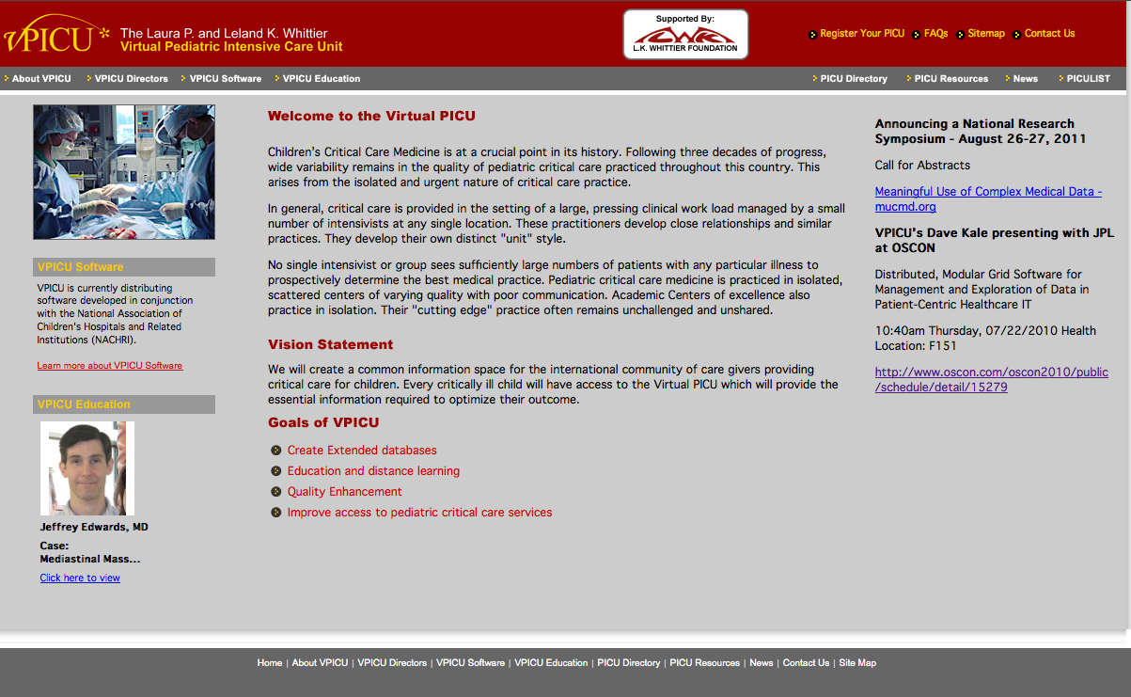
What is the VPICU?
Whittier Virtual Pediatric Intensive Care Unit
  Children’s Hospital Los Angeles
  Multi-disciplinary
    Clinical Intensivists
    Data Modeling
    Data Mining
    Software Engineering

Slide 7
VPICU Vision
To create a common information space for the international community of care givers providing critical care for children.
Every critically ill child will have access to the Virtual PICU which will provide the essential information required to optimize their outcome.

Slide 8
VPICU projects
Data extraction and management
Take data from proprietary stores, make it accessible
Data-driven decision support
Tools that learn continuously from the data
National, distributed data-sharing network
Enable research on scales previously impossible while maintaining security, privacy, compliance
Other projects (beyond the scope of this talk):
  Standardized benchmarking for PICU performance
  Support for clinical practice and research at CHLA
  Integration of tele-presence technology into PICU practice

Slide 9



How did this happen?

Slide 10
Collaboration Background
Prior working relationship between two principals
Funded National Library of Medicine grant
American Recovery and Reinvestment Act
2 years to make it happen

Slide 11
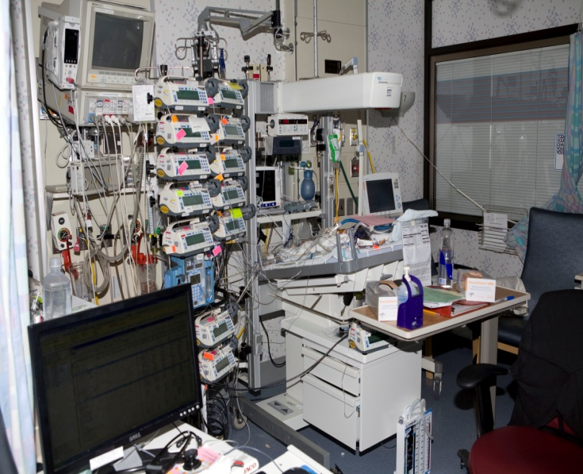
What Data are we Collecting?

Slide 12
Research Data Challenges in the VPICU

Slide 13
VPICU Research Data Challenges
Secondary use of observational clinical data
  Collected for clinical purposes
  Not optimized for research
  Online (real-time query) access mostly actively discouraged
Many data sources and technologies
Proprietary formats
Missing or incomplete records
  Gathered over time, highly variable annotations
Restrictions on use
  Legal, ethical, privacy considerations associated with research use

Slide 14
VPICU Research Data Challenges
VPICU Research Data
  Collected for clinical use
  Massive (…and growing)
  Incomplete, proprietary descriptions
  Fragmented across data stores
  Incomplete, inconsistent
  Highly restricted
Ideal Research Data
  Collected for research purposes
  Manageable size, static
  Well-described, annotated
  Self-contained
  Complete, internally consistent
  Minimal restrictions on use

Slide 15
VPICU Data System Principles

Slide 16
VPICU System Architectural Principles
P1 Loose Coupling - Allows components of the data system to independently evolve, allows easier maintenance, and insulated impact.
P2 Distributed Deployment - Distributing, replicating, and allowing for discovery and identification of services supports NFPs like security, extensibility, and scalability. For the VPICU system, each major subsystem can communicate using common protocols.
P3 Information-model Driven - Data system objects and metadata can be described, and validated independently of the system. The information model helps to codify data relationships and exchange of data. In VPICU, the model describes the nature of the data products processed through the system.

Slide 17
VPICU System Architectural Principles
P4 Extensibility, Scalability, Security - Non-functional properties guiding the development and deployment of the VPICU data system components.
P5 Technology Independence - Database vendors, middleware platforms, and analysis tools change frequently. The VPICU system should be able to adapt to such changes.
P6 Open Standards - Data systems and components should be constructed using open standards to reduce vendor lock, and increase the ability to leverage common components

Slide 18
VPICU Systematic Approach

Slide 19
VPICU Systematic Approach
Develop a common model to describe the information space.
Develop compute services that support extraction of data from existing CHLA databases.
Identify mechanisms to integrate data from disparate sources into a common repository and map them to the information model.
Construct a set of online research databases to enable data mining and analysis.

Slide 20
VPICU Systematic Approach, Cont’d
Deploy a data grid infrastructure of hardware & software to facilitate utilization of the data environment by external entities and applications.
Deploy a set of compute services to support data mining and analysis.
Develop an architectural plan and roadmap for scaling and integrating other PICUs.

Slide 21
VPICU Information Model

Slide 22
VPICU Information Model
An ontological representation of the concepts and relationships in the data

Slide 23
VPICU Information Model
A “Data Dictionary” to provide a common interpretation of terminology for inconsistently annotated data
  Name
  Alias
  Units of measure
  Valid Ranges
  Equivalence Codes in other taxonomies (e.g.: ICD-9, SNOMED-CT)

Slide 24
VPICU Information Model
Infused into each stage of the VPICU data system architecture
Enables the “loosely connected components” approach
Common metadata supports a multi-institution, distributed data environment
Critical to being able to effectively catalog and archive data for long-term usability

Slide 25
VPICU Data System
Architecture

Slide 26
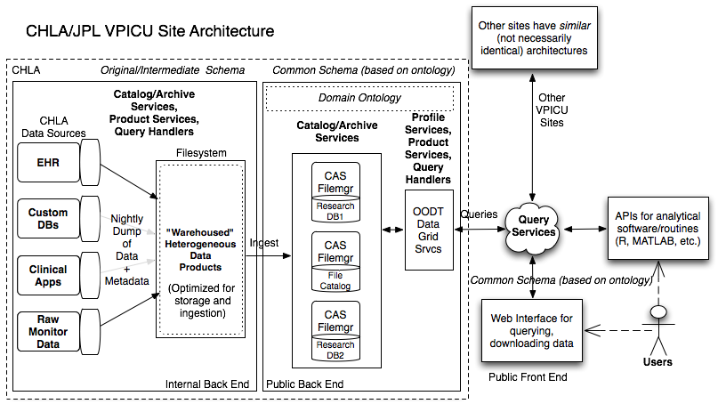
VPICU Data System Architecture
workflow
workflow
workflow

Slide 27
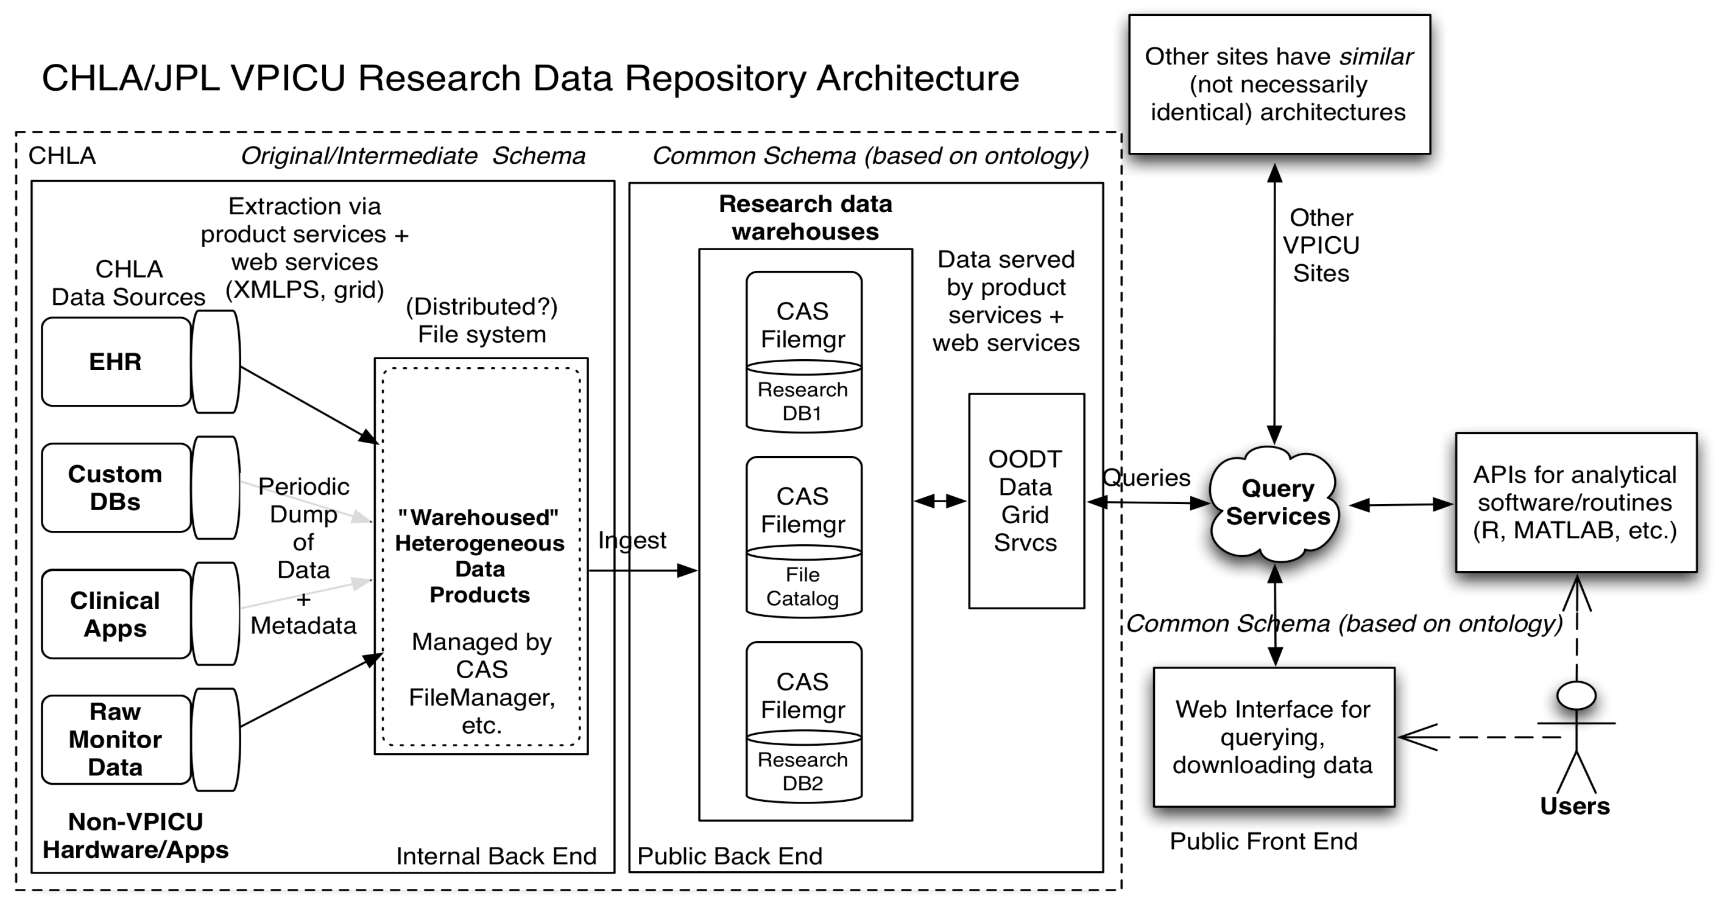
VPICU Data System Architecture
Decouple from (proprietary) vendor databases
  Online queries not always possible
  Proprietary formats complicate integration
  Long-term availability not guarantee
  Periodic extractions to “staging” files
  Files are universal data connectors
  Stored on local hardware
  Minimal transformation; just get data
  Schedule to minimize impact on production (clinical) servers.

Slide 28
VPICU Data System Architecture
Integrate data from disparate sources into a long-term data archive using a common domain model
  Leverage the information model to overlay a common conceptual representation
  Annotate data with consistent terminology
  Create an archive for the data, and a catalog for the metadata

Slide 29
VPICU Data System Architecture
Provide an environment for executing dynamic, configurable processing tasks ( e.g. computational “workflows”)
  Develop processing pipelines that perform specific tasks (de-identification, de-duplication, normalization, etc.) on the data to prepare it for research use
  Provide a single standard interface (and API) for accessing raw VPICU research data
  Generate research-ready databases or datasets by invoking workflow tasks on raw VPICU data
workflow

Slide 30
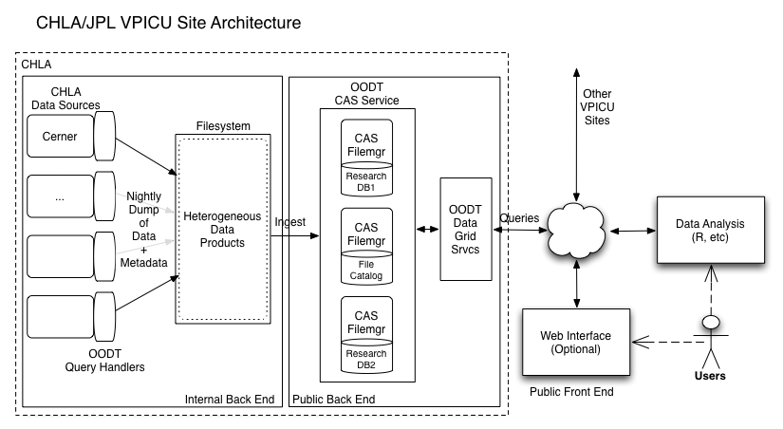
What are “research databases?”
Designed for specific research questions, analytical techniques
Need not always be relational or databases at all
Available via web interfaces and software services
Researcher using R can connect directly through R bindings
Examples:
  Relational database for traditional retrospective studies
  Search engine over free text clinical notes, etc.
  Patient/patient comparison, retrieval (find patient like this one)
  Data-backed patient simulator for “testing” interventions
Public-facing, de-identified
* Available to legitimate researchers

Slide 31
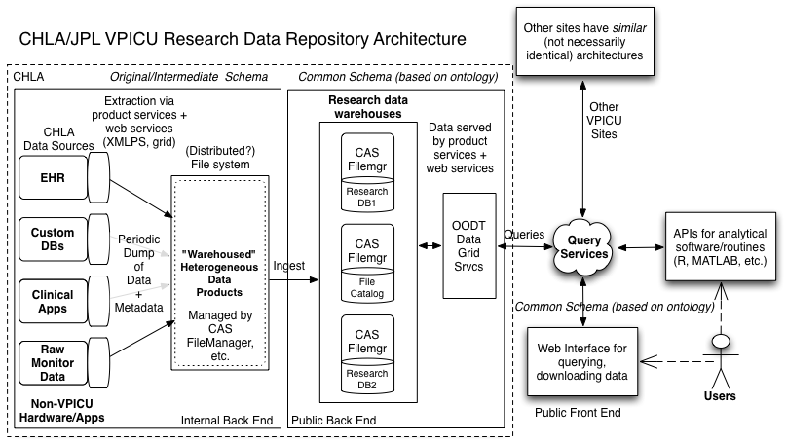
VPICU Data System Architecture
Provide options for multi-faceted access to the data to enable discovery & analysis
  Tiered data portal with secure, role based access to features and data
  Direct access via language-specific bindings and/or RESTful services
31

Slide 32
VPICU Data System Architecture
workflow
workflow
workflow

Slide 33
Recall…
Grant funded…
+ 2 Year fixed timeline…
+ Ambitious goals
= Not a lot of resources available to develop robust, scalable data system components from scratch

Slide 34
OODT to the Rescue

Slide 35
OODT + VPICU
OODT components form the base of every phase of the VPICU data system architecture.
Most of the actual data system effort is configuration
…plus a little bit of wrapper code

Slide 36
VPICU Architecture
OODT Components in Use
  OODT Xml Product Service (XML-PS)
  OODT Web Grid
    Container for XML-PS
    RESTful query interface
Function:
  Extraction from proprietary, upstream data sources
  Alignment to common information model
EHR
Homegrown
Clinical apps
File-based storage
Monitor data
Proprietary data sources

Slide 37
OODT Components in Use
  OODT Crawler
    Directory crawling, staging
  OODT File Manager
    Cataloging and archiving
Function:
  Ingestion of raw data products into a heterogeneous, long-term archive we control
File-based storage
VPICU-owned resources

Slide 38
“Research databases”
OODT Components:
OODT File Mgr
OODT Workflow Mgr
OODT Resource Mgr
OODT PCS PGE
OODT PCS Services
Function:
Development of research data products for end-users
File-based storage

Slide 39
OODT Components:
OODT File Manager
OODT Web Grid
OODT Balance
Function:
Dissemination of research data products to the community
File-based storage

Slide 40
VPICU Architecture
File-based storage

Slide 41
Wrapping Up

Slide 42
VPICU Data System Wrap-Up
Development of a long-term archive & metadata catalog of PICU patient data from multiple sources, aligned to a common information model, suitable for development of purpose-driven research databases/datasets generated by applying customizable, reusable workflows to the raw data.

Slide 43
VPICU Data System Wrap-Up
The NLM investment in the CHLA/JPL partnership has resulted in an architecture that Improves accessibility of PICU data resources. OODT provides an open-source, low-cost component framework suitable as the software backbone for a national network of connected PICU sites.

Slide 44
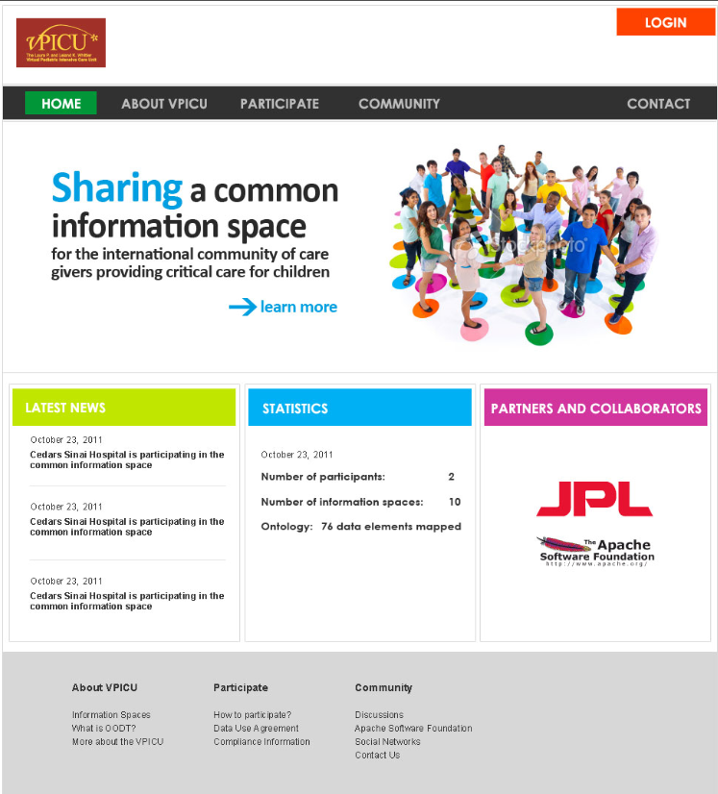
VPICU Data System Next Steps
Making the public face of the data system
Building streamlined interfaces for access
Fostering collaboration among principals

Slide 45
VPICU Data System Next Steps
Iteratively improve the existing CHLA deployment
  Additional datasets, workflows
  Improved management, configuration
Support federation among multiple PICU sites
  Data sharing among PICU sites to facilitate analysis and decision support
  Greater re-use of data, processing, and analysis algorithms

Slide 46
Acknowledgements
Jet Propulsion Laboratory: Dan Crichton, Chris Mattmann, Cameron Goodale, Sean Kelly, Steve Hughes, Amy Braverman, Thuy Tran
Children’s Hospital Los Angeles:
Randall Wetzel, Paul Vee, David Kale, Roby Khemani, Ptrick Ross, Jeff Terry, Robert Kaptan, Doug Hallam

Slide 47
More Information - VPICU
Phone:
323.361.2557
Email:
Paul.Vee@chla.usc.edu
Address:
4650 Sunset Blvd. MS#12
Los Angeles, CA 90027
We will create a common information space for the international community of care givers providing critical care for children. Every critically ill child will have access to the Virtual PICU which will provide the essential information required to optimize their outcome.
Web:
www.vpicu.org

Slide 48
More Information - OODT
Web:
  http://oodt.apache.org
JIRA:
  https://issues.apache.org/jira/browse/OODT
Wiki:
  https://cwiki.apache.org/confluence/display/OODT
Email:
  user@oodt.apache.org

Slide 49
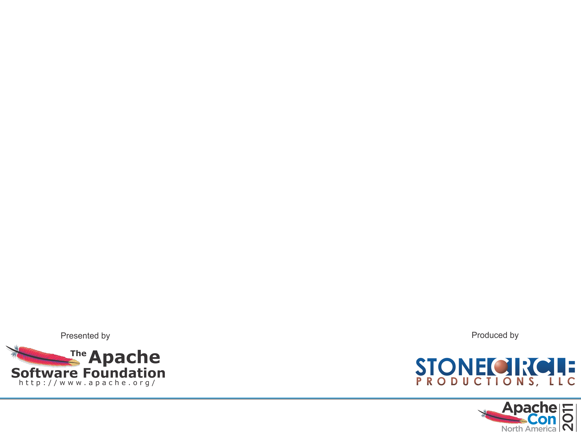
Contact
Andrew Hart
  ahart@apache.org
  http://people.apache.org/~ahart
  @andrewfhart on Twitter

Slide 50
Thanks!

