Slide 1
Is Your IndexReader Really Atomic or Maybe Slow?
Uwe Schindler
SD DataSolutions GmbH, uschindler@sd-datasolutions.de

Slide 2
My Background
Committer and PMC member of Apache Lucene and Solr - main focus is on development of Lucene Java.
Implemented fast numerical search and maintaining the new attribute-based text analysis API. Well known as Generics and Sophisticated Backwards Compatibility Policeman.
Working as consultant and software architect for SD DataSolutions GmbH in Bremen, Germany. The main task is maintaining PANGAEA (Publishing Network for Geoscientific & Environmental Data) where I implemented the portal's geo-spatial retrieval functions with Apache Lucene Core.
Talks about Lucene at various international conferences like the previous Lucene Eurocon and ApacheCon EU/US, Berlin Buzzwords, Lucene Revolution, and various local meetups.

Slide 3
Agenda
Motivation / History of Lucene
AtomicReader & CompositeReader
Reader contexts
Wrap up

Slide 4
Lucene Index Structure
Lucene was the first full text search engine that supported document additions and updates
Snapshot isolation ensures consistency
Segmented index structure
Committing changes creates new segments

Slide 5
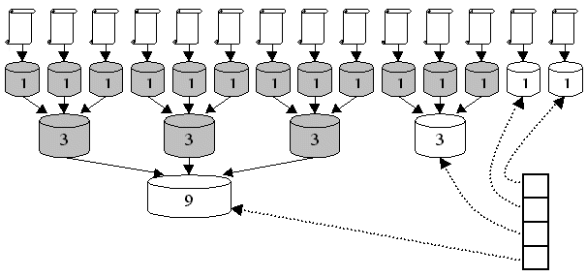
Segments in Lucene
Each index consists of various segments
placed in the index directory. All documents
are added to new new segment files, merged with other on-disk files after flushing.
Lucene writes segments incrementally and can merge them.
Optimized* index consists of one segment.
Image: Doug Cutting
*) The term “optimal” does not mean all indexes must be optimized!

Slide 6
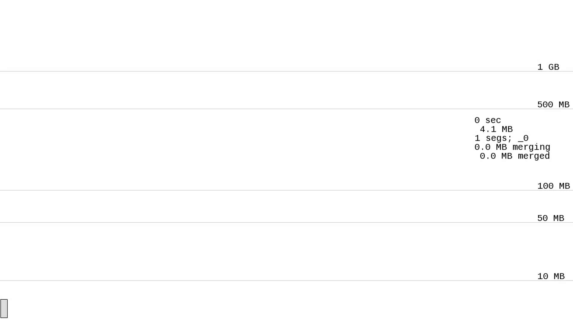
Lucene merges while indexing all of English Wikipedia
Video by courtesy of:
Mike McCandless’ blog, http://goo.gl/kI53f

Slide 7
Indexes in Lucene (up to version 3.6)
Each segment (“atomic index”) is a completely functional index:
  SegmentReader implements the IndexReader interface for single segments
Composite indexes
  DirectoryReader implements the IndexReader interface on top of a set of SegmentReaders
  MultiReader is an abstraction of multiple IndexReaders combined to one virtual index

Slide 8
Composite Indexes (up to version 3.6)
Atomic “views” on multi-segment index:
  Term Dictionary: on-the-fly merged & sorted term index (priority queue for TermEnum,…)
  Postings: posting lists for each term appended, convert document IDs to be global
  Metadata: doc frequency, term frequency,…
  Stored fields, term vectors, deletions: delegate global document IDs -> segment document IDs (binary search)
  FieldCache: duplicate instances for single segments and composite view (memory!!!)

Slide 9
Merging Term Index and Postings

Slide 10
Composite Indexes (up to version 3.6)
Atomic “views” on multi-segment index:
  Term Dictionary: on-the-fly merged & sorted term index (priority queue for TermEnum,…)
  Postings: posting lists for each term appended, convert document IDs to be global
  Metadata: doc frequency, term frequency,…
  Stored fields, term vectors, deletions: delegate global document IDs -> segment document IDs (binary search)
  FieldCache: duplicate instances for single segments and composite view (memory!!!)

Slide 11

Searching before Version 2.9
IndexSearcher used the underlying index always as a “single” (atomic) index:
  Queries are executed on the atomic view of a composite index
  Slowdown for queries that scan term dictionary (MultiTermQuery) or hit lots of documents, facetting
  => recommendation to “optimize” index
  On every index change, FieldCache used for sorting had to be reloaded completely
Image: © The Walt Disney Company

Slide 12
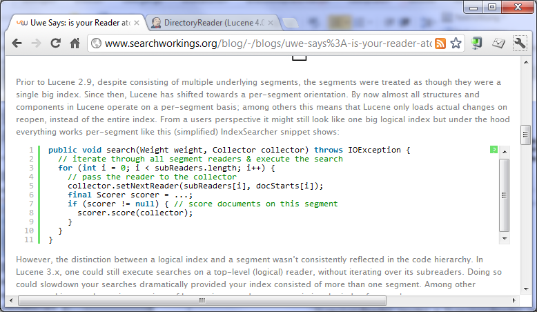
Lucene 2.9 and later:
Per segment search
Search is executed separately on each index segment:
Atomic view no longer used!

Slide 13
Per Segment Search: Pros
No live term dictionary merging
Possibility to parallelize
  ExecutorService in IndexSearcher since Lucene 3.1+
  Do not optimize to make this work!
Sorting only needs per-segment FieldCache
  Cheap reopen after index changes!
Filter cache per segment
  Cheap reopen after index changes!

Slide 14
Per Segment Search: Cons
Query/Filter API changes:
  Scorer / Filter’s DocIdSet no longer use global document IDs
Slower sorting by string terms
  Term ords are only comparable inside each segment
  String comparisons needed after segment traversal
  Use numeric sorting if possible!!!
  (Lucene supports missing values since version 3.4 [buggy], corrected 3.5+)

Slide 15
Agenda
Motivation / History of Lucene
AtomicReader & CompositeReader
Reader contexts
Wrap up

Slide 16
Composite Indexes (up to version 3.6)
Atomic “views” on multi-segment index:
  Term Dictionary: on-the-fly merged & sorted term index (priority queue for TermEnum,…)
  Postings: posting lists for each term appended, convert document IDs to be global
  Metadata: doc frequency, term frequency,…
  Stored fields, term vectors, deletions: delegate global document IDs -> segment document IDs (binary search)
  FieldCache: duplicate instances for single segments and composite view (memory!!!)

Slide 17
Composite Indexes (version 4.0)
Atomic “views” on multi-segment index:
  Term Dictionary: on-the-fly merged & sorted term index (priority queue for TermEnum,…)
  Postings: posting lists for each term appended, convert document IDs to be global
  Metadata: doc frequency, term frequency,…
  Stored fields, term vectors, deletions: delegate global document IDs -> segment document IDs (binary search)
  FieldCache: duplicate instances for single segments and composite view (memory!!!)

Slide 18

Early Lucene 4.0
Only “historic” IndexReader interface
available since Lucene 1.0
80% of all methods of composite IndexReaders throwed UnsupportedOperationException
  This affected all user-facing APIs
  (SegmentReader was hidden / marked experimental)
No compile time safety!
  Query Scorers and Filters need term dictionary and postings, throwing UOE when executed on composite reader
Image: © The Walt Disney Company

Slide 19

Heavy Committing™ !!!
Image: © The Walt Disney Company

Slide 20

IndexReader
Most generic (abstract) API to an index
  superclass of more specific types
  cannot be subclassed directly (no public constructor)
Does not know anything about “inverted index” concept
  no terms, no postings!
Access to stored fields (and term vectors) by document ID
  to display / highlight search results only!
Some very limited metadata
  number of documents,…
Unmodifiable: No more deletions / changing of norms possible!
  Applies to all readers in Lucene 4.0 !!!
Passed to IndexSearcher
  just as before!
Allows IndexReader.open() for backwards compatibility (deprecated)

Slide 21
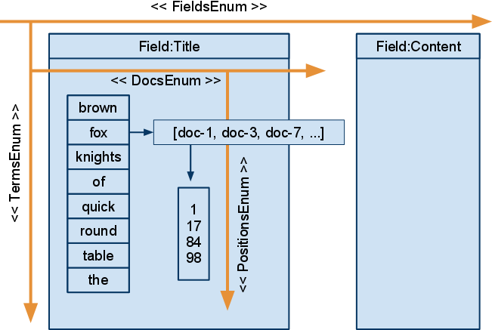
AtomicReader
Inherits from IndexReader
Access to “atomic” indexes (single segments)
Full term dictionary and postings API
Access to DocValues (new in Lucene 4.0) and norms

Slide 22
CompositeReader
No additional functionality on top of IndexReader
Provides leaves() to retrieve all atomic child readers
DirectoryReader and MultiReader implement this class

Slide 23
DirectoryReader
Abstract class, defines interface for:
  access to on-disk indexes (on top of Directory class)
  access to commit points, index metadata, index version, isCurrent() for reopen support
  defines abstract openIfChanged (for cheap reopening of indexes)
  child readers are always AtomicReader instances
Provides static factory methods for opening indexes
  well-known from IndexReader in Lucene up to 3.6
  factories return internal DirectoryReader implementation (StandardDirectoryReader with SegmentReaders as childs)

Slide 24
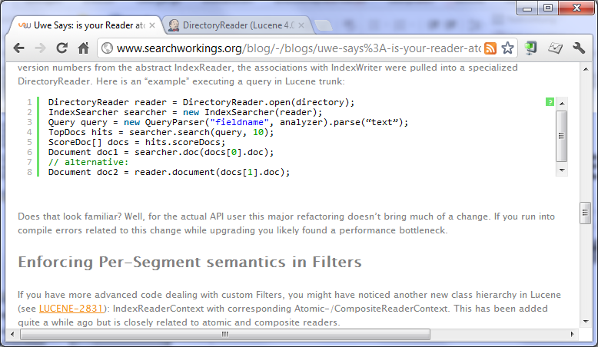
Basic Search Example
Looks familiar, doesn’t it?
Image: © The Walt Disney Company

Slide 25
“Arrgh! I still need terms and postings on my DirectoryReader!!! What should I do? Optimize to only have one segment? Help me please!!!”
(example question on java-user@lucene.apache.org)

Slide 26


What to do?
Calm down
Take a break and drink a beer*
Don’t optimize / force-merge your index!!!
*) Robert’s solution

Slide 27
Solutions
Most efficient way:
  Retrieve atomic leaves from your composite:
  reader.leaves()
  Iterate over sub-readers, do the work
  (possibly parallelized)
  Merge results
Otherwise: wrap your CompositeReader:

Slide 28

(Slow) Solution
AtomicReader
SlowCompositeReaderWrapper.wrap(IndexReader r)
Wraps IndexReaders of any kind as atomic reader, providing terms, postings, deletions, doc values
  Internally uses same algorithms like previous Lucene readers
  Segment-merging uses this to merge segments, too
Solr always provides an AtomicReader for convenience through SolrIndexSearcher. Plugin writers should use:
AtomicReader
rd = mySolrIndexSearcher.getAtomicReader()

Slide 29
Other readers
FilterAtomicReader
  Was FilterIndexReader in 3.x
  (but now solely works on atomic readers)
  Allows to filter terms, postings, deletions
  Useful for index splitters (e.g., PKIndexSplitter, MultiPassIndexSplitter)
  (provide own getLiveDocs() method, merge to IndexWriter)
ParallelAtomicReader, -CompositeReader

Slide 30
IndexReader Reopening
Reopening solely provided by directory-based DirectoryReader instances
No more reopen for:
  AtomicReader: they are atomic, no refresh possible
  MultiReader: reopen child readers separately, create new MultiReader on top of reopened readers
  Parallel*Reader, FilterAtomicReader: reopen wrapped readers, create new wrapper afterwards

Slide 31
Agenda
Motivation / History of Lucene
AtomicReader & CompositeReader
Reader contexts
Wrap up

Slide 32
WTF ?!?
IndexReaderContext
AtomicReaderContext
CompositeReaderContext

Slide 33
The Problem

Slide 34
The Problem

Slide 35
The Problem

Slide 36
Solution
Each IndexReader instance provides:
IndexReaderContext getContext()
The context provides a “view” on all childs (direct descendants) and leaves (down to lowest level AtomicReaders)
Each atomic leave has a docBase (document ID offset)
IndexSearcher passes a context instance relative to its own top-level reader to each Query-Scorer / Filter
  allows to access complete reader tree up to the current top-level reader
  Allows to get the “global” document ID

Slide 37
Agenda
Motivation / History of Lucene
AtomicReader & CompositeReader
Reader contexts
Wrap up

Slide 38
Summary
Lucene moved from global searches to per-segment search in Lucene 2.9
Up to Lucene 3.6 indexes are still accessible on any hierarchy level with same interface
Lucene 4.0 splits the IndexReader class into several abstract interfaces
IndexReaderContexts will support per-segment search preserving top-level document IDs

Slide 39

Learn more about Lucene 4.0:
Available at your newspaper dealer on November 8th, 2012!

Slide 40



Contact
Uwe Schindler
uschindler@apache.org
http://www.thetaphi.de
@thetaph1
  SD DataSolutions GmbH
  Wätjenstr. 49
  28213 Bremen, Germany
  +49 421 40889785-0
  http://www.sd-datasolutions.de
40

