Slide 1
Apache Hadoop at Yahoo!
Ready for Business
Chris Douglas
Hadoop Team
chrisdo@yahoo-inc.com
@chris_douglas
Notes:
Yahoo uses Apache Hadoop extensively. Yahoo is a technology company; its infrastructure complements its mission.
This talk will cover how Yahoo has used the Hadoop platform in the last five years to solve problems for its business,
How it has made changes in the Hadoop platform to complement its goals
How it has changed its operating environment to leverage its investment in Hadoop

Slide 2
Introductions
Apache Hadoop
  Full time contributor since May 2007
  Committer, Member of PMC
  Apache Member
Yahoo
  Hadoop HDFS, Performance, MapReduce development team

Slide 3
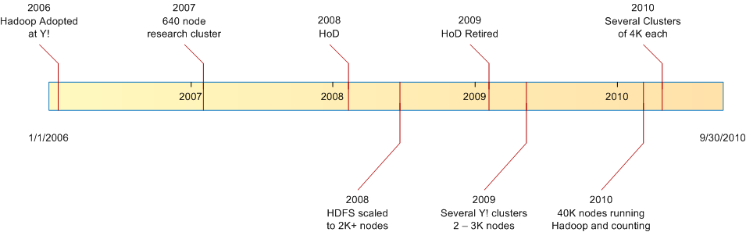
Timeline of Apache Hadoop at Yahoo
Hadoop is mission critical for Yahoo
Making Hadoop enterprise-ready for Yahoo
Notes:
Yahoo has supported contributors to Apache Hadoop since the start of 2006
Timeline: milestones in scaling Hadoop clusters and Hadoop adoption at Yahoo.
This presentation: cover what has driven Yahoo’s contributions, the effect on the technical direction
How business needs/structure trans into architecture and code
Briefly: emphasize how thoroughly Apache Hadoop has conquered Y! datacenters

Slide 4
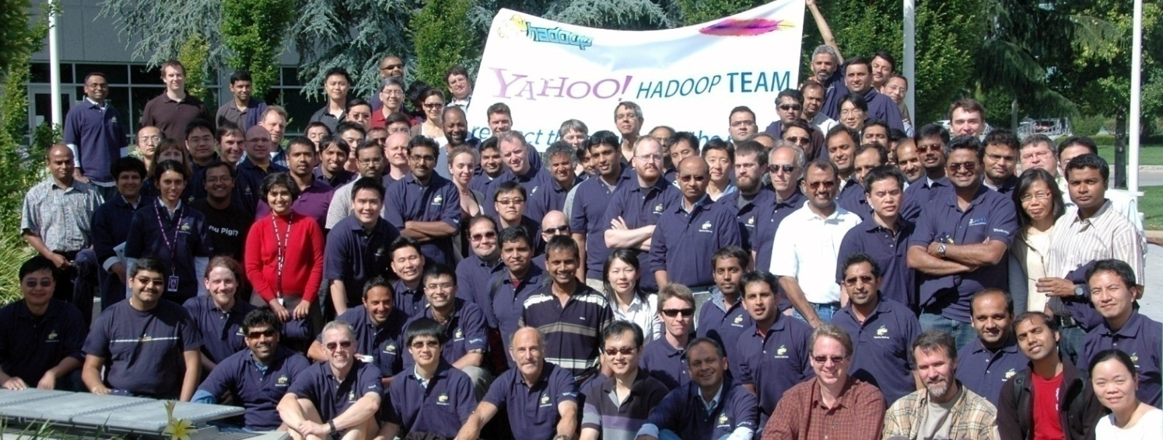
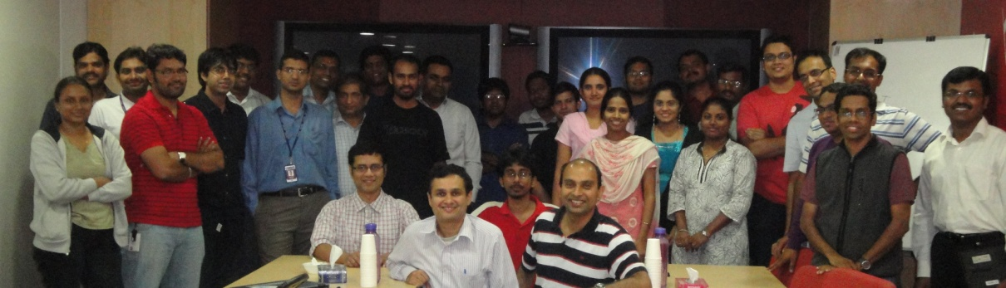
The Team - Hadoop Development
Notes:
Over 100 people contributing full-time to improving and supporting Hadoop at Y!
Dev of core framework (HDFS/MapReduce)
ALSO 0: TESTING – TBDiscussed, validating Hadoop is hard, and getting more difficult
ALSO 1: SUPPORT – driving adoption requires negotiation w/ existing tech; Y! is 15+ years old, has a lot of that
- Includes driving features in Hadoop through user representatives

Slide 5
Code Contributions
Notes:
All dev work since 2006 has been contributed to Apache (@start of my tenure, ran Apache Hadoop unmodified in production; would continue until 2009)

Slide 6
Hadoop as a Service
Total Nodes = 43,936
Total Storage = 206 PB
Notes:
0) Storage growing; approaching 1/5 exabyte
1) Research/dev clusters v. large and- TBDiscussed- “creative” users
2) Pretty good uptime (Q1?), but more asked

Slide 7
Application Patterns

Slide 8
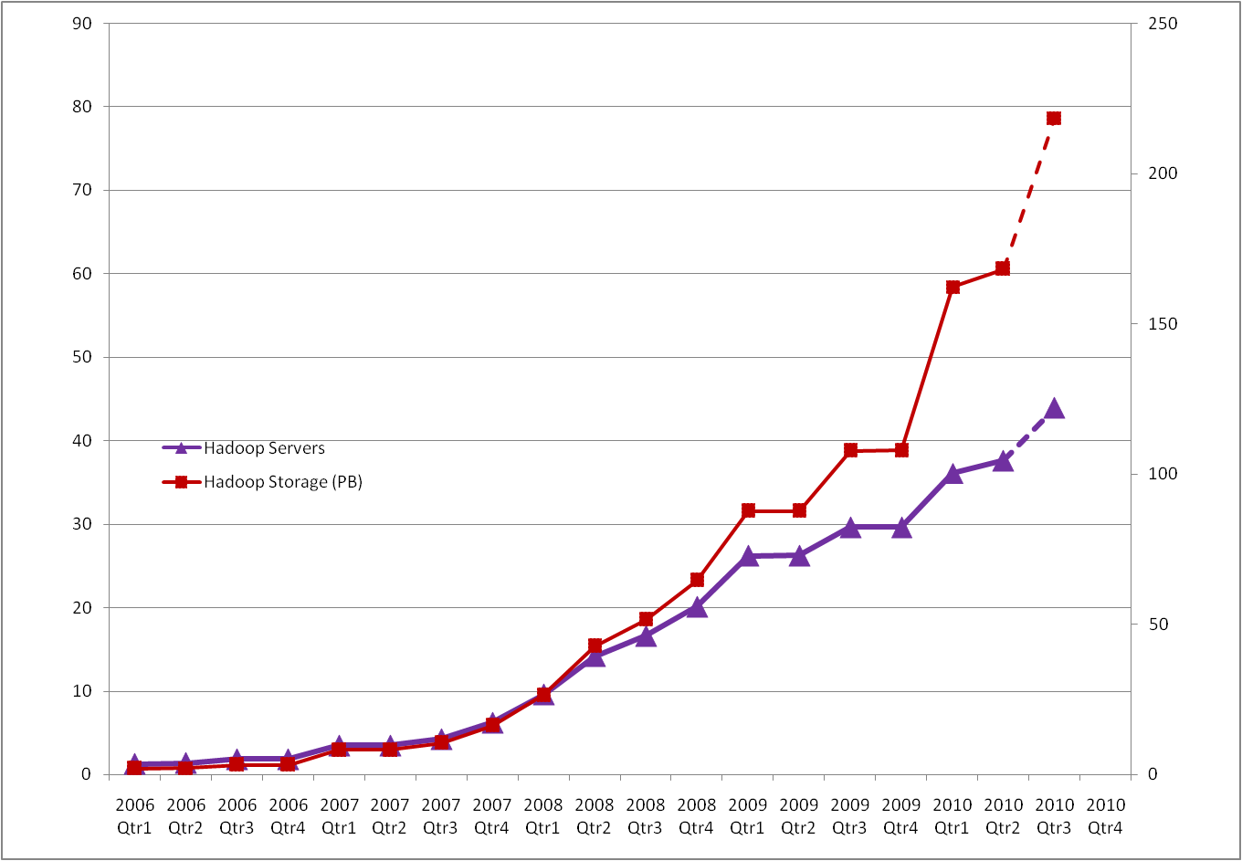
Hadoop Usage at Yahoo!
44K Hadoop Servers
206PB Raw Hadoop Storage
1M+ Monthy Hadoop Jobs
Petabytes
Thousands of Servers
Today

Slide 9
Research to Mission Critical
Notes:
Early problems were for large scale, distributed jobs – recall origins in building/processing large graphs
Now, recent past: driving 0) small pipelines, 1) small queries on shared datasets 2) over user data 3) in multi-tenant environments
Near Future: greater scale, more direct support of large, utility clusters
<TRANSITION: changes to support Hadoop in the enterprise>

Slide 10
Themes
Economies of scale, per cluster
More users (diverse patterns)
More data
Fewer disruptions
Fewer operators
Backwards Compatibility
API and semantic consistency
Feature consistency across shifts in deployment
Reflect business environment in operational environment
Allow technology to complement users’ workflow
Express relationships between users in rules
Notes:
0) Pack more into each deployment; distribute load/demand over clusters, not usage
1) Larger clusters and fewer disruptions are opposing goals. Stability is the real goal
2) If the number of operators per cluster can grow more slowly than the cluster size, can scale people
3) Compatibility doesn’t stop w/ APIs and applications; new models need to evolve from users’ existing environment
4) The features added create incentives for users/business units that track with Yahoo’s organization

Slide 11

Evolution of Hadoop at Yahoo!
Utilization at Scale
Security
Multi-tenancy
Super-size
4400+ patches on hadoop-0.20!
HDFS
Federation
04/11
Yahoo Hadoop
Apache Hadoop
09/10
Multi-Tenancy
04/10
09/09
Security
CapacityScheduler
04/09
hadoop-0.20
yhadoop-0.20
20.S
Multi-tenant
hadoop-next
Notes:
Themes from here on out on this slide.
Expensive to validate (3-4 months); Y! want to spend at least a year on a branch.

Slide 12
Utilization at Scale
HDFS
Federation
04/11
Yahoo Hadoop
Apache Hadoop
09/10
Multi-Tenancy
04/10
Security
CapacityScheduler
04/09
hadoop-0.20
yhadoop-0.20
20.S
Multi-tenant
hadoop-next

Slide 13
Motivation - CapacityScheduler
Exploit shared storage
  Unified namespace
Provide compute elasticity
  Stop relying on private clusters and Hadoop on Demand (HoD)
  Higher utilization at massive scale
Notes:
One namespace – previously, had to negotiate w/ data “owners”, which could take months and engineering to get datasets onto clusters
(unified namespace also motivates later themes, such as security and namespace federation)

Slide 14
Hadoop On Demand (HoD)
Rack 0
Rack 1
Rack (N-1)
Rack N
MASTER
MASTER
[0,10)
...
<--------------------------(HDFS)-------------------------->
User0
Job0-0
Each map() has a list of preferred hosts. The JobTracker (master) attempts to match each map to the closest host in its sub-cluster.
x2000
x100
User1
Job1-0
Job1-1
Job1-2
x500
x500
x500
Notes:
SETUP: Assume some number of racks of machines, each running a DataNode (HDFS block storage server)
0) User0 allocates a compute cluster. Note that this is done blindly, as #machines, without noting locality
1) A MapReduce cluster with its own JobTracker (MASTER) and compute nodes, isolated from others’
2) User0 submits a job to the newly allocated cluster
3) Since the master has instances on most racks, most reads will be intra-rack at worst. With luck (and/or large cluster) even get data-local read from HDFS
4) Also has the advantage that users submitting very different types of jobs (e.g. chains of map-only jobs from User1) can partition the machine’s “slots” differently
HoD: torque/maui allocation of compute resources on the grid
+ : isolation of JobTracker and user processes
+ : could deploy independent versions of MapReduce
+ : could be used to deploy HDFS for development
+ : features added during dev (log collection) were very helpful to application developers
-- : poor locality, utilization, and latency (long allocation, predictable on receipt)
-- : Caused users to work around by sharing allocated clusters
-- : Clusters not reclaimed as jobs wind down

Slide 15
CapacityScheduler
Resource allocation in shared, multi-tenant cluster
A cluster is funded by several business units
Each group gets queue allocations based on their funding
  Guaranteed capacity
  Control who can submit jobs to their queues
  Set job priorities within their queues
Support for “High-RAM” jobs
Challenges
Single master (JobTracker)
HoD feature replication
Notes:
Phasing out HoD required considerable stabilization effort from the MapReduce team (most in BLR). Users had written applications assuming:
Isolation: could specify how many simultaneous tasks would run on a machine; never shared with unknown users
JobTracker: only had to scale the master server for a handful of users and jobs, at worst. If user crashed the JT, did not affect cluster availability
Modest versioning: HDFS required an upgrade, but if in dire need, one could deploy a custom/old version of MapReduce
High latency for allocation, low latency for jobs: While allocation could take hours for large, busy clusters, jobs were not held up by others’ work

Slide 16
CapacityScheduler
Rack 0
Rack 1
Rack (N-1)
Rack N
MASTER
[0,10)
...
<--------------------------(HDFS)-------------------------->
User0
Job0-0
x2000
x100
User1
Job1-0
Job1-1
Job1-2
x500
x500
x500
Notes:
SETUP: Same setup as before, but now each node is running a multi-tenant TaskTracker (worker node for MapReduce)
0) User0 submits a job to the JobTracker (master)
1) All map() tasks are packed with tighter granularity into the cluster
2) User1 submits a job to the newly allocated cluster
3) From the HoD days, the user requires “fat” tasks on the grid. To the scheduler, each map() requires two logical slots on the machine. Jobs can request multiple “slots” per task
3.1) Note: the CS can “reserve” slots for a high-RAM job (Rack N, Slot 1)
4) With a single master for multiple users, the JobTracker requires some mediation between users. Fair scheduler is one example (pools of users, etc.)
4.1) CapacityScheduler uses Queues

Slide 17
CapacityScheduler - Queues
Rack 0
Rack 1
Rack (N-1)
Rack N
JobTracker
[0,5)
...
JobTracker
Job<USER>-<JOB>
Job0-0
Job3-0
Job3-1
Q₀
x2000
x5000
x250
x100
x250
x1
Maps
Job1-0
Job1-1
Job1-2
Q₁
x500
x500
x500
Job2-0
Job5-0
Q₀
Q₁
Q₂
Q₂
x200
x1500
x100
x10
Notes:
SETUP: To track Queues, simplify our diagram (HDFS is still here, of course). Ignore reduces
0) RIGHT: Graph of capacities or the percentage of the cluster allocated to a group
Users belong to Groups/Business units; business units purchase guaranteed capacity on a grid
A queue with pending work has high priority if it is below its GC
1) The CapacityScheduler elects to initialize a job, making its tasks schedulable.
As tasks are scheduled, that’s queue’s actual capacity is tracked @the scheduler
2) As more jobs are initialized, users may utilize the unused capacity in other queues; Users{0,1,3} are using capacity alloc to Q2
3) When Users{2,5} submit jobs to the system, Q2 is under its capacity and will reclaim it at the expense of over-capacity queues

Slide 18
CapacityScheduler - Benefits
Improved utilization and latency
Isolation in support of user applications with high resource requirements
Significantly better utilization of excess capacity
  Mix SLA critical and ad-hoc jobs
Predictable latencies
CS
HoD
Hadoop 18

Slide 19
Security
HDFS
Federation
04/11
Yahoo Hadoop
Apache Hadoop
09/10
Multi-Tenancy
04/10
Security
CapacityScheduler
04/09
hadoop-0.20
yhadoop-0.20
20.S
Multi-tenant
hadoop-next
Notes:
0) CapacityScheduler/JobTracker stabilization (w/ feature backports) was very expensive
1) Security investment had a hard, external deadline
Security was implemented in Apache Hadoop trunk, and also backported on top of this internal branch.
Not going to spend time on the details, as Owen covered his team’s implementation in his talk this morning.
Encourage all intereted in learning about how security works in Hadoop to talk to him.

Slide 20
Motivation - Security
Revenue bearing applications
Strong security for data on multi-tenant clusters
  Enable sharing clusters between disjoint kinds of users
  Larger namespaces with diverse datasets
Auditing
  Access to data
  Access and change management
Notes:
0) Want to move revenue-bearing applications to the grid
1) Add access and change management: who has access to which data
2) Allows the grid to share users with different privileges, saving overhead in data loading and user migration
3) Load personally identifiable information (PII) into the grid

Slide 21
Secure Hadoop
Kerberos based strong authentication
  Client-based authentication introduced in hadoop-0.16 (2007)
  Authenticate RPC and HTTP connections
Multiple person-years of development
Integration with existing security mechanisms in Yahoo
Authorization
  Use HDFS Authorization
  Add MapReduce Authorization
CapacityScheduler and Job/Task log ACLs
Notes:
0) Uses kerberos; integrates cleanly into existing Y! infra and applications
1) Pluggable mechanisms, also supported some proprietary mech
2) Also supported by new grid infra @Yahoo, including Oozie
3) Added ACLs to CapacityScheduler queues and job logs (some control over meta-information of jobs)

Slide 22
Multi-Tenancy
HDFS
Federation
04/11
Yahoo Hadoop
Apache Hadoop
09/10
Multi-Tenancy
04/10
Security
CapacityScheduler
04/09
hadoop-0.20
yhadoop-0.20
20.S
Multi-tenant
hadoop-next
Notes:
We have a:
0) Mechanism for better utilization of shared clusters
1) Mechanism for protecting/segregating data w/ authentication and authorization
We need mechanisms to provide better user isolation.
Can coexist, but past Dunbar number where they can do so politely

Slide 23
Motivation – Multi-Tenancy
Growing demand for consolidation, unified namespaces
  Economics of scale and operability
  Several clusters of 4k nodes each
Growing demand for stability
  Isolation for applications
  Shield framework from poorly designed or rogue applications
Growing “creativity” of users
  Features not developed with multi-tenancy or scale in mind
  Particularly volatile research clusters
Notes:
0) Massive datasets
1) Need to allow researchers to share w/o taking down cluster for ad-hoc jobs
Remember lower uptime in research? This is why.

Slide 24
Multi-Tenancy
Limits ensuring availability of the Apache Hadoop service
  Plug uptime vulnerabilities in the framework
  Enforce best practices (Arun C Murthy)http://developer.yahoo.com/blogs/hadoop/posts/2010/08/apache_hadoop_best_practices_a/ (http://s.apache.org/CaS)
Shield clusters from poorly written applications
  JT exposed to self-inflicted DDoS attacks, e.g. job counters
  NameNode exposed to applications performing too many metadata operations from the backend tasks
Shield users from one another
  Impose limits on utilization at worker nodes, e.g. memory/disk usage
Metrics and Monitoring
Operability tools for managing large groups of users
Notes:
0) Given JobTracker SPOF, must protect itself
1) Also included fixes to metrics; redesigned by Luke Lu to be scalable, pluggable
2) Redesign for more efficient query of JobHistory by Dick King
3) Better operability: adjust CapacityScheduler/queue limits without restarting JT, diagnostic info for jobs
4) Long-time user asks, e.g. Greg Roelofs implemented RFC-compliant gzip decompressor for concat gzip files

Slide 25
Super-Sized Hadoop
HDFS
Federation
04/11
Yahoo Hadoop
Apache Hadoop
09/10
Multi-Tenancy
04/10
Security
CapacityScheduler
04/09
hadoop-0.20
yhadoop-0.20
20.S
Multi-tenant
hadoop-next
Notes:
0.22!

Slide 26
Motivation – Super-sized clusters
Massive storage and processing
  Hardware gets more capable per dollar
  Continued consolidation for economics and operability
Unified namespaces. Again.
Better hardware
  More spindles/node and larger disks
  4k 2011 nodes == 12k 2009 nodes
  Need to scale the HDFS master (NameNode)
Notes:
0) The economies of scale are still active, but we also need to scale w/ new hardware
We cannot run 4k node clusters with twice as many spindles, each supporting 2x as many blocks
1) In particular, the HDFS master (NameNode)

Slide 27
Opportunity:
Vertical & Horizontal scaling
Vertical scaling
  More RAM, Efficiency in memory usage
  First class archives (tar/zip like)
  Partial namespace in main memory
Namenode
Horizontal: Federation
  Horizontal scaling/federation benefits:
  Scale
  Isolation, Stability, Availability
  Flexibility
  Other Namenode implementations or non-HDFS namespaces

Slide 28
HDFS Federation
Redefine the meaning of a HDFS cluster
  Scale horizontally by having multiple NameNodes per cluster
    Striping – Already in production
  Shared storage pool
  Shared namespace
    Striping – Mount tables in production
  Helps availability
  Better isolation
72 PB raw storage per cluster
  6000 nodes per cluster
  12TB raw, per node
Notes:
0) Scaling the NameNode (master server in HDFS) is difficult
1) DataNodes report to multiple NameNodes; storage is shared between clusters, so no manual rebalancing is necessary
2) Client-side mount table partitions namespace

Slide 29
Block (Object) Storage Subsystem
  Block (Object) Storage Subsystem
Shared storage provided as pools of blocks
Namespaces (HDFS, others) use one or more block-pools
Note: HDFS has 2 layers today – we are generalizing/extending it.
Namespace
Foreign NS n
NS1
...
NS k
...
Pools 1
Pools k
Pools n
Block storage
Block Pools
Balancer
Datanode 1
Datanode 2
Datanode m
...
...
...

Slide 30
Availability
Mission critical system
HDFS
  Faster HDFS restarts
    Full cluster restart in 75min (down from 3-4 hrs)
    NN bounce in 15 minutes
    Part of the problem is the NameNode’s size – Federation will help
  Steps towards automated failover
    Backup NN (AvatarNode)
    Move state off the NN server so we can failover easily
  Federation will significantly improve NN isolation, availability, & stability
Availability for Map-Reduce framework and jobs
  Continued operation across HDFS restarts

Slide 31
/* TODO */
Issues in public clusters
  Yahoo controls access to its clusters and its users have a common hierarchy for resolving issues
  Funding for clusters spans business units, but not companies
Deploying and operating clusters
  Yahoo employs a professional operations team experienced in managing Apache Hadoop and its “quirks”
  Not a “turn-key” product. Its largest users customize the platform to meet their needs. This is a good thing!

Slide 32
Questions?
Thanks!

