Slide 1
Apache POI for Content Management
Apachecon North America
November 3, 2010
David Fisher, JM Lafferty Associates, Inc.
with the assistance of Yegor Kozlov, Dinom, LLC

Slide 2
Overview
The Apache POI Project's mission is to create and maintain Java APIs for manipulating various file formats based upon the Office Open XML standards (OOXML) and Microsoft's OLE 2 Compound Document format (OLE2).
How we got involved
What can be done with the various Office file formats
Working with Excel files
Creating PowerPoint files

Slide 3
How We Got Involved
While developing an investor targeting and contact management website for corporate investor relations. We had two client driven requirements to satisfy:
Excel output that did not lose the leading “0” from US Postal Codes.
A Client, Microsoft, would not look at PDFs, they wanted PowerPoint.
We found Apache POI in the Jakarta project and that solved the first requirement.
Our first attempt at the second involved driving PPT using a Java to COM bridge.

Slide 4
Problems Driving Windows
Driving a GUI for a server app is silly.
Only one PPT at a time could be created.
Server setup was difficult.
Server restart could require operator intervention.
Graphic quality was poor for both
PICT files created by our software, and
JPEG files transformed from our Postscript output.

Slide 5
Extending POI, Giving Back
We decided to extend HSLF to produce PowerPoint decks with images. This removed the COM bridge.
We contributed this back to POI:
to help build the community.
to get “free” beta testers.
We have continued to enhance HSLF to directly produce shapes.
We have continued to contribute in many areas.

Slide 6
What You Can Do With POI
Document Structure
– OOXML – Open Office XML Standards
– OLE2 – Microsoft’s Binary File Formats
Operational Models
– Text Extraction – text with varying amounts of structure.
This feature is used by Apache Tika.
– Reading – drill down into a file and get what you want.
– Writing – create rich output.
– Formula Evaluation – use an Excel workbook as a Computation Engine.
Examples
– Many excellent examples are available in the source distribution.
– A few real world examples are available on the website.
– Code snippets are available on the website.

Slide 7
Document Structure APIs OLE2 & OOXML
Older binary file formats are OLE2 based – .xls, .ppt, .doc, …
OLE2 looks a lot like FAT.
Several Files / Streams are included.
POIFS is our API to access all OLE2 files at the low level.
HPSF is our API for manipulating Document Properties.
Newer xml file formats are OOXML based – .xlsx, .pptx, .docx, …
OOXML is a zip file of XML files of data and metadata. Easy to inspect.
The structure is “similar” to OLE2.
Office Open XML file format defined in ECMA standard 376.
Implementation based on the OpenXML4J contributed in 2008.
XMLBeans 2.3 is used to hide the details of OOXML manipulation.

Slide 8
Operational Approaches
File Types | OLE2 | OOXML | User Model | Event Models | Extraction
Excel | HSSF | XSSF
 | SS ¹
PowerPoint | HSLF | XSLF
Word | HWPF | XWPF
Visio | HDGF
Outlook | HSMF
Publisher | HPBF
¹ A combination user model allowing access to both HSSF and XSSF

Slide 9
Excel – HSSF, XSSF, and SS
Binary Format (.xls) has been supported since POI 1.0 by HSSF.
Workbook consists of records.
Format specification was closed until 2008.
User Model provides access to objects in the file.
Event Model provide access to the records in the file.
UserEvent Model is a hybrid.
OOXML Format (.xlsx) has been supported since POI 3.5 by XSSF.
Workbook consists of xml files in a zip file.
Format specification is an open standard.
User Model provides access to object in the file.
Event Model provides for SAX parsing.
The SS User Model provides a combined model that allows access to both HSSF and XSSF.

Slide 10
Spreadsheet User Model Basics
Open / create a Workbook
From the Workbook, get or add Sheets
From a Sheet, get Rows
From a Row, get Cells
From a Cell, get contents
values
styles
format
comments
…

Slide 11
More on the User Model
Object model designed to closely match the Excel application’s object model.
Low level file structure may peek through for some cases.
HSSF usermodel uses model which manipulates records.
XSSF usermodel uses XMLBeans which does the xml

Slide 12
org.apache.poi.ss.usermodel
Interfaces provide access to almost all the functionality you'll want for working with both types.
Where things are very different between OLE2 and OOXML, cast to the appropriate concrete class.
Unless you have very constrained memory, this is the recommended user model.

Slide 13
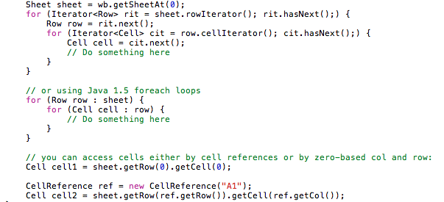
Iterate over rows and cells

Slide 14
Cells are the key
Cells contain data, and may have styles, formatting rules, comments, hyperlinks etc.
Cells can be of different types, such as string, number.
Type is important!
Numbers and dates are always stored as floating point values.
Integers, dates are done by formatting these floating point values.

Slide 15
Working with cells

Slide 16
Cell Style
CellStyle gives you access to the most cell style properties, e.g. font, borders, data formats.
CellStyle in .xls has some limitations – the number of colors available is limited to the built-in pallete.
Cell Styles must be shared. Do not create per-cell, otherwise you will get a “Too many styles” error in Excel when opening your workbook.
Think of Cell Styles like CSS and create them like that.

Slide 17
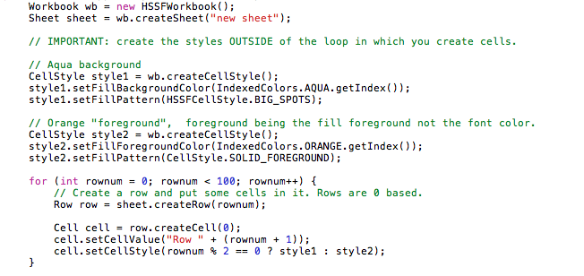

Slide 18
Dates in Excel
Dates are stored as floating point numbers, which are fractional days since 1900 or 1904!
No specific cell type in the file indicates that this is a date.
Only way to detect dates is from formatting rules.
POI tries to detect these for you.

Slide 19
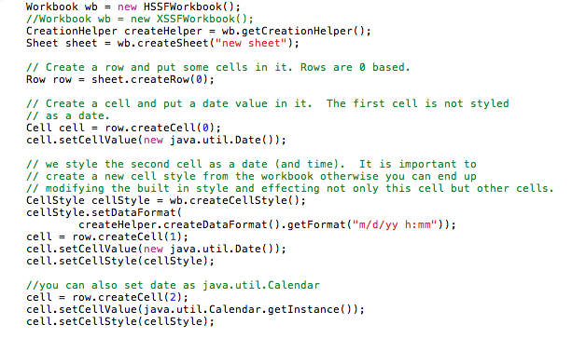
Creating Date Cells

Slide 20
Formulas
POI can read and write formulas
AND evaluate them!
POI has a largely complete implementation of the Excel formula parser and evaluator
Doesn't do some functions, but now does most.
Massive improvements of late.

Slide 21
What is supported?
Almost all basic functions are.
VBA based ones never will be.
Quite a few complex functions are.
Some of the POI function classes are stubs – if it extends NotImplementedFunction it isn't done yet.

Slide 22
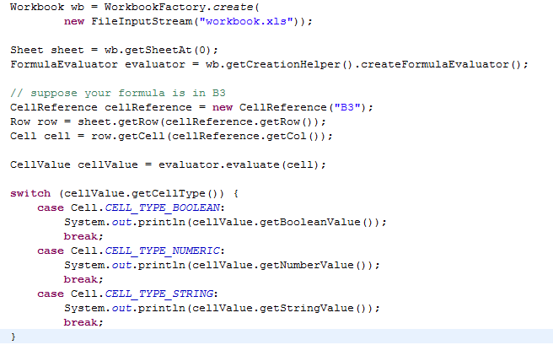
Using FormulaEvaluator

Slide 23
There are more features
Advanced Excel features go:
Rich Text
Data validations
Conditional formatting
Cell comments
Drawings
…

Slide 24
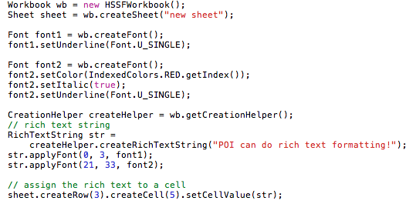
RichText in Cells

Slide 25
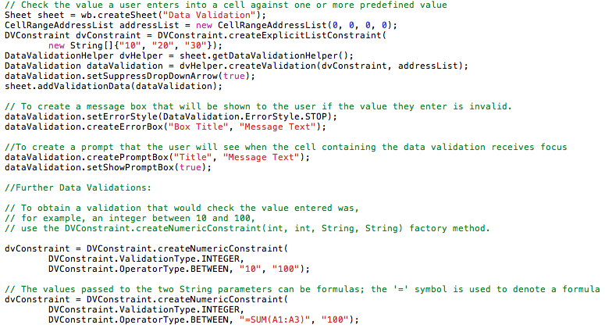
Data Validation
Unit Test

Slide 26
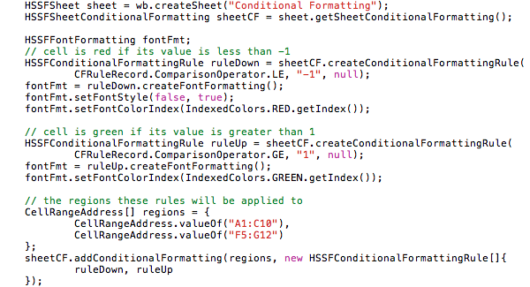
Conditional Formatting
Unit Test

Slide 27
Pictures
Images are part of the drawing support. To add an image just call createPicture() on the drawing patriarch. Currently the following types are supported:
PNG
JPG
DIB
Picture.resize() relies on AWT
Positioning of graphic object is not precise, the result can look ‘off’ on a system with different dpi or different version of Excel, e.g. Excel for MAC.

Slide 28
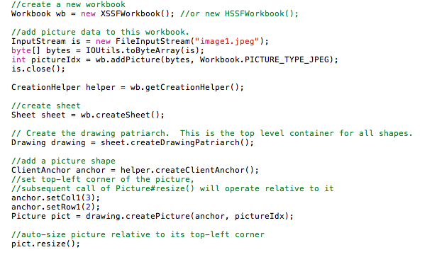

Slide 29
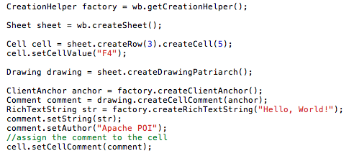
Cell Comments
Unit Test

Slide 30
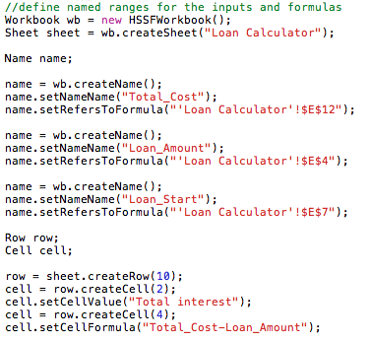
Defined Names
Full Example Code

Slide 31
Auto-Sizing Columns
Handled by the sheet object and NOT the cell.
Needs to use awt stuff, so either must be running in a graphical environment, or be correctly set to headless
If running headless, set
-Djava.awt.headless=true.
Heavily dependent on correct fonts.

Slide 32
VBA
POI can’t manipulate with VBA , but you can use a template.
The Template XLS can include a VBA signed with a digital certificate to avoid warnings about untrusted code.

Slide 33
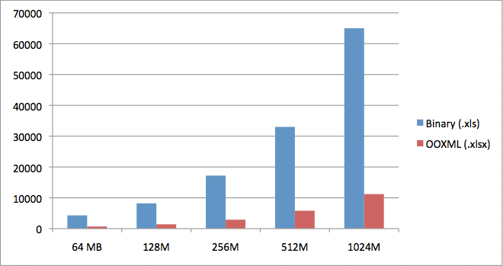
Rows in Spreadsheet and Memory Requirements
Rows
Available Memory
OOXML requires 5x as much memory per row.

Slide 34
PowerPoint User Model
Object model designed to closely match the PowerPoint application’s object model.
Low level file structure may peek through for some cases.
HSLF model which manipulates records.
XSLF usermodel uses XMLBeans which does the xml.
XSLF is still rather incomplete.

Slide 35
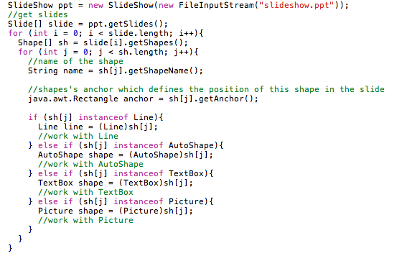
Iterate through Slides and Shapes

Slide 36
PPT Graphics layer
It's possible to treat a HSLF file almost as a Graphics2D canvas, and draw onto it.

Slide 37
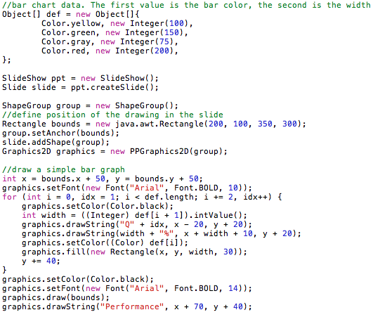

Slide 38
Result – we can draw!
Q1
100%
Q2
150%
Q3
75%
Q4
200%
Performance

Slide 39
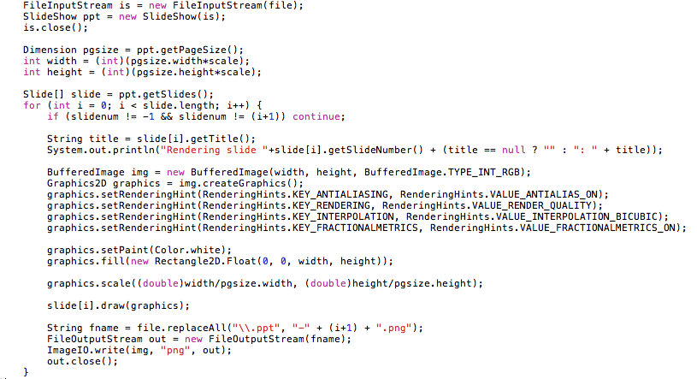
Convert Slides to PNG
Example

Slide 40
This presentation will be available on:
http://people.apache.org/~wave/apacheconNA2010/.

