Slide 1
Hardening Enterprise Apache Installations
Sander Temme
sander@temme.net
Notes:
Hello everyone, welcome to Hardening Enterprise Apache Installations.

Slide 2
Disclaimer
The information discussed in this presentation is provided "as is" without warranties of any kind, either express or implied, including accuracy, fitness for a particular purpose, reliability, or availability.
It is your web server infrastructure, and you alone are responsible for its secure and reliable operation. If you are uncertain about your approach to hardening and protection, consult a security professional.
Notes:
First, a disclaimer.

Slide 3

Agenda
Ten Tips!
Apache HTTP Server Security
Secure Apache Deployment
Application Security
Case Study
Notes:
With that out of the way, this is what I would like to talk about today.
(…)
This: (build) is The Club™, a marvelous and affordable security device that encourages car thieves to steal the car next to yours instead of your own. Whenever we discuss a tip that you can implement with little effort and cost, I’ll put a The Club image next to it.
Show of hands: Who runs a web site? Who are here for a post lunch nap? Who owns their servers? Who runs on shared hosting?
Lots of stuff to talk about: let’s get started!

Slide 4
Tip (1) Strong Passwords
Number one attack vector
Use strong passwords for Mgmt
Force SSL
OTP
Manage Out-of-Band
Notes:
Depending on who you talk to, abuse of site management credentials is the number one attack vector. This is really bad, because there is no technical defense against it! If an attacker obtains your username and password, your server doesn’t know it’s not you logging in.
So protect those login credentials well. Use good passwords, and actually change them once in a while.
Of course, you can have the best passwords in the world, but they won’t do you any good if you let anyone on the network see them. Run your management interface over SSL: popular content management packages like Wordpress and Joomla! allow you to do that. If you can’t run over SSL, consider using One Time Passwords. Finally, if you can, manage your site out of band. Use a different channel like ssh, or do not expose the management interface on your outward-facing site.

Slide 5
Tip (2) Writing to DocRoot
Notes:
Second tip: be very careful allowing your web server to write to any spot under its Document Root. The Document Root is the directory on the server from which Apache serves content: pages, images, interpreted PHP scripts, etc. If Apache can write files to this content directory, it can then serve those same files back out. So if an attacker tricks the web server into writing a file containing malware to your Document Root, your server is now serving malware. In a default Apache installation, file system permissions prevent this from happening.
Some applications require write access to the web server. I’m going to pick on the Joomla! Content Management System a little: it comes with an easy first-run installer that allows you to set up your website, through the web server, in four easy steps. Part of that installation is writing the configuration.php file to the web server, and the installer complains when file system permissions prevent this from happening.

Slide 6
Tip (2) Writing to DocRoot
Notes:
Now, the installer actually does this right: after you complete the installation steps it presents the contents of the configuration file to you, and you can copy that to your web server over ssh. Remember the last tip? This is out-of-band management at work.

Slide 7
Tip (2) Writing to DocRoot
Notes:
Once installed, the CMS would like write access to a whole bunch of directories under its installation root, as shown here. Some of these are for logging and caching, some are for uploading content, others for installing and upgrading plugins and language modules. Joomla! will run without write access to these directories, but you’d have to upload all of these items through another channel. You could give Joomla! write access by allowing the Apache user or group write access to that location in the file system, but were you to do that, it’d be up to Joomla! to keep bad content out. By opening up the file system permissions, you’d be giving up a very important line of defense.

Slide 8
Apache is Secure
Very few vulnerabilities reported
No critical vulnerabilities in 2.2.x
Upgrade to any new release
  announce@httpd.apache.org
Default installation locked down
  But it doesn’t do a whole lot
  http://httpd.apache.org/security/vulnerabilities-oval.xml

Slide 9
Apache Security Process
Report security problems to security@apache.org
Real vulnerabilities are assigned CVE number
Vulnerabilities are classified, fixed
New httpd version released
http://httpd.apache.org/security_report.html
http://cve.mitre.org/
http://httpd.apache.org/security/impact_levels.html
announce@apache.org

Slide 10

Tip(3) Use Packages
Notes:
Next tip: use software packages. While the beauty of Open Source is that you can grab the source code to any software package you use to run your site, this quickly becomes hard to manage. Fortunately, most operating system distributions provide a collection of pre-built packages that you can install on your server. These packages, whether RPMs from Red Hat or .DEBs from Debian, or FreeBSD Ports, have been vetted, configured and patched to work well together.

Slide 11
Package Considerations
Pre-built software
Easy install
Automated updates
  Play well with other packages
Quick rebuild
Customize when needed
Notes:
This makes it really easy to provision your web server, or servers, with everything they need to serve your web application. And once installed, your distribution vendor provides updates for security issues and bug fixes, pre-built to fit into their installation.
You can install your software packages right with the operating system: this allows you to quickly recover from a failed server installation. You can capture your server operating system and software installation in, for instance, a Kickstart file for Red Hat, and use that as input for a reinstall. This becomes especially interesting in situations where you frequently build and tear down servers, like if you’re running on Amazon EC2.
Of course, you may not completely agree with how your distributor builds their packages. Fortunately, you can customize them. If you don’t have the knowledge or bandwidth to do so, just use them as they come. But if you have customization needs, and can afford the time and effort to build your own packages, you can do so.
Eventually, you may end up building your own deployment system, with packages for your custom software and content, so your web servers can emerge completely ready to use from Kickstart.

Slide 12
Tip (4) Config Version Control
OS Config
Apache Config
Site content, code, scripts…
Notes:
Your server configuration should be in Version Control. This will help you manage your rollout, help you audit configuration changes and recover from outages.
Ideally, all your configuration changes and site updates go through your version control system: that means nobody hacks on the live site, and you can always roll back a configuration or site change.
The actual version control method is up to you, but you should use a tool that stores your configuration files in a central location, away from the servers themselves.

Slide 13
Tip (5) Fail Thoroughly
Kill compromised server
Recover fast
  Reinstall from packages
  Config from version control
Notes:
So what do the above two tips buy you? Quick Recovery! If or when you have a compromised server, you can respond quickly to a compromise. You already know which OS and software packages you had installed, and your configuration is in version control. So you can just take the compromised server offline, and quickly build a new one.

Slide 14

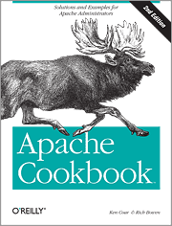
Tip (6) Apache Configuration
Write your own
Formal testing
Avoid <IfModule>
Disable unused modules
Notes:
I strongly recommend that you write your own Apache configuration. The Apache configuration language is not black magic, and you should understand what it does and why
Strongly recommend to empty out the configuration file and write your own. Only take the bits from the default configuration file that you really need; strip out the comments, strip out the <IfModule> bits (if a module you need isn’t there, you want your server to fail to run, not run without that functionality), etc.
Use the Apache documentation and/or get a book like Apache: The Definitive Guide by Ben and Peter Laurie.
AAA stuff to a new slide.

Slide 15
Tip (7) OS Hardening
Writable directories
Chroot, FreeBSD jail, Solaris Zones
Use sudo
One Time Passwords
Notes:
The fewer places on the system to which the webserver can write, the fewer vulnerabilities. Making well-known spots unavailable
Remove the key from under the mat.
Anecdote: Linux server running PHPBB on a cable or DSL line. Noticed weird stuff, found that someone had downloaded files to his /tmp directory, then executed the binary which was a spam relay or C&C… but named ‘httpd’ so it didn’t show.
chroot and related virtualization techniques: they limit the amount of damage an attacker can do to the

Slide 16
OS Hardening (2)
Unnecessary services
Unused packages
Netboot for web heads
Notes:
Title: OS Hardening
The fewer places on the system to which the webserver can write, the fewer vulnerabilities. Making well-known spots unavailable
Remove the key from under the mat.
Same with chroot and related virtualization techniques:
Split slide in two

Slide 17
Windows
Use what you know!!!
Pull Server Root out of install dir
  httpd -n Apache2.2 -d c:\mysite -k config
Create apache user
  Services run as SYSTEM user
    Can write to many directories
  Write access only to c:\mysite\logs subdirectory
  Let Apache2.2 Service log on as apache
Notes:
A badly maintained Linux server is less secure than a well-maintained Windows server
Take out sub-bullets
Point to handout

Slide 18
Tip(8) Network
Block outgoing connections
  Web Server only serves incoming connections
Minimize incoming connections
  Port 80, port 443
  ssh, sftp, etc. through bastion
Use firewall
Notes:
Split into different slides
Limit incoming connections to necessary services (http, https) and nothing else

Slide 19
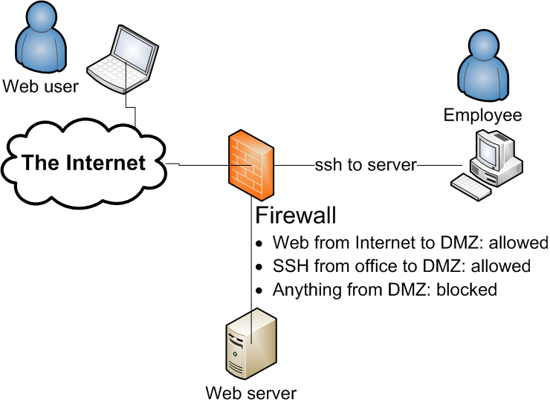
Suggested DMZ Configuration
Notes:
Introduce DMZ = De-Militarized Zone (and point to it)

Slide 20
ModSecurity
Web Application Firewall
Runs Right Inside Apache
  Can see SSL session content
Rule-based request filtering
…
Notes:
Split example onto next slide, bigger font.

Slide 21
ModSecurity Filter
# Accept only digits in content length
#
SecRule REQUEST_HEADERS:Content-Length "!^\d+$” \
"deny,log,auditlog,status:400, \
msg:'Content-Length HTTP header is not numeric', \
severity:'2',id:'960016', \
tag:'PROTOCOL_VIOLATION/INVALID_HREQ'"

Slide 22
Application Security

Slide 23
Malware Growth Continues in 2010
First Half 2010 Statistics
3,200,000
327 million infection attempts
2,800,000
2,400,000
119 million malware hosting servers
2,000,000
36% spike in malware growth year-on-year
1,600,000
1,200,000
800,000
400,000
0
1998
1999
2000
2001
2002
2003
2004
2005
2006
2007
2008
2009
Notes:
23
In Q1 of 2010 there were over 327 million infection attempts from over 119 million malware hosting servers found on the Internet. According to IBM, the first half of 2010 saw a 36% spike in malware over the same time last year as over 10 million new pieces of malware were released into the wild.

Slide 24

















Slide 25
Considerations
Safest: Disconnected, turned off, buried…
Next best: flat files
Dynamic content: danger
How to mitigate danger?

Slide 26
Common Sense
Restrict what can run
Restrict what it can do
  Reach out to network?
  Write to the filesystem?
  Write to a database?
  Load scripts or modules?

Slide 27
An Important Question
WHY?
Notes:
This is the question that every web server administrator should ask about any changes made to his or her server deployment.

Slide 28
Why…
Does your server have to “see” the net?
Can users upload stuff that gets executed?
Would httpd have to write to the filesystem?
Would you expose anything but 80 and 443?
Would you serve that URL?
Would your OS execute untrusted code or scripts?
Would your users be able to log in and edit through the front door?
Does your site have to be served by a scripting engine?
Notes:
Have developer justify to admin: why is this particular change necessary
Get rid of … bullet

Slide 29
Database Privileges
Bugzilla: GRANT SELECT, INSERT, UPDATE, DELETE, INDEX, ALTER, CREATE, LOCK TABLES, CREATE TEMPORARY TABLES, DROP, REFERENCES ON bugs.* TO bugs@localhost IDENTIFIED BY '$db_pass';
Wordpress: GRANT ALL PRIVILEGES ON databasename.* TO "wordpressusername"@"hostname” IDENTIFIED BY "password";
Joomla 1.5: GRANT ALL PRIVILEGES ON Joomla.* TO nobody@localhost IDENTIFIED BY 'password';
Drupal: SELECT, INSERT, UPDATE, DELETE, CREATE, DROP, INDEX, ALTER, CREATE TEMPORARY TABLES, LOCK TABLES
Gallery 2: mysql gallery2 -uroot -e"GRANT ALL ON gallery2.* TO username@localhost IDENTIFIED BY 'password'”;
Notes:
Dangerous terms: DROP; GRANT ALL PRIVILEGES
Generally: application setup should separate database creation and schema population from application database access.

Slide 30
Tip (9) Database Privileges
Line of defense!
Apps written by coders
  Not DBAs
GRANT ALL PRIVILEGES
  Really?
Separate schema definition from app code

Slide 31
Tip (10) PHP Configuration
PHPIniDir directive specifies location of php.ini file
Disable dangerous features:
  register_globals = Off
  allow_url_fopen = Off
  display_errors = Off (production)
  enable_dl = Off
Notes:
Discuss each directive? Depends on time.
Put description of directives in handout.

Slide 32
Further Reading
Ryan C. Barnett, Preventing Web Attacks With Apache, ISBN 0-321-32128-6
Ivan Ristic, Apache Security, ISBN 978-0596007249
Tony Mobily, Hardening Apache, ISBN 978-1590593783
The Web Hacking Incident Database 2009 Report: http://bit.ly/2DaBBy
http://httpd.apache.org/security_report.html
http://www.cisecurity.org/
Mike Andrews and James A. Whittaker, How to Break Web Software, ISBN 0-321-36944-0
http://www.owasp.org/
NIST Guidelines on Securing Public Web Servers: http://bit.ly/41oFmE
Notes:
Consider updating?

Slide 33
Conclusion
The threat
The mitigation
  Secure admin access
  Understand your config
  Patch and update
  Design for responsiveness
  Key not under mat
  Default deny

Slide 34
Thank You
http://people.apache.org/~sctemme/ApconNA2010/
Blog: http://www.temme.net/sander/
Follow @keysinthecloud

Slide 35
Backup Slides

Slide 36
The Threat Model
Notes:
The Threat Model: let’s discuss who gets attacked, what the motive is behind these attacks and how they take place.

Slide 37
Who Gets Attacked?
Everyone!
Big or Small
Notes:
Everyone is under attack. Whether you’re a small player or the Fortune 500, automated attack tools scan the entire IP range and will barrage your services with requests that identify weak spots. Even if you are serving an Intranet that is not visible to the general Internet, you should consider the possibility that people within your organization download Trojan horses, or bring them in when they connect their laptops to your network.

Slide 38
Notes:
OK, let’s go Graphjam. This pretty pie chart is taken from the 2009 report of the Web Hacking Incident Database. As you can see, over 50% of the incidents on which they reported resulted in a defacement,
What are the motives behind these attacks? This pretty pie chart comes from the 2009 Report of the Web Hacking Incident Database. It suggests that over 75% of attacks are done to steal data, to deface the website or to plant malware on it. Information Theft is particularly attractive to the malfeasants, because the results can be used for financial gain. Data can be used or sold for profit, where defacements only bring bragging rights.

Slide 39
Source: The Web Hacking Incidents Database, 2009 Report

Slide 40
Case Study
apache.org, August 2009

Slide 41
The Incident
Apachecon.com rooted
ssh tunnel to people.apache.org
Malware served from apache.org servers

Slide 42

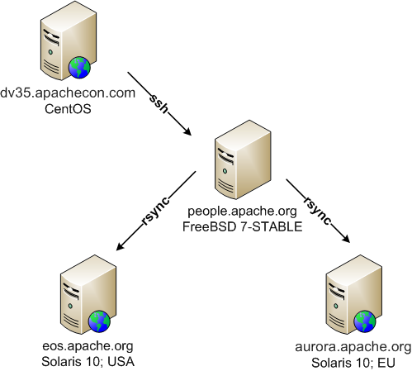

apache.org Network

Slide 43
Response
Shut down affected servers
Rolled back ZFS Snapshot
Rebuilt apachecon.com

Slide 44
Changes
Require One-Time Passwords
Better ssh key management
Remove ExecCGI
Improve content management
https://blogs.apache.org/infra/entry/apache_org_downtime_report

Slide 45
Software and Libraries
Be on Announcements lists
Update as needed
Consider packages

