Slide 1
Intelligent Apps with Apache Lucene, Mahout and friends
Grant Ingersoll

Slide 2
Topics
What is an Intelligent Application?
Examples
I’ve heard of Lucene/Solr, but what else can I use?
Mahout
OpenNLP
Others? UIMA, Weka, Mallet, MinorThird, etc.
Building Blocks
Tying it all together

Slide 3
What is an Intelligent Application?
I favor a loose definition
Evolving as techniques get better
General Characteristics:
Embraces fuzziness and uncertainty by:
Learning from past behavior and adapting
Leveraging the masses while incorporating the personal
Provide Content Insight
Organize vast quantities of data into consumable chunks
Encourage Serendipity
Do what users want even if they don’t know it yet, but don’t turn them off either
Notes:
Do what users expect – Go beyond just UI design
Early days of Amazon recommender

Slide 4
Caveats
I’m mostly interested in applications where:
Unstructured text is a component
i.e. I’m not building a next-gen video game
Users interact via text, clicks, etc.
Typing in queries
Browsing links, reading ads/content, etc.
Some of these tools are useful for other applications too
Consider the topics here to be a toolkit, not all apps need all features

Slide 5
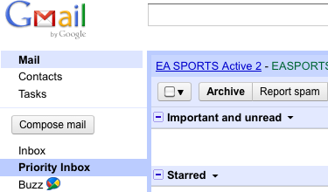
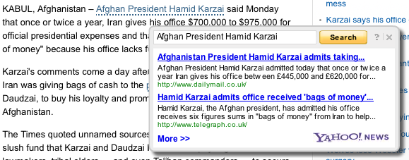
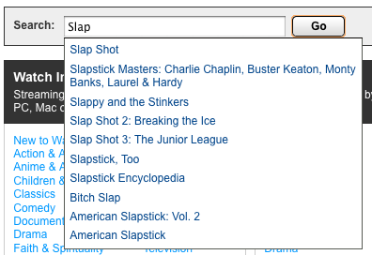
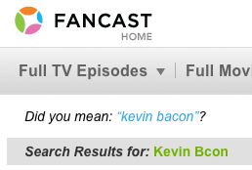
Examples
Amazon
Yahoo
http://www.fancast.com
http://www.netflix.com
Notes:
In fact, the Gmail shows 3 examples

Slide 6
Apache Open Source Players
Lucene/Solr
http://lucene.apache.org
Mahout
http://mahout.apache.org
UIMA
http://uima.apache.org
Nutch
http://nutch.apache.org
Tika
http://tika.apache.org
Hadoop
http://hadoop.apache.org
ManifoldCF
http://incubator.apache.org/connectors

Slide 7
Other Open Source Players
OpenNLP (ASL)
http://opennlp.sourceforge.net
-> Incubator?
Carrot2 (BSD)
http://project.carrot2.org/
MALLET (CPL)
http://mallet.cs.umass.edu/
Weka (GPL)
http://www.cs.waikato.ac.nz/~ml/weka/index.html

Slide 8
Building Blocks
Content
Users
Search
Discovery/Guides/Organization
Aggregating Analysis
Domain Knowledge
Language Analysis
Relationships
User History
Extraction
User Profile/Model
Context
Acquisition
Adaptation
Notes:
On the users side, I won’t go into too much detail about things like history, profile, modeling

Slide 9
Building Blocks: Acquisition and Extraction
Garbage In Garbage Out
Acquisition:
Nutch
Solr Data Import Handler
ManifoldCF
Extraction
Tika (PDFBox, POI, etc.)
Notes:
In my day to day experience, this seemingly mundane task is where you will spend a good amount of time

Slide 10
Building Blocks: Language Analysis
Basics:
Morphology, Tokenization, Stemming/Lemmatization, Language Detection…
Lucene has extensive support, plus pluggable
Intermediate:
Phrases, Part of Speech, Collocations, Shallow Parsing…
Lucene, Mahout, OpenNLP
Advanced:
Concepts, Sentiment, Relationships, Deep Parsing…
Machine Learning tools like Mahout

Slide 11
Building Blocks: Domain Knowledge
You, Your Business, Your Requirements
Focus groups
Examples:
Synonyms, taxonomies
Genre (sublanguage: jargon, abbreviations, etc.)
Content relationships (explicit and implicit links)
Metadata: location, time, authorship, content type
Tools:
Tika, Machine Learning tools like Mahout

Slide 12
Building Blocks: Search
Search is often the interface through which users interact with a system
Doesn’t require explicit typing in of keywords
Sometimes a search need not be a search
Less frequently used capabilities become more important:
Pluggable Query Parsing
Spans/Payloads
Terms, TermVectors
Lucene/Solr can actually stand-in for many of the higher layers (organizational)
Notes:
You can build recommenders, classifiers, clustering, etc. on L/S

Slide 13
Building Blocks: Organization/Discovery
Organization
Classification
Named Entity Extraction
Clustering
Collection
Search Results
Topic Modeling
Summarization
Document
Collection
Discovery/Guidance
Faceting/Clusters
Auto-suggest
Did you mean?
Related Searches
More Like This

Slide 14
Building Blocks: Relationships
Harness multilevel relationships
Within documents: phrases/collocations, co-reference resolution, anaphora, even sentences, paragraphs have relationships
Doc <-> Doc:
Explicit: links, citations, etc.
Implicit: shared concepts/topics
User <-> Doc:
Read/Rated/Reviewed/Shared…
User <-> User
Explicit: Friend, Colleague, Reports to, friend of friend
Implicit: email, Instant Msg, asked/answered question

Slide 15
Building Blocks: Users
History
Saved Searches -> Deeper analysis -> Alerts
Profile
Likes/Dislikes
Location
Roles
Enhance/Restrict Queries, personalize scoring/ranking/recommendations

Slide 16
Building Blocks: Aggregating Analysis
You’re an Engineer, do you know what’s in your production logs?
Log analysis
Who, what, when, where, why?
Hadoop, Pig, Mahout etc.
Classification/Clustering
Label/Group users based on their actions
Power users, new users, etc.
Mahout and other Machine Learning techniques

Slide 17
Adaptation
Automated
Retrain models based on user interactions on a regular basis
Manual
Lessons learned incorporated over time

Slide 18
Tying it Together
Key Extension Points
Analyzer Chain
UpdateProcessor
Request Handler
SearchComponent
Qparser(Plugin)
Event Listeners

Slide 19
Example
http://github.com/gsingers/ApacheCon2010
Work-in-Progress Proof of Concept
Wikipedia dataset
http://people.apache.org/~gsingers/wikipedia/enwiki-20070527-pages-articles.xml.bz2
Index, classify, cluster, recommend

Slide 20
Indexing

Slide 21
Searching

Slide 22
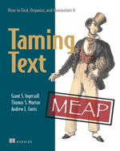
Resources
Handles
@gsingers
grant@lucidimagination.com
http://blog.lucidimagination.com
http://lucene.grantingersoll.com
Taming Text by Grant Ingersoll, Thomas Morton and Drew Farris
http://lucene.li/1c
Code: apachecon2010

