Slide 1
Getting started with Java Contexts and Dependency Injection in Java EE6
Rohit Kelapure
Apache Open Web Beans
IBM WebSphere Application Server
http://twitter.com/#!/rkela
http://www.linkedin.com/in/rohitkelapure

Slide 2
History of J2EE /Java EE
Web Services
J2EE 1.4
EJB 2.1 (Timers
Pluggable JMS)
Servlet 2.4
JSP 2.0
Web Services*
JMX Mgmt.*
J2EE Deploy*
JACC*,
JAAS*
JAX-RPC*,
JAXR*
JSTL*
Nov03
20 specs
Robust
Scalable
J2EE 1.3
EJB 2.0 (CMP,
MDB, local EJBs )
Servlet 2.3
(Events, Filters)
JSP 1.2
JDBC 2.1
JCA* 1.0
JAAS* 1.0
JAXP* 1.0
Sept 01
13 specs
Ease of Development
JEE 5.0
EJB 3.0 (POJO components)
JPA 1.0* (POJO persistence)
JSF 1.2*
Servlet 2.5
JSP 2.1 (Common EL)
JAXB*, SAAJ*, StAX*, JAX-WS*
Web Services (POJO components, Protocol Independence)
Annotations (IoC), Injection
May06 24specs
Project JPE
EJB 1.0
Servlet 2.1
May 98
Enterprise Application
J2EE 1.2
EJB 1.1
Servlet 1.1
JSP 1.1
JMS 1.0.2
JDBC 2.0
JNDI 1.2
JAF 1.0
JTA 1.0
JTS 0.95
JavaMail 1.1
Dec 99
10 specs
* Introduced in spec.
Notes:
http://www.ibm.com/developerworks/websphere/library/techarticles/0707_barcia/0707_barcia.html
http://en.wikipedia.org/wiki/Java_EE_version_history

Slide 3
JSF 1.2 Shortcomings
No integration with EJBs
No templating support (before JSF 1.2)
Transparent to HTTP Requests
Difficult to create custom components
Lacks
  conversation scope
  advanced components (tabbed panes, menus, trees)
Weak page oriented support
Overly complex lifecycle
JSP & JSF inherent mismatch

Slide 4
EJB 2 Shortcomings
Sheer amount of code
  Boilerplate code
Glutton for XML (deployment descriptors)
Broken Persistence Model
Difficult Unit Test
Rigid API interfaces
Needs IDE Tooling
Notes:
http://techbus.safaribooksonline.com/9781933988344/ch01lev1sec4

Slide 5
Emergence of SEAM
  Bind EJBs directly to JSF-View using EL
  Contextual Components
Page flow & Navigation Rules
Interceptors
Conversation Scope, Persistence
Dependency Injection (Bijection)
Security
Ajax Support
Seam-gen
Integration testing
*picture source: Steffen Ryll
Notes:
http://www.slideshare.net/reverttoconsole/introduction-to-jboss-seam-21-1376155
http://www.slideshare.net/javablend/muir-seam-2-in-practice-presentation
Container mgmt. of application state
Conversation scoped Persistence Context
Here is a small sampling of the many improvements that Seam brings to the Java EE platform, all of which succeed in making the platform simpler:
Eliminates the shortcomings in JSF that have been the subject of countless rants
Mends the communication between JSF and transactional business components
Collapses unnecessary layers and cuts out passive middle-man components
Offers a solution for contextual state management, discouraging the use of the stateless architecture (i.e., procedural business logic)
Manages the persistence context (Hibernate Session or JPA EntityManager) to avoid lazy initialization exceptions in the view and subsequent requests
Provides a means for extending the persistence context for the duration of a use case
Connects views together with stateful page flows
Brings business processes to the web application world
Plugs in a POJO-based authentication and authorization mechanism backed by JAAS that is enforced at the JSF view ID level, accessible via the EL, and can be extended using declarative rules and ACLs
Provides an embedded container for testing in non-Java EE environments
Delivers more than 30 reference examples with the distribution

Slide 6
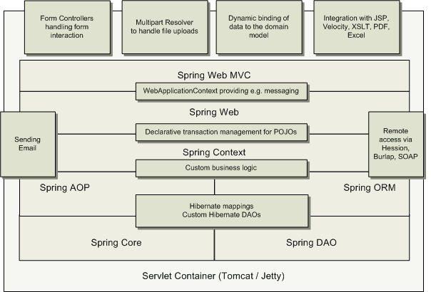
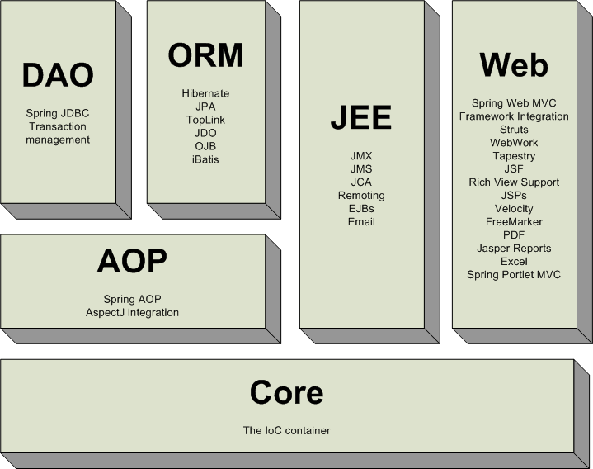
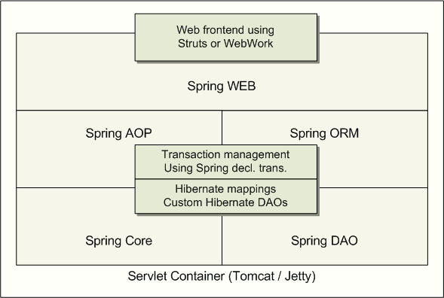
Spring Framework
Lightweight dependency injection
Aspect oriented
Layered application & container framework
Well defined modules on top of the core container
NOT an all-or-nothing solution
Notes:
Lightweight— Spring is lightweight in terms of both size and overhead. The bulk of the Spring Framework can be distributed in a single JAR file that weighs in at just over 2.5 MB. And the processing overhead required by Spring is negligible. What’s more, Spring is nonintrusive: objects in a Spring-enabled application often have no dependencies on Spring-specific classes.
Dependency Injection— Spring promotes loose coupling through a technique known as dependency injection (DI). When DI is applied, objects are passively given their dependencies instead of creating or looking for dependent objects for themselves. You can think of DI as JNDI in reverse—instead of an object looking up dependencies from a container, the container gives the dependencies to the object at instantiation without waiting to be asked.
Aspect-oriented— Spring comes with rich support for aspect-oriented programming (AOP) that enables cohesive development by separating application business logic from system services (such as auditing and transaction management). Application objects do what they’re supposed to do—perform business logic—and nothing more. They are not responsible for (or even aware of) other system concerns, such as logging or transactional support.
Container— Spring is a container in the sense that it contains and manages the lifecycle and configuration of application objects. In Spring, you can declare how each of your application objects should be created, how they should be configured, and how they should be associated with each other.
Framework— Spring makes it possible to configure and compose complex applications from simpler components. In Spring, application objects are composed declaratively, typically in an XML file. Spring also provides much infrastructure functionality (transaction management, persistence framework integration, etc.), leaving the development of application logic to you.

Slide 7

Java EE6 to the rescue

Slide 8
Evolution of J2EE→Java EE6 (Dec 09)
New specs (JAX-RS, DI, CDI, Bean Validation)
Prune dead wood
  EJB 2.x, JAX-RPC, JAXR, JEE App. Deploy, JEE App mgmt.
Extensibility
  Easy Framework Pluggability (web fragments & CDI Extensions)
Enhanced ease of development
  POJO annotation based Servlets,
  Async processing (Servlet 3.0 & EJB 3.1)
  EJB 3.1
    EJB-in-WAR, No-interface view, Singleton, EJB-lite, Timers, Standalone-container
  Contextual Dependency Injection (CDI)
  RESTful services, Portable JNDI names
  JSF2.0
    Facelets, built-in-AJAX, Skins, Annotations, Resource handling
    Simplified Navigation, Easier custom components, View & Page scopes
    Bookmarkable pages, Project Stage, Expanded event model
  JPA 2.0
    Mapping enhancements, JPAQL, Criteria Query API, Pessimistic locking
Profiles reduce platform size - Web Profile 12 specs
Notes:
JSF fu articles
http://www.ibm.com/developerworks/java/library/j-jsf1/?ca=drs-
http://www.ibm.com/developerworks/java/library/j-jsf2fu1/index.html
http://www.ibm.com/developerworks/java/library/j-jsf2fu2/index.html
http://www.ibm.com/developerworks/java/library/j-jsf2fu3/index.html?ca=drs-
http://www.ibm.com/developerworks/java/library/j-jsf2fu-0410/index.html?ca=drs-
Beginning Java EE6 Platform from Antonio Goncalves

Slide 9
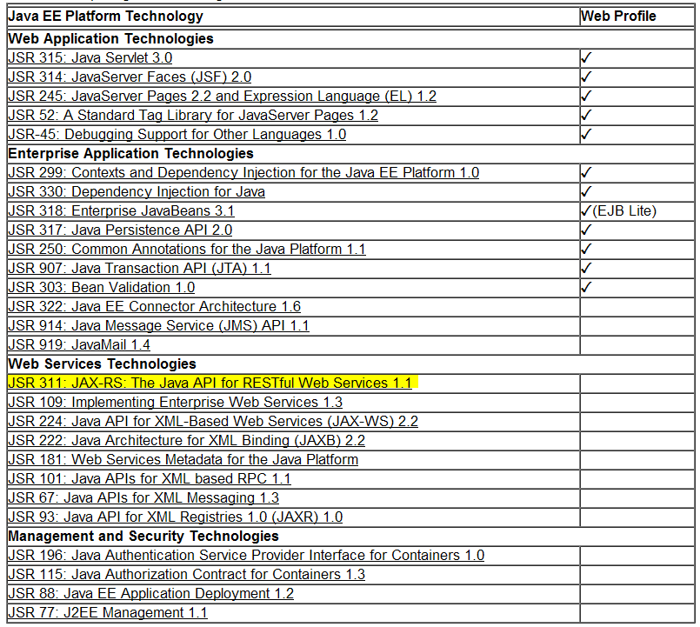
Java EE Platform & the Web Profile
Notes:
http://static.springsource.org/spring/docs/2.0.x/reference/introduction.html

Slide 10
Java EE6 → Dependency Injection JSR 330
Dependency Injection for Java
Foundation for CDI
  CDI provides EE context to Injection
Standardizes annotations
  @Inject, @Named, @Qualifier, @Scope, @Singleton
Abstract
  Does NOT specify how applications are configured
Implementations
  Apache Geronimo
  Spring Source tc Server
  Google Guice (Java SE)
  Apache Open Web Beans (Java EE & SE)
  JBoss Weld (Java EE & SE)
  Resin CanDI (Java EE & SE)

Slide 11
Example Generic Injection JSR330
// injection-point; no get/set needed...
@Inject private BusinessService service;
// Provide an implementation
public class DefaultBusinessService implements BusinessService{
…
}
import static java.lang.annotation.ElementType.*
import java.lang.annotation.*;
import javax.inject.Qualifier;
@Qualifier
@Target( { TYPE, METHOD, FIELD })
@Retention(RUNTIME)
public @interface FancyService
{ }
// Use Qualifier to inject a more meaningful implementaion of the service:
@Inject @FancyService private BusinessService fancyService;

Slide 12
Java EE6 →Managed Beans 1.0 spec.
Common Bean Definition
  POJO that is treated as managed component by the Java EE container
Annotating POJOs with @javax.annotation,ManagedBean
Standard annotations @PostConstruct & @PreDestroy can be applied to methods in managed bean
  perform resource initialization, cleanup etc
Bean can be injected in Servlet or managed JEE component
  Using @Resource, @Inject , InitialContext.lookup(“java:module/”)
Component specs (EJB, CDI, JSF, JAX-RS ) add characteristics to managed bean.
EJB, CDI are defined as managed beans too and so; are implicitly managed beans as well
@javax.annotation.ManagedBean(value="mybean")
public class MyManagedBean {
...
}
Notes:
http://blogs.sun.com/arungupta/entry/totd_129_managed_beans_1
The Managed Beans specification defines the basic programming model for application components managed by the Java
EE container

Slide 13
Contextual Dependency Injection JSR299
Future of JEE
Loose Coupling
  Server & Client, Components, Concerns & Events
Design pattern Specific type of IoC
  Don’t call us, we will call you
  No hard coded dependencies
Inspirations SEAM, Spring, Guice
Spec. lead SEAM Gavin King
  Reference Implementation Weld
Dramatic reduction in LOC
Goes far beyond what was possible with Java EE5
Not only an API but also a SPI
  Seam 3 to be released as CDI extensions

Slide 14
CDI Services
Contextual State and lifecycle mgmt.
Typesafe dependency injection
Interceptors and decorators
  extend behavior with typesafe interceptor bindings
SPI enables portable extensions
  integrates cleanly with Java EE
Adds the Web conversation context
  + to standard contexts (request, session, application)
Unified component model
  Integration with the Unified EL
    Enables use of EJB 3.0 components as JSF managed beans
Events decouple producers and consumers

Slide 15


Slide 16
Relationship to other Java EE Specs
Contextual lifecycle mgmt. for EJBs
  Session bean instances obtained via DI are contextual
    Bound to a lifecycle context
    Available to others that execute in that context
    Container creates instance when needed
    Container Destroys instance when context ends
Contextual lifecycle mgmt. for Managed Beans
Associate Interceptors with beans using typesafe interceptor bindings
Enhances JSF with a sophisticated context & DI model
  Allows any bean to be assigned an unique EL name

Slide 17
What is a CDI Managed Bean
Concrete POJO
  No argument constructor
  Constructor annotated with @Inject
Objects returned by producers
Additional types defined by CDI SPI
Defined to be a managed bean by its EE specification
  EJB session beans (local or remote)
  Message Driven Beans
  JEE Resources (DataSources, JMS Destinations)
  Persistent Unit, Persistent Contexts
  Web Service References
  Servlets, Filters, JSF Managed Beans, Tag Libraries …
Built-in Beans
    JTA User Transaction
  Security Principal representing caller identity
  Bean Validator & Validation Factory

Slide 18
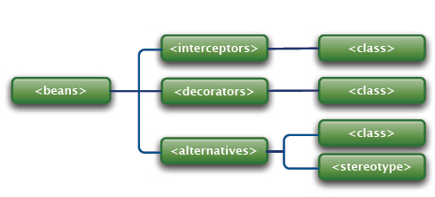
CDI Packaging
Bean classes packaged in a Bean Deployment Archive
To activate CDI create a beans.xml file (can be empty)
  META-INF
  WEB-INF/classes
Container searches for beans in all bean archives in application classpath
http://java.sun.com/xml/ns/javaee/beans_1_0.xsd
* Picture source Norman Richards

Slide 19
Types of CDI Injection
Field Injection
Parameter Injection
  Observer, producer & disposer methods
  Initializer methods
@ConversationScoped
public class Order {
@Inject @Selected Product product; //field injection
@Inject //Initializer method
void setProduct(@Selected Product product) {
this.product = product;
}
}

Slide 20
Bean Definition
Bean Type
Qualifier
Scope
EL Name
Interceptors
Implementation

Slide 21
Bean Type: Set of Java Types a Bean Provides
public class BookShop
extends Business implements Shop<Book>{
...
}
Client visible Bean types
  BookShop, Business, Shop<Book>, Object.
@Stateful
public class BookShopBean extends Business
implements BookShop, Auditable {
...
}
Bean types
  BookShop, Auditable , Object
Restricted using the @Typed annotation
  @Typed(Shop.class) public class BookShop
Notes:
Bean Type The bean type is the set of Java types that the bean provides. CDI injection always uses type as the primary identifier for determining the bean that will provide an instance. Unless otherwise restricted, a bean’s type includes all the superclasses and interfaces in the Java type hierarchy.

Slide 22
Qualifiers
Distinguish between beans of the same Type
@ASynchronous
class AsynchronousPaymentProcessor
implements PaymentProcessor {
...
}
@Synchronous
class SynchronousPaymentProcessor
implements PaymentProcessor {
...
}
//Qualifier type
@Qualifier
@Target({TYPE, METHOD, PARAMETER, FIELD})
@Retention(RUNTIME)
public @interface Synchronous{}
Specifying qualifiers on an injected bean aka Client
@Inject @Synchronous PaymentProcessor paymentProcessor
Notes:
Sometimes, a bean type alone does not provide enough information for the container to know which
bean to inject. For instance, suppose we have two implementations of the PaymentProcessor
interface: CreditCardPaymentProcessor and DebitPaymentProcessor. Injecting a field of type
PaymentProcessor introduces an ambiguous condition. In these cases, the client must specify some additional
quality of the implementation it is interested in. We model this kind of "quality" using a qualifier.
A qualifier is a user-defined annotation that is itself annotated @Qualifer. A qualifier annotation is an extension of
the type system. It lets us disambiguate a type without having to fall back to string-based names. Here's an example
of a qualifier annotation:
Qualifiers allow extra type information to be supplied while
keeping the reference type generic
● A Qualifier provides guidance to CDI about which bean class
should be used. ● An injection point can use multiple qualifiers. All qualifiers
must be present on the bean.
@Qualifier
@Target({TYPE, METHOD, PARAMETER, FIELD})
@Retention(RUNTIME)
public @interface CreditCard {}
There may be multiple beans that implement a desired Java type. It is possible to distinguish between multiple types using qualifier annotations. Qualifiers are developer-defined and provide a type-safe way to distinguish between multiple beans implementations.
qualifier type represents some client-visible semantic associated with a type that is satisfied by some implementations of
the type (and not by others). For example, we could introduce qualifier types representing synchronicity and asynchronicity.
In Java code, qualifier types are represented by annotations.

Slide 23
Qualifiers
Bean can define multiple qualifier types
  Injection Point only needs enough qualifiers to uniquely identify a bean
Every bean
  Built-in qualifier @Any
  Default qualifier @Default when one is not explicitly declared
Producer methods and fields can also use qualifiers
@Produces @Asynchronous
public PaymentProcessor createAsynchronousProcessor() {
return new AsynchronousPaymentProcessor();
}
Qualifiers with members
  @Target({FIELD, PARAMETER}) @Retention(RUNTIME)
  @Qualifier
  public @interface Currency {
  public String code();
  }
  // client
  @Inject @Currency(code=“USD”) PaymentProcessor processor;

Slide 24
Scope: Lifecycle & Visibility of Instances
Scoped Objects exist a lifecycle context
  Each bean aka contextual instance is a singleton in that context
  Contextual instance of the bean shared by all objects that execute in the same context
// Session scoped bean shared by all requests
// that execute in the context of that session
public @SessionScoped class ShoppingCart implements Serializable { ... }
@Produces @RequestScoped @Named("orders")
List<Order> getOrderSearchResults() { ... }
@ConversationScoped public class Order { ... }
@Produces @SessionScoped User getCurrentUser() { ... }
Notes:
Java EE components such as servlets, EJBs and JavaBeans do not have a well-defined scope. These components are either:
• singletons, such as EJB singleton beans, whose state is shared between all clients,
• stateless objects, such as servlets and stateless session beans, which do not contain client-visible state, or
• objects that must be explicitly created and destroyed by their client, such as JavaBeans and stateful session beans,
whose state is shared by explicit reference passing between clients.
Scoped objects, by contrast, exist in a well-defined lifecycle context:
• they may be automatically created when needed and then automatically destroyed when the context in which they were
created ends, and
• their state is automatically shared by clients that execute in the same context.
All beans have a scope. The scope of a bean determines the lifecycle of its instances, and which instances of the bean are
visible to instances of other beans, as defined in Chapter 6, Scopes and contexts. A scope type is represented by an annotation
type.
For example, an object that represents the current user is represented by a session scoped object:
All beans have a well-defined scope that determines the lifecycle and visibility of instances. The set of scopes is fully extensible, with built-in scopes including request scope, conversation scope, session scope and application scope. Beans can also be dependent and inherit the scope of their injection point
An instance of a session-scoped bean is bound to a user session and is shared by all requests that execute in the
context of that session

Slide 25
Scope: Lifecycle & Visibility of Instances
Normal Scopes
  @RequestScoped DTO/Models, JSF Backing beans
  @ConversationScoped Multi-step workflow, Shopping Cart
  @SessionScoped User login credentials
  @ApplicationScoped Data shared by entire app, Cache
Pseudo scope
  @Dependent (default scope) makes sense for majority
    Bound to the lifecycle of the object they were injected
Qualifier
  @New (new instance will be created)
    Not bound to the declared scope
    Has had DI performed
Custom scopes provided by Extensions
  OpenWebBeans provides @ViewScoped through the Jsf2ScopesExtension
Notes:
Java EE components such as servlets, EJBs and JavaBeans do not have a well-defined scope. These components are either:
• singletons, such as EJB singleton beans, whose state is shared between all clients,
• stateless objects, such as servlets and stateless session beans, which do not contain client-visible state, or
• objects that must be explicitly created and destroyed by their client, such as JavaBeans and stateful session beans,
whose state is shared by explicit reference passing between clients.
Scoped objects, by contrast, exist in a well-defined lifecycle context:
• they may be automatically created when needed and then automatically destroyed when the context in which they were
created ends, and
• their state is automatically shared by clients that execute in the same context.
All beans have a scope. The scope of a bean determines the lifecycle of its instances, and which instances of the bean are
visible to instances of other beans, as defined in Chapter 6, Scopes and contexts. A scope type is represented by an annotation
type.
For example, an object that represents the current user is represented by a session scoped object:
All beans have a well-defined scope that determines the lifecycle and visibility of instances. The set of scopes is fully extensible, with built-in scopes including request scope, conversation scope, session scope and application scope. Beans can also be dependent and inherit the scope of their injection point
An instance of a session-scoped bean is bound to a user session and is shared by all requests that execute in the
context of that session
Scope Description
Dependent A dependent reference is created each time it is injected and the reference is
removed when the injection target is removed. This is the default scope for CDI
and makes sense for the majority of cases.
ApplicationScoped An object reference is created only once for the duration of the application and the
object is discarded when the application is shut down. This scope makes sense for
service objects, helper APIs or objects that store data shared by the entire
application.
RequestScoped An object reference is created for the duration of the HTTP request and is
discarded when the request ends. This makes sense for things like data transfer
objects/models and JSF backing beans that are only needed for the duration of an
HTTP request.
SessionScoped An object reference is created for the duration of an HTTP session and is
discarded when the session ends. This scope makes sense for objects that are
needed throughout the session such as maybe user login credentials.
ConversationScoped A conversation is a new concept introduced by CDI. It will be familiar to Seam
users, but new to most others. A conversation is essentially a truncated session
with start and end points determined by the application, as opposed to the session
which is controlled by the browser, server and session timeout. There are two
types of conversations in CDI -- transient which basically corresponds to a JSF
request cycle and long-running which is controlled by you via the Conversion.begin
and Conversion.end calls. A transient conversation can be turned into a
long-running one as needed. Conversations are very useful for objects that are
used across multiple pages as part of a multi-step workflow. An order or shopping
cart is a good example. Conversations deserve detailed discussion so we will take
a much closer look at them in a later article in the series.

Slide 26
EL Name: Lookup beans in Unified EL
Binding components to JSF Views
Specified using the @Named annotation
public @SessionScoped @Named("cart“) class ShoppingCart implements Serializable {
...
}
Now we can easily use the bean in any JSF or JSP page
<h:dataTable value="#{cart.lineItems}" var="item">
...
</h:dataTable>
Container derives default name in absence of @Named
  Unqualified short class name of the bean class
@Named is a built-in Qualifier
Notes:
Although it’s completely optional, beans may define an EL name that can be used for non-type safe access. One common usage of EL name is for binding components to JavaServer Faces (JSF) views.
used in places where CDI’s type-based lookup is not possible.

Slide 27
Interceptors
Separate cross-cutting concerns from business logic
Associate Interceptors to managed beans using Interceptor Bindings
@Inherited
@InterceptorBinding //Interceptor Binding Type definition
@Target({TYPE, METHOD})
@Retention(RUNTIME)
public @interface Transactional {}
//Declaring Interceptor Bindings of an Interceptor
@Transactional @javax.interceptor.Interceptor
public class TransactionInterceptor {
@AroundInvoke
public Object manageTransaction(InvocationContext ctx)
throws Exception { ... }
}
//Binding Interceptor to Bean
@Transactional public class ShoppingCart { ... }
public class ShoppingCart {
@Transactional
public void placeOrder() { ... }
}

Slide 28
Interceptors
Enabled manually in the beans.xml
Order defined in beans.xml
@Dependent object of the object it intercepts
<beans>
<interceptors>
<class>org.mycompany.TransactionInterceptor</class>
<class>org.mycompany.LoggingInterceptor</class>
</interceptors>
</beans>

Slide 29
Implementation & Design Patterns
Bean Implementation provided by
  Developer … Java class
  Container … Java EE env. Resource beans
Contextual Singleton
All Normal scoped beans are proxied
  Contextual Reference implies a proxy for a contextual instance
Dynamic Proxies
  Passivation of contextual instances
  Scope Management
    Narrower scope injected into a wider scope
Chaining of Dynamic Proxies
  Interceptor and Decorator chaining
Notes:
http://www.javaworld.com/cgi-bin/mailto/x_java.cgi?pagetosend=/export/home/httpd/javaworld/javaworld/jw-01-2006/jw-0130-proxy.html&pagename=/javaworld/jw-01-2006/jw-0130-proxy.html&pageurl=http://www.javaworld.com/javaworld/jw-01-2006/jw-0130-proxy.html&site=jw_core
http://java.sys-con.com/node/38672

Slide 30


Slide 31
Alternatives
Deploy time selection of bean implementation
Alternate implementation of bean
  Explicitly enabled in the beans.xml
  Overrides the original bean
@Alternative // annotate bean class, producer method or field
@Specializes
public class MockOrder extends Order {
... // alternative implementation
}
<beans>
<alternatives>
<class>org.example.MockOrder</class>
</alternatives>
</beans>
@Specializes
  Alternate inherits the metadata (name, qualifiers ) etc of the parent
Notes:
Alternatively, an alternative may be declared by annotating a bean, producer method or producer field with a stereotype
that declares an @Alternative annotation.
If an interceptor or decorator is an alternative, non-portable behavior results.
Qualifiers allow class selection but require modification to
source code and recompiling if they need to be changed
● Alternatives allow CDI to alternate bean classes based on
XML configuration data (beans.xml)
● Alternative classes (annotated with @Alternative) are
disabled by default
● An enabled (via beans.xml) alternative class takes
precedence over a non-alternative class
● Two enabled alternative classes matching the same
qualifiers on an injection point would result in an exception

Slide 32
Stereotypes
Meta-annotation that bundles multiple annotations
Stereotype bundles
  Scope
  Interceptor Bindings
  @Named
  @Alternative
Bean annotated with a stereotype inherits all annotations of the stereotype
@RequestScoped
@Secure
@Transactional
@Named
@Stereotype
@Target(TYPE)
@Retention(RUNTIME)
public @interface Action {}
Built-in Stereotypes
  @Model
  @Decorator
  @Interceptor
@Alternative applied to a stereotype
  ALL beans with that stereotype are enabled/disabled as a group

Slide 33
Producers
Application control of bean instance creation & destruction
Producer Fields
public class Shop {
@Produces @ApplicationScoped @Catalog @Named("catalog")
List<Product> products = ....;
}
Producer Methods
public class Shop {
@Produces @ApplicationScoped @Catalog @Named("catalog")
List<Product> getProducts(CatalogID cID) { ... }
}
Disposer Methods
  Customized cleanup of object returned by a producer method
public class Shop {
public void close(@Disposes @Catalog List<Product> products) {
products.clear();
}
}

Slide 34
Injecting Java EE Resources
When injecting EJBs
  Use @Inject to get Contextual Injection
  Use @EJB ONLY for remote session beans
Define producers making EE types available for injection… non contextual injection
@Produces @WebServiceRef(lookup="java:app/service/PaymentService")
PaymentService paymentService;
@Produces @PersistenceContext(unitName="CustomerDatabase")
@CustomerDatabase EntityManager customerDatabasePersistenceContext;
Consume the Injected types in other CDI Beans
@Inject @CustomerDatabase EntityManager myEntityManager
@Inject PaymentService myPaymentService
Notes:
Almost always use @Inject
● Lets you use interceptors, delegates, scope based beans,
qualifiers, etc
● Can inject EJBs
● @EJB is okay for remote session beans in some cases
● Lets you specify a JNDI name
● @Resource is seldom needed
● Injecting a DataSource
● Producers can be used to enable @Inject based injection
for @EJB and @Resource dependencies if needed

Slide 35
Decorators
Implements one or more bean types
  Can be abstract
  Implements the interface it is decorating
Extend bean types with function specific to that type
Called after interceptors
Explicitly enabled in the beans.xml
public interface Htmlable { String toHtml(); } //interface
public class HtmlDate extends Date implements Htmlable {
public String toHtml() { //date class that knows its HTML representation
return toString();
}
}
@Decorator public class StrongDecorator implements Htmlable {
@Inject @Delegate @Any private Htmlable html;
public String toHtml() { //decorator that puts the HTML inside <strong> tags
return "<strong>" + html.toHtml() + "</strong>";
}
}
Notes:
Any calls to the delegate object that correspond to a decorated type will be called on the decorator, which may in turn invoke the method directly on the delegate object.

Slide 36
Events: Observer Pattern
// Event is a POJO
public class MyEvent { String data; Date eventTime; .... }
// Event<MyEvent> is injected automatically by the container
@Stateless @Named (“producer”)
public class EventProducer {
@Inject @My Event<MyEvent> event; //@My is a Qualifier
public void doSomething() {
event.fire(new MyEvent());
}
}
// Declare method that takes a parameter with @Observes annotation
@Stateless // Transactional, Conditional observer
public class EventConsumer {
public void afterMyEvent(
@Observes(during=AFTER_SUCCESS receive=IF_EXISTS) @My MyEvent event) {
// .. Do something with MyEvent
}
}
<h:form> // Fire the event from a JSF 2.0 Page
<h:commandButton value="Fire!" action="#{producer.doSomething}"/>
</h:form>
Notes:
http://www.dzone.com/links/r/decoupling_event_producers_and_consumers_in_jee6.html
http://www.adam-bien.com/roller/abien/entry/java_ee_6_observer_with
Event Producer -> Event Consumer(s) [foreground thread]
Event Producer -> Event Sender -> JMS Queue [foreground thread]
JMS Queue -> Event Dispatcher -> Event Consumer [background thread
If there are multiple observers for an event, the order that they are called in is not defined
CDI will automagically wire EventProducer and EventConsumer
so that when EventProducer fires the event, EventConsumer.afterMyEvent gets called

Slide 37
CDI Extensions
Portable
  Activated by dropping jars on the application classpath
  Loaded by the java.util.ServiceLoader
Service provider of the service javax.enterprise.inject.spi.Extension declared in META-INF/services
Code to javax.enterprise.inject.spi .* interfaces
Integrate with container through container lifecycle events by
  Providing its own beans, interceptors and decorators
  Injecting dependencies into its own objects
  Providing a context implementation for a custom scope
  Augmenting or overriding the annotation-based metadata with other source

Slide 38
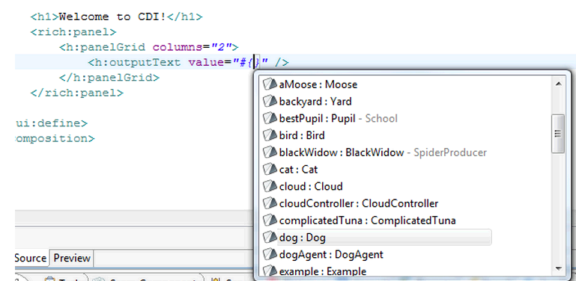
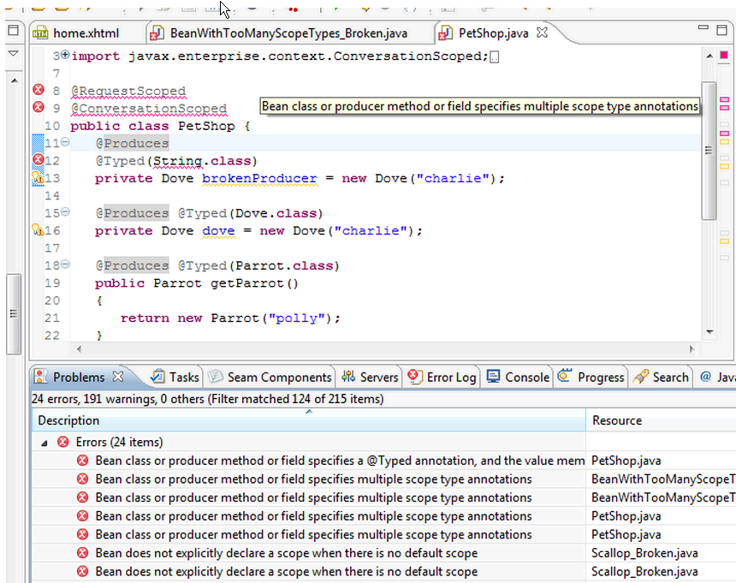
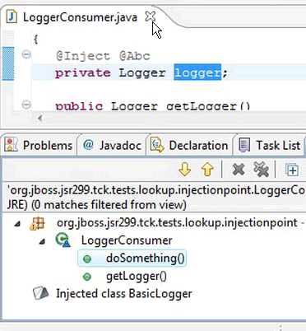
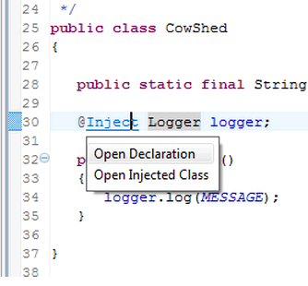
Eclipse IDE JBossTools
Notes:
JBoss tools 3.2 has excellent CDI support. See http://docs.jboss.org/tools/whatsnew/cdi/cdi-news-3.1.0.CR2.html From various sources ... " CDI annotations are now supported in JBoss Tools 3.1, allowing CDI utilization on any Eclipse Java project. Enabling CDI is as simple as going to the Configure menu and checking the box for CDI. Code completion for @Named components along with the code completion, refactoring, and open-on navigation that was done for Seam also applies to CDI components. In addition to the nice code completion for @Named beans, you can also easily navigate to @Injection sites using Ctrl+Click or by searching for all occurrences where named beans are used. If you enable validation, the project will check for errors in your CDI constructs and give instant feedback. Methods refactoring on CDI beans will be reflected in Eclipse expressions. New Contexts and Dependency Injection wizards help you create common annotation types such as Qualifiers, Stereotypes, Scope, and Interceptor Binding. CDI construct validation has also been expended by covering around 60 TCK validations. It also warns developers early on if things are not wired up correctly in the source code."

Slide 39
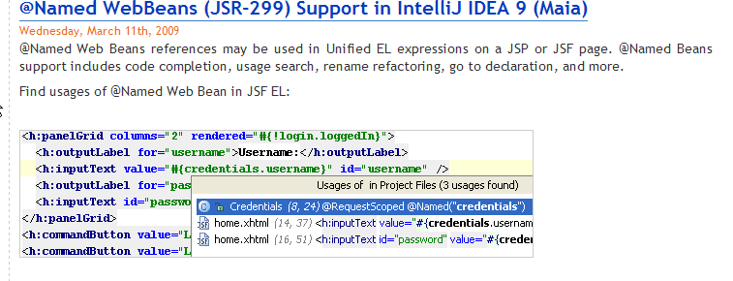
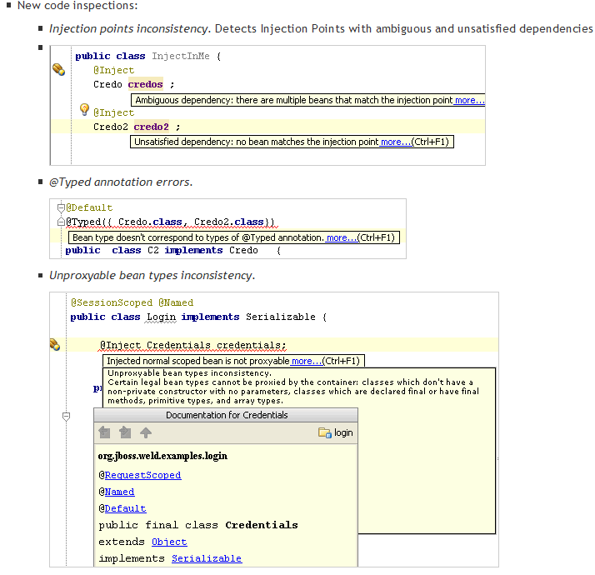
IntelliJ IDE
Support
Notes:
http://blogs.jetbrains.com/idea/tag/cdi/

Slide 40
Apache Open Web Beans
1.0.0 release … October 2010
  http://www.apache.org/dist/openwebbeans/1.0.0/
Apache License v2
Running in production web sites
14 Committers (Looking for more ☺)
Active developer mailing list
Well defined hook points for integration with JEE containers
Works in Java SE & Java EE
  Container agnostic
Consumers
  Servlet Containers
    Jetty
    Apache Tomcat 6, 7
  Apache Open EJB
  Apache Geronimo
  WebSphere Application Server 8
    Now in beta, Developer license is FREE
  WebSphere Community Edition
Notes:
1.0.0 implements the latest API, passes the JSR-330 TCK and the JSR-299 standalone TCK.

Slide 41
Apache Open Web Beans Getting Started
Ensure Subversion and Maven binaries are on the PATH
svn co http://svn.apache.org/repos/asf/openwebbeans/trunk openwebbeans
mvn package
Install Eclipse plugins for maven and subversion
http://m2eclipse.sonatype.org/sites/m2e
http://subclipse.tigris.org/update_1.6.x
Eclipse→ File → Import → Existing Maven Projects
Samples Downloaded
  /samples/conversation-sample
  /samples/ejb-sample
  /samples/ejb-telephone
  /samples/guess
  /samples/jms-sample
  /samples/jsf2sample
  /samples/reservation
  /samples/standalone-sample
  /samples/tomcat7-sample
Running samples
  New m2 Maven Build
  Base Directory: ${workspace_loc:/reservation}
  Goals: org.mortbay.jetty:maven-jetty-plugin:6.1.21:run
  Profiles: jetty
Using Apache Open Web Beans with Tomcat
  http://java.dzone.com/articles/using-apache-openwebbeans
Debugging :Using the Jetty plugin inside Eclipse: http://bit.ly/4VeDqV

Slide 42
Troubleshooting
CDI Exception | How to Fix
AmbiguousResolutionException More than one bean eligible for injection. | Add qualifiers or alternatives to @Inject to narrow bean resolution. Disable alternatives. Annotate class with @Typed
UnproxyableResolutionException bean type cannot be proxied by the container | Ensure that bean types are legal. Check if class is declared final, has final methods or private CTOR with no parameters
UnsatisfiedResolutionException No bean eligible for injection | Remove qualifiers from injection point or add qualifiers to existing types. Enable alternatives
BusyConversationException Rejected request b/c concurrent request is associated with the same conversation context. | Before starting a conversation check if one already exists using Conversation.isTransient()
NonexistentConversationException Conversation context could not be restored | Check if conversation is being propagated with the cid GET request parameter
ContextNotActiveException Bean invocation in inactive context | Ensure that methods on the injected bean are called in a context that is active as defined by the scope of the bean.
ObserverException Exception is thrown while handling event | Fix observer method code that throws the exception.

Slide 43
Future of CDI
Closer integration between EJB and CDI beans
Transactions, Security, Concurrency etc delivered as Interceptors that can be applied to any CDI bean
Popular CDI portable extensions rolled into the core spec.

Slide 44
CDI/Java EE vs Spring
Similar programming models
  Spring AOP vs JEE6 Interceptors & Decorators
  @Component vs @Stateless
  @Autowired vs @Inject
  ApplicationContext vs BeanManager
Spring supports JSR330 style annotations
Spring does NOT provide support for CDI/JSR 299
SPRING + CDI/JEE6 DON’T MIX
  Too much overlap
  Support and Migration cost
For start-to-scratch projects CDI is the right choice
Spring Framework | Java EE 6/ CDI
Flexible, best-of-breed, mix-and-match | Full package
Vendor lock-in | Standards based
Notes:
http://ocpsoft.com/java/spring-to-java-ee-a-migration-guide-cdi-jsf-jpa-jta-ejb/
JEE6 web profile vs. Spring 3 1. -Spring: not standards-based; introduces vendor lock-in 2. -Spring: AOP overkill; higher learning curve compared to JEE interceptors 3. -Spring: excessive XML configs (although this is not as relevant anymore) 4. Spring: selective adoption of EE6 specs such as Bean Validation, JSF 2.0, JPA 2.0 5. +EE6: standards-based; no vendor lock-in; multiple implementations of JSRs 6. +Spring: don’t need to upgrade to EE6 server (JSE5 is required) 7. Hot incremental deployment for development envmts (e.g. Tapestry 5 and Seam 2.x)? 8. Lightweight vs. heavyweight (considering the EE6 web profile) 9. +EE6: Portable extensions in CDI 10. +Spring: easier to find developers with Spring experience vs. developers with EE6 experience 11. -Spring: using OSIV, for handling LIEs whereas Seam has a more elegant solution via SMPC and Hibernate manual flush 12. -Spring: conversation support via Spring Web Flow but there's also JSF and Spring MVC to confuse you more? 13. +EE6: profile concept with full and web thus far 14. ++Spring: don't need to upgrade to EE6 server to use Spring3
http://jandiandme.blogspot.com/2010/10/spring-vs-java-ee-and-why-i-dont-care.html
ava EE 6 and Spring 3 became very similar - at least the resulting architecture and even design will differ only in details (see also Juergen Hoeller comment). I don't expect differences in development lifecycle either - e.g. Glassfish deployment (changing a JPA entity or a Session Bean) takes only a few hundred milliseconds - but you could achieve the same easily with Spring as well (there is no reason, why not).
Spring also comes with own server. Spring has (since October 7th, 2008) similar maintenance policies to opensource servers with commercial support. If you would like to have patches for an older Spring-version - you will have to buy commercial support from SpringSource / VMWare.
For serious projects you will have to sign two maintenance and support contracts - one with your application server vendor and the another one with SpringSource. That is very hard to justify having Java EE 5 / 6 in place. In mid term I only see this two options:Deploying Spring on the "proprietary" tc Server
Deploying Java EE 6 applications without Spring (you could build them with Spring support, but deployment to production will be the issue)
All the migration projects will also have to make this decision, whether they will stick with Java EE, or migrate straight to Spring. This decision has nothing to do with technology - and a lot with business / strategy / politics. You could of course build Spring from source and deliver a binary by yourself. Delivering an uncertified, un-indemnified "custom" Spring-build would be impossible for "mission critical" and very hard for most commercial projects.
The future of Enterprise Java is very clear - full stack Spring or full stack Java EE - but no mix any more.

Slide 45
Links/References
JSR 299 spec http://bit.ly/cbh2Uj
Weld Reference Implementation http://bit.ly/aLDxUS
Spring to Java EE http://bit.ly/9pxXaQ
WebSphere Application Server 8 Beta http://bit.ly/aKozfM
Apache Open Web Beans dev mailing list http://bit.ly/b8fMLw
Weld Blog http://relation.to/
CDI Reference card http://bit.ly/7mWtYO
CDI, Weld and the Future of SEAM: http://slidesha.re/9nODL2
Reza Rahman Articles on CDI
  http://bit.ly/aIhCD6
  http://bit.ly/adHGKO
  http://bit.ly/d4BHTd
  http://bit.ly/dcufcQ
  http://bit.ly/d0kO9q

Slide 46
DEMO

Slide 47


Slide 48
CDI Portable Extensions Resources
https://cwiki.apache.org/EXTCDI/
https://cwiki.apache.org/EXTCDI/core-usage.html
http://bit.ly/botJKZ
http://bit.ly/9cVdKg
http://bit.ly/axmKob

