Slide 1
Apache Traffic Server
Do we really need another proxy server?
Leif Hedstrom, Akamai Technologies
zwoop@apache.org
@zwoop

Slide 2
Oh Absolutely!

Slide 3
Origins of the software
Notes:
Traffic Server started as a commercial product, developed and sold by Inktomi way back in the days
Yahoo! Acquired Inktomi in 2003, and while developing our own CDN, we “found” Traffic Server laying on the shelves.
Dusting it off and porting to modern Linux, it immediately beat existing intermediaries hands down in our benchmarks, typically by 5x or more
In 2009, Y! donated the Traffic Server source code to the Apache Software Foundation.
In April of 2010, Apache Traffic Server became a TLP.

Slide 4
Notes:
Before entering into the Apache community, the Y! version of TS was only running on 32-bit Linux.
A direct benefit of being OpenSource gave us not only 64-bit support, but also ports to most common Linux distributions, FreeBSD, OpenSolaris and MacOSX.
Performance has more than doubled, and in some cases, trippled, since we released he code into the Apache Open Source community, and most of these improvements have come from external contributors.

Slide 5
Plenty of FOSS Proxy Servers
Notes:
Traffic Server is obviously not the only HTTP intermediary in the Open Source community. Existing servers include Apache mod_proxy, Squid, NGINX, Varnish and Haproxy.
This makes the task of choosing a Proxy server an interesting, but challenging task. You really need to understand your problem space, your requirements, and any restrictions (like, budget).
Easy for me to pick, but lets discuss some of the considerations you should take.

Slide 6
Choosing an intermediary
Notes:
For me, there are three important areas to consider when choosing the proxy server (or probably, any other server for that matters):
Performance and scalability
Features
Is it a good product for operations to manage, and for engineers to develop applications for?
We’ll discuss these in details, but the goal for Apache Traffic Server is obviously to be smack in the middle of this Venn diagram. We’re not quite there yet.

Slide 7
The concurrency problem
Notes:
Alright, so lets talk about what problems a good HTTP (and/or proxy server) can solve.
There are two primary concurrency problems for the server software developers to consider:
How can the software handle tens of thousands of concurrent TCP connections?
How can the software take advantage of modern multi-core CPUs? Commodity hardware today has 2, or 4 and even 8 or more cores in each server.
* Additionally, while solving these two problems, we have to make sure we don’t introduce other resource starvations, for example, memory pressure.

Slide 8
Traffic Server process model
Notes:
There are n worker threads per core, typically 2. This gives around 16 – 24 threads of execution threads on typical modern hardware, each running an event loop
There are m I/O threads per disk spindle. This is used to deal with disk I/O outside of the worker threads, and the default is 4. A critical configuration decision here is to scale this appropriately, particularly if a “disk” is raided, and might have more than 1 spindle under the hood.
There are also a small number of “helper” threads, to do tasks like accepting new connections, produce log output and stats aggregation and presentation
* All threads share resources, such as RAM and Disk cache, configurations, stats and logs.

Slide 9
Traffic Server performance
100,000 requests / sec with small content out of cache, for a single (quad-core + HT) box
3.6Gbps out of a single box, with larger content (4x GigE NIC bonded)
(best case scenarios)
Notes:
I wasn’t going to go into performance numbers, because out of context they are fairly useless, but here are some numbers from the Y! CDN and our lab.
The Y! CDN is on some ~100 servers, most of which are idle most of the time. The reason for such a large deployment is because we cover most of the world, and also need to handle major outages as well as traffic spikes.

Slide 10
 | ATS | HAproxy | nginx | Squid | Varnish | mod_proxy
Worker Threads | Y | N | N | N | Y | Y*)
Multi-Process | N | Y | Y | N | Y | Y
Event-driven | Y | Y | Y | Y | N | Y*)
Plugin APIs | Y | N | Y | part | Y | Y
Forward Proxy | Y | N | N | Y | N | Y
Reverse Proxy | Y | Y | Y | Y | Y | Y
Transp. Proxy | Y | Y | N | Y | N | N
Load Balancer | part | Y | Y | Y | Y | Y
Cache | Y | N | Y | Y | Y | Y
ESI | soon | N | N | Y | Y | N
ICP | Y | N | N | Y | N | N
Keep-Alive | Y | N | Y | Y | Y | Y
SSL | Y | N | Y | Y | N | Y
Pipeline | Y | N | Y | Y | N | Y
Notes:
This table is much to large to go into details, but it shows that there are a number of features to take into consideration when choosing an intermediary.
This is not a complete list in any way, it is merely an example of what features you might want to consider for your proxy choices.

Slide 11
http://www.flickr.com/photos/stuartpilbrow/3345896050/
Notes:
Easy to use, easy to configure, and generally easy to manage from an operational perspective.
Configuring your software should not be this hard!
Defaults should be “reasonable”, and let you get started fast.

Slide 12
Traffic Server making Ops easy
Traffic Server will restart automatically if it crashes
Traffic Server will kill itself if it isn’t responding
Traffic Server can reload most configurations without server restarts
Adding plugins is a matter of dropping in the shared object, and restarting
Stats and configurations are accessible via command line utilities and APIs
Notes:
Traffic Server will monitor itself, and restart the main server process if something isn’t functional.
Even through process restarts, the HTTP port is still being listened on, and new requests are queued up in the listen backlog.
Most configurations can be modified and reloaded, without server restarts
Adding plugins is easy, just drop them in place and restart the server.

Slide 13
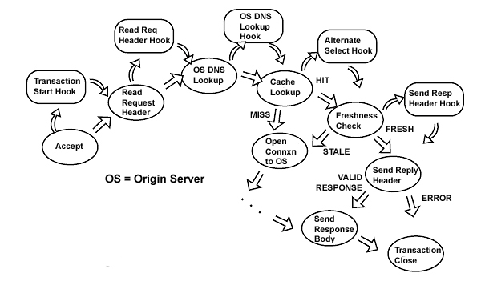
Plugin APIs - Continuations
Notes:
A plugin APIs allows for developers to extend the capabilities of the Apache Traffic Server.
A set of example plugins are available, which augments the developer SDK documentations.
A set of production quality plugins are being prepared to be released by Yahoo to the Apache community.
We encourage developers to contribute and release plugins, and will gladly accept contributions.

Slide 14
plugin.config
records.config
partition.config
hosting.config
cache.config
update.config
ip_allow.config
storage.config
logs_xml.config
parent.config
remap.config
icp.config
Notes:
Traffic Server comes with a fairly large number of configuration files.
Most of the configurations have reasonable “defaults”.
Most applications wouldn’t use even a fraction of the available configuration options and features.

Slide 15
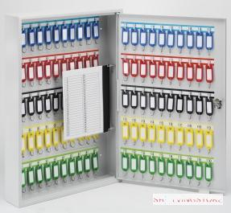
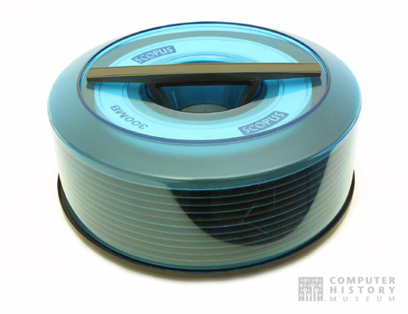
records.config
storage.config
remap.config
Notes:
Getting started, only two or maybe three configuration files are necessary to tweak.
records.config is a key-value configuration format, holding most global application configuration settings
storage.config is used to specify disk storage configurations
remap.config is used to specify mapping rules for rewriting requests, typically in a reverse proxy setup

Slide 16
Critical in records.config
CONFIG proxy.config.exec_thread.autoconfig INT 1
CONFIG proxy.config.exec_thread.autoconfig.scale FLOAT 2.0
CONFIG proxy.config.exec_thread.limit INT 2
CONFIG proxy.config.http.server_port INT 8080
CONFIG proxy.config.http.cache.http INT 1
CONFIG proxy.config.cache.ram_cache.size INT 512M
CONFIG proxy.config.reverse_proxy.enabled INT 1
CONFIG proxy.config.url_remap.remap_required INT 1
CONFIG proxy.config.url_remap.pristine_host_hdr INT 0
CONFIG proxy.config.ssl.enabled INT 0
CONFIG proxy.config.ssl.server.cert.filename STRING server.pem
Notes:
Critical for performance: number of worker threads. The defaults are “ok”, but in a very high performance setup, tuning this can make a noticeable difference.
Default port is 8080
Default is to run as a reverse proxy
Easy to change to open forward proxy

Slide 17
CONFIG proxy.config.url_remap.remap_required INT 1
Notes:
* The defaults are for a reverse proxy, now lets examine all the configuration changes necessary to turn this into a forward proxy server.

Slide 18
CONFIG proxy.config.url_remap.remap_required INT 0
Notes:
Yes, that is it, there’s one bit of configuration changes between a reverse proxy and an open forward proxy.
There’s not much that can be done to simplify this!

Slide 19
Q & A

