Slide 1
Evaluation of Excel Formulas in Apache POI
Apache POI - The Open Source Java solution for Microsoft Office
Yegor Kozlov
yegor@apache.org

Slide 2
Agenda
History of Excel support in POI
Excel Formulas. Why bother?
Formulas under microscope
Formula Evaluator: from basics to advanced
Extensibility
Modeling Excel semantics

Slide 3
History of Excel support POI
Excel binary format BIFF8 is supported since POI 1.0 (2002)
Current version is 3.7 and both binary (.xls) and OOXML (.xlsx) formats are supported
Until 2007 the format spec was closed and most of work was based on hacking.
Now both .xls and .xlsx formats are open (to a certain degree)

Slide 4
Excel Formulas. Why bother?
First versions of POI focused on reading and writing spreadsheets. OK for a start, but the power of Excel is in its formulas.
Use cases:
Evaluate Excel workbooks on server side
Fill XLS templates with data and predict formula results
Insert new formulas or modify existing ones. Create formulas in Excel and evaluate them in POI or the other way around
Define your complex financial or scientific models in Excel: POI’s formula evaluator will take care of the calculation graph

Slide 5
Excel Usermodel API
Common UserModel (DOM-like) interface for both .xls and .xlsx formats
Open / create a Workbook
From the Workbook, get existing or add new Sheets
From a Sheet, iterate over Rows
From a Row, get at the Cells
From a Cell, get contents (values, formulas), styling, formatting, comments etc.

Slide 6
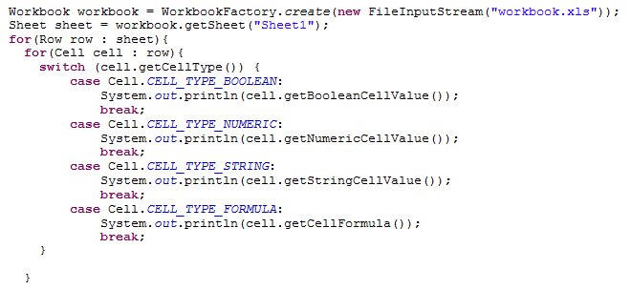
Excel Usermodel API Example

Slide 7
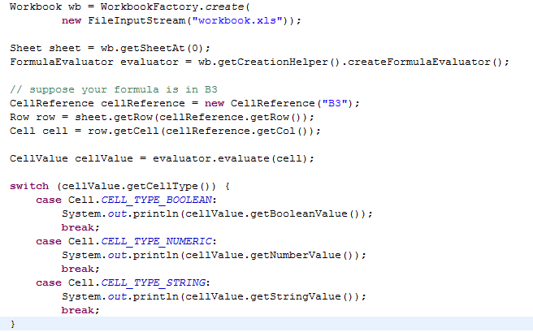
Formula Evaluator

Slide 8
Using the evaluator
Evaluator class is
org.apache.poi.ss.usermodel.FormulaEvaluator
Has a variety of methods, but most common are:
evaluate(cell)
evaluateFormulaCell(cell)
evaluateAllFormulaCells(workbook)

Slide 9
What is supported?
Built-in functions: over 350 recognized, 280 evaluatable
Add-in functions: initial support for Excel Analysis Toolpack (built-in in Excel 2007+)
Support for User-Defined functions
Full support for defined names
Detection of circular references
…much more

Slide 10
Formula QA
Every implemented function has a junit test case
Integrated tests involving re-calculation of the whole workbook with chained formula dependencies
To make the spreadsheet load faster, Excel stores a computed value with every formula. An additional test is to compare POI’s result and the last result seen by Excel
Rounding errors are possible

Slide 11
Excel Formulas
A formula consists of indivisible particles called tokens. In the BIFF8 terminology tokens are called PTGs (for Parsed Thing)
For .xls, the tokens of a formula are stored in the Reverse-Polish Notation (RPN). This means that the formula is disassembled before saving. To get the formula string you need to assemble it from its tokens.
For .xlsx, the formula is just text, but to validate we still need to parse it.

Slide 12
Formula Parsing and Evaluation
SUM(A1:B1)
Formula Parser
Ptg[]
Formula Evaluator
Result
(number or string)

Slide 13
Formula Tokens
The tokens of a formula are stored in the Reverse-Polish Notation (RPN). This means, first there occur all operands of an operation, followed by the respective operator.
Example:
The simple term 1+2 consists of the 3 tokens “1”, “+” and “2”. Written in RPN, the formula is converted to the token list
“1”, “2”, “+”.
During parsing such an expression, operands are pushed onto a stack. An operator pops the needed number of operands from stack, performs the operation and pushes the result back onto the stack.

Slide 14
Formula Tokens (continued)
Other examples for RPN token arrays:
Formula | Token array | Parsing result
2*4+5 | 2, 4, *, 5, + | First, the integer constants 2 and 4 are pushed onto the stack. The * operator pops them from the stack and pushes 8. Then the constant 5 is pushed. The + operator pops 5 and 8 and pushes 13 (the final result).
ABS(2*–A1) | 2, A1, -, *, ABS | First, the integer constant 2 and the value from cell A1 (for example 3) are pushed onto the stack. The unary - operator pops the topmost value 3 from stack and pushes the negated value -3. The * operator pops -3 and 2 and pushes -6. The ABS function needs 1 parameter. It pops -6 and pushes 6 (the final result).

Slide 15
Token Overview
Unary Operator Tokens
unary plus
unary minus
percent sign
Binary Operator Tokens
addition
subtraction
multiplication
exponentiation
……. altogether 15 types of binary tokens
Constant Operand Tokens
String
Error
Integer
Floating-point number
Boolean

Slide 16
Token Overview (Continued)
Function Operator Tokens
Function with fixed number of arguments
Function or macro command with variable number of arguments
Operand Tokens
Internal defined name
cell reference (A1)
area reference (A1:B2)
Control Tokens, Special Tokens
Parentheses
“Goto” and “Jump”

Slide 17
Developing Formula Evaluation
All Excel formula function classes implement the interface
org.apache.poi.hssf.record.formula.functions.Function
There are sub-interfaces that make life easier when implementing numeric functions, 1-arg, 2-arg and 3-arg function:
org.apache.poi.hssf.record.formula.functions.NumericFunction
org.apache.poi.hssf.record.formula.functions.Fixed1ArgFunction
org.apache.poi.hssf.record.formula.functions.Fixed2ArgFunction
etc

Slide 18
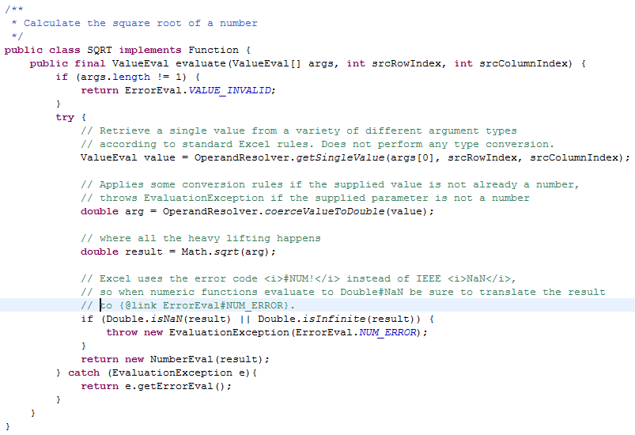
Walkthrough of an "evaluate()" implementation.

Slide 19
Floating-point Arithmetic in Excel
Excel uses the IEEE Standard for Double Precision Floating Point numbers
Cases Where Excel Does Not Adhere to IEEE 754:
Positive/Negative Infinities: Infinities occur when you divide by 0. Excel does not support infinities, rather, it gives a #DIV/0! error in these cases.
Not-a-Number (NaN): NaN is used to represent invalid operations (such as infinity/infinity, infinity-infinity, or the square root of -1). NaNs allow a program to continue past an invalid operation. Excel instead immediately generates an error such as #NUM! or #DIV/0!.
This can be an issue when saving results of your scientific calculations in Excel:
“where are my Infinities and NaNs? They are gone!”

Slide 20
User Defined Functions (UDF)
User-defined functions (UDFs) are custom functions that extend the calculation and data-import capabilities of Excel.
Use cases:
Functions that are not built into Excel, e.g. custom mathematical functions
Custom implementations to built-in functions
Custom data feeds for legacy or unsupported data sources, and application-specific data flows, e.g. calling web services.

Slide 21
User Defined Functions (UDF)
Users can call UDFs from a cell through formulas—for example, "=MyUdf(A1*3.42)"—just like they call built-in functions.
UDFs can be created in two ways:
Using built-in VBA
Compiled into *.dll as Excel add-on
The above means that the source code is not always available

Slide 22
UDF and POI
All UDFs implement the interface
org.apache.poi.hssf.record.formula.functions.FreeRefFunction
org.apache.poi.hssf.record.formula.udf.UDFFinder is a registry of UDFs

Slide 23
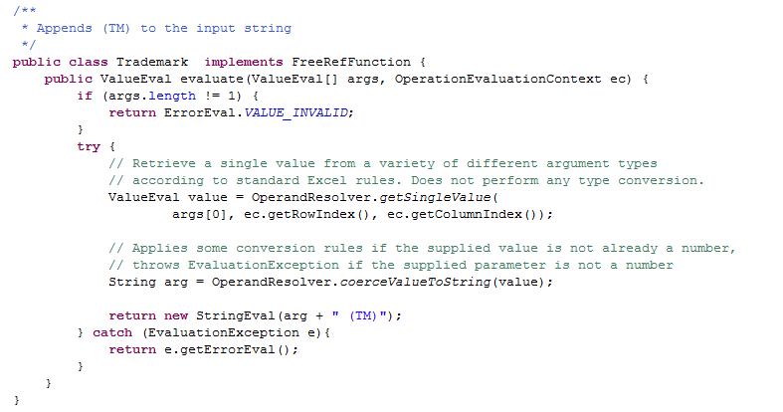
Implementing a UDF
VBA code:

Slide 24
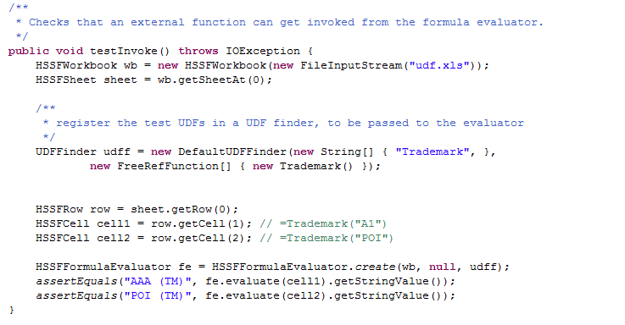
Implementing a UDF (continued)

Slide 25
Modeling Excel Semantics (be careful when mixing types)
If you have formula "=TRUE+1", it evaluates to 2. So also, when you use TRUE like this: "=SUM(1,TRUE)", you see the result is: 2.
So TRUE means 1 when doing numeric calculations, right? Wrong!
Because when you use TRUE in referenced cells with arithmetic functions, it evaluates to blank - meaning it is not evaluated - as if it was string or a blank cell, eg. "=SUM(1,A1)" when A1 is TRUE evaluates to 1.
This behavior changes depending on which function you are using. eg. SQRT(..) that was described earlier treats a TRUE as 1 in all cases.

Slide 26
org.apache.poi.hssf.record.formula.eval.OperandResolver wraps most of the logic for you
Retrieves a single value from a variety of different argument types according to standard Excel rules.
Can convert arguments to Java primitives (int, double, String, boolean)
Converts a string to a double using standard rules that Excel would use

Slide 27
Not supported yet
Some functions (mostly statistical and financial). Commons-Math is a possible donor.
Evaluation across multiple workbooks – only simple cases are supported
Some region operators (union)
Evaluation of array formulas (In Excel, formulas that look like "{=...}" as opposed to "=...")

Slide 28
Questions?
http://poi.apache.org/
http://people.apache.org/~yegor

